Slide 1

WWII: Utah Women on the Home Front
From Relief to Resistance

Slide 2
Utah Women in the Workforce
WWII pulled thousands of Utah men into military service. Utah faced labor shortages in factories, transportation, military sites, and essential services.
By 1944, women made up nearly 37% of Utah’s paid workforce, up from about 18% in 1940. This was one of the largest wartime increases in the nation.

Slide 3
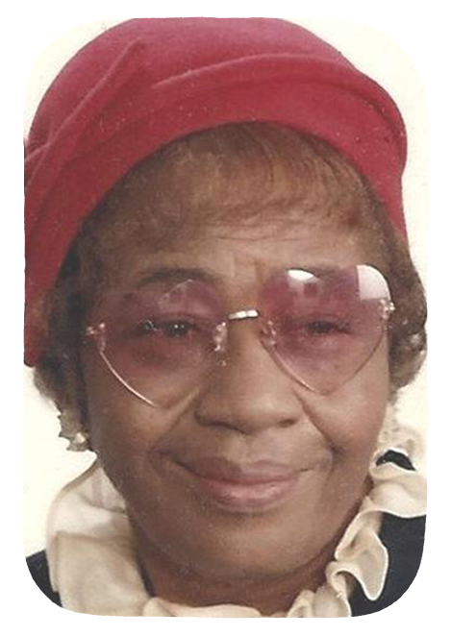
Ruby Timms Price
Ruby’s brother was in the military and went missing while fighting during WWII. She wanted to become a fighter pilot to help find him, so she traveled to Hill AFB, took an exam, and joined an aeronautics class.
As a woman, especially a woman of color, she was unable to become a fighter pilot.
But Ruby worked at Hill Air Field as an embarkation specialist, director of the Gargoyle Dramatic Club, on the cafeteria committee, and organizing social events.

Slide 4
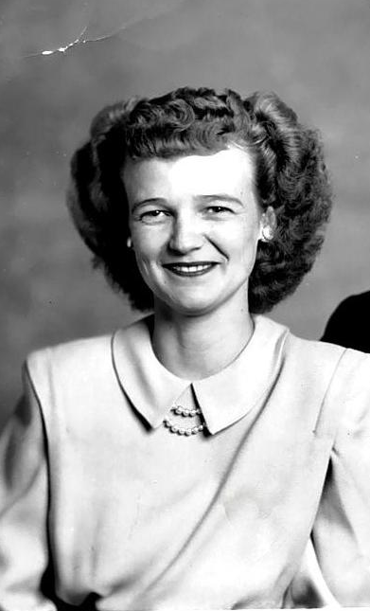
Zola Anderson Ruesch
Zola worked in the Manti Parachute Factory, sewed parachutes for the Army, Navy, and Marines.
Zola and her co-workers would often fold in encouraging notes into the parachutes.
The factory’s owner and manager, Colonel Fauntleroy, claimed, “There are no better national defense workers anywhere in the country today.”

Slide 5
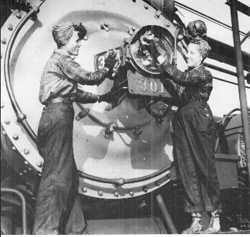
Utah Rosies
Women were employed at all of the Utah military facilities and in private industries with military contracts.
They drove trucks at the Kearns Defense Depot, repaired damaged aircraft at Hill Air Force Base, and worked on trains at the Denver & Rio Grande Western rail yards, etc.
Women juggled these work responsibilities with caring for home and family, especially if their husbands and fathers were away in the military.

Slide 6
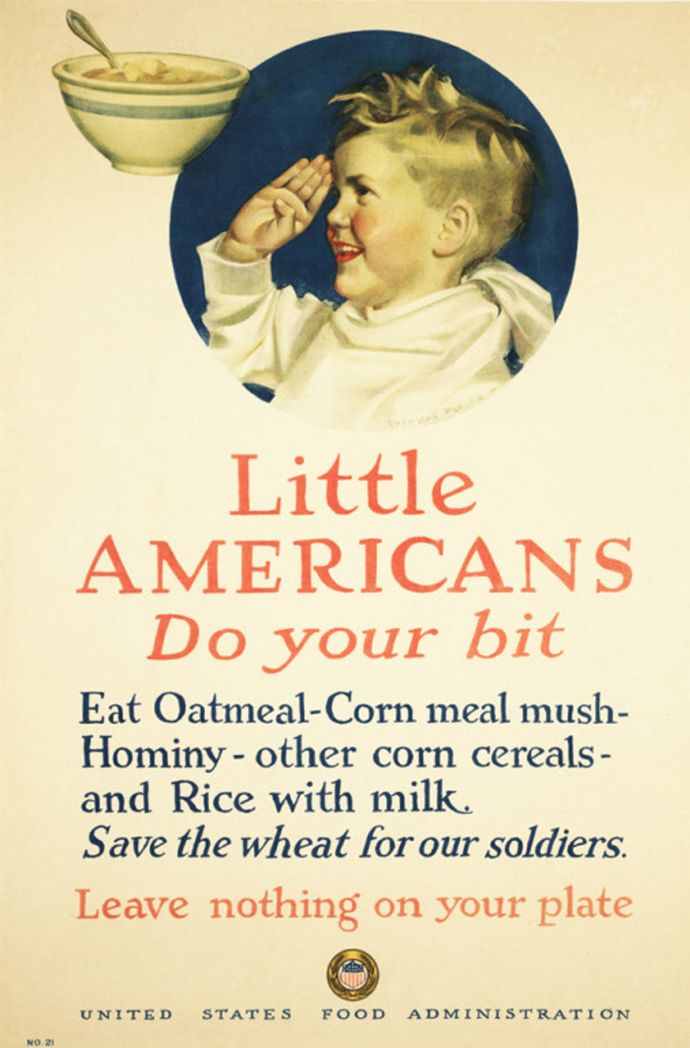
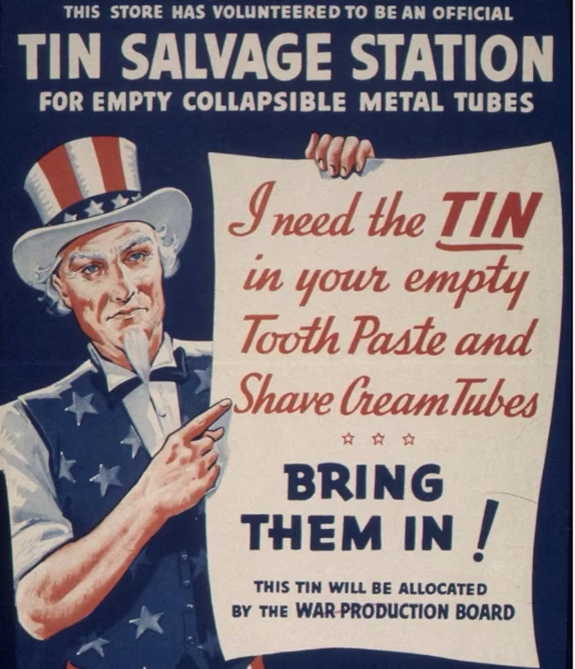
Utah Women on the Home Front
Not all women joined the industrial workforce, but many still supported the war effort through community-based organizations such as the Church of Jesus Christ of Latter-Day Saints Relief Society, the Minute Women of America, and the American Red Cross.

Slide 7
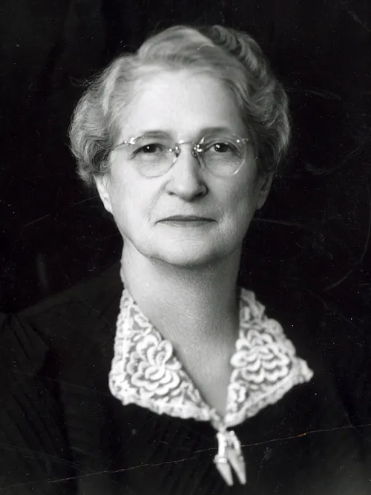
Amy Brown Lyman and the Relief Society
Amy became President of the LDS Relief Society organization for women in 1940.
She organized women to help individuals and families during the war.
Relief Society women sewed bandages for the Red Cross, assembled first aid kids, donated blood, and purchased war bonds.
The Relief Society also sent clothing, soap, safety pins, and other items to war-torn Europe.

Slide 8
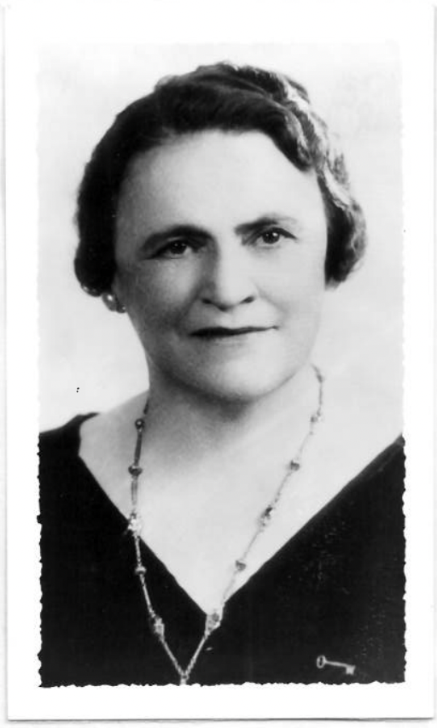
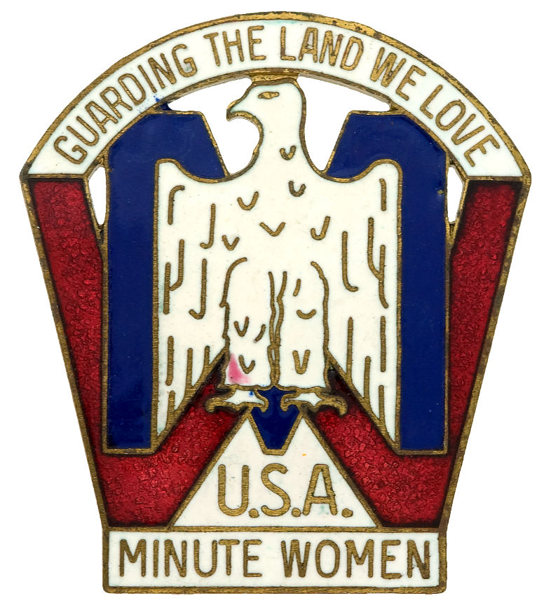
Bertha Stevenson and the Minute Women
The Minute Women were a salvage organization collecting materials needed for the war effort.
Bertha led the Salt Lake chapter, organizing drives for paper, silk, and nylon, and collecting millions of pounds of household fats, tin cans, rubber, and scrap metal.
Bertha oversaw 1,778 Minute Women and 2,000 Paper Troopers (children who collected waste paper).
The Salt Lake chapter was one of the most successful Minute Women organizations in the country.

Slide 9
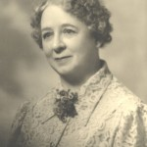
Maude Dee Porter and the Ogden Red Cross Canteen
Maude organized the Ogden Red Cross Canteen in 1942 at the Ogden Train Depot.
Many troop trains would pass through town and the canteen fed the soldiers passing through.
The Ogden Canteen served 1.6 million soldiers, providing food and a little piece of home to soldiers on their way to new assignments.
“[service] is one way of paying [your] rent in the world.”

Slide 10
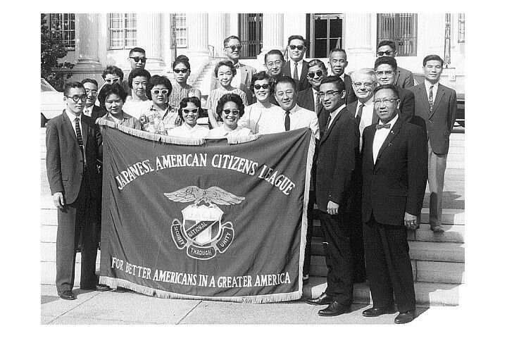
Utah Women as Advocates
Utah women worked in factories and volunteered during WWII. They also took on the role of advocates. They raised their voices for justice, peace, and the protection of civil rights during the war.

Slide 11
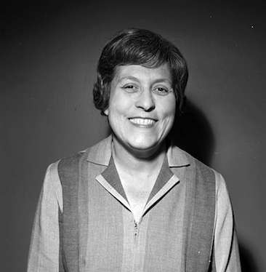
Esther Landa and Jewish Advocacy
“The time for equity and justice is now.”
Esther devoted her life to Jewish causes, especially after the atrocities of the Holocaust became well known.
She worked with Hadassah (Jewish women’s philanthropic organization), and the United Jewish Appeal.
She was president of the National Council of Jewish Women for a time.
She formed Esther’s Circle that is still active in Utah today (a political and service-oriented organization).

Slide 12
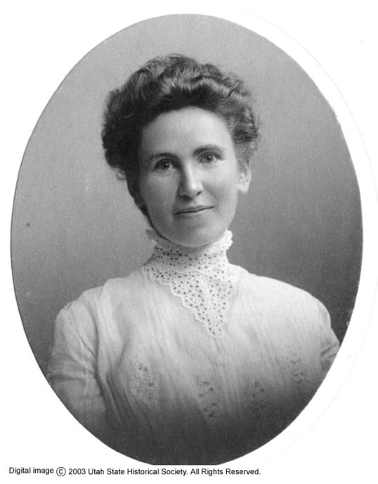
Elise Furer Musser, an Advocate for Peace
Elise emigrated to the US from Switzerland at 19.
She served as a State Senator, Utah State Chairman of Democratic Women, and an interpreter and teacher at Neighborhood House, which served immigrant families.
President Roosevelt made her a delegate to peace conferences in the 1930s in the effort to avoid war.
During WWII, she served as President of the British War Relief Society of Utah and led relief efforts for Russia, Belgium, and Greece.

Slide 13
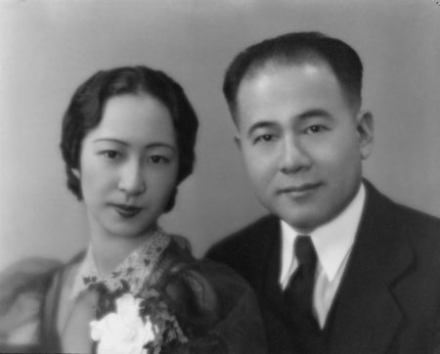
Alice Kasai, Advocate for Japanese American Citizenship
Alice’s husband was placed in an incarceration camp for two-and-a-half years after Pearl Harbor.
During this time, she advocated for the Japanese community in Utah. Her home was the headquarters for the Japanese American Citizens League in SLC.
After the war, Alice and her husband lobbied for citizenship and other civil rights for Japanese immigrants.
They helped establish the International Peace Garden in Salt Lake City.

Slide 14
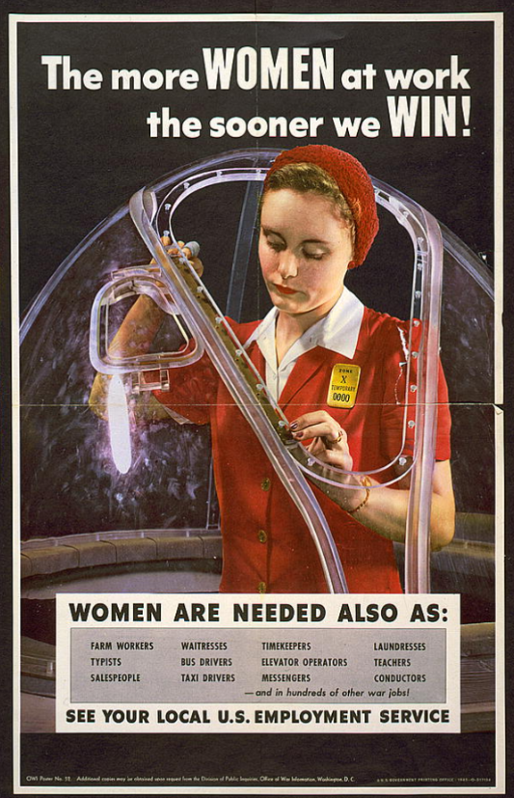
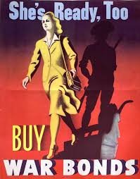
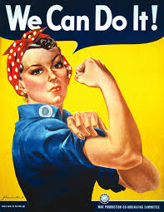
WWII “Rosie” Posters
What messages did these posters send?

Slide 15
Redesign the Narrative: Creating WWII “Rosie” Posters
Create your own WWII-style poster, but with a Utah twist.
Include Utah women and the work they contributed to WWII.
Include: A bold slogan, powerful imagery, and Utah-specific references.
What story are you telling? Why was this work important during the war? Why is it still important today?

