Slide 1

WWII: Women in the Military
Breaking Barriers and Serving with Honor

Slide 2
Four Key Military Groups Women Served In:
WASPs (Women Airforce Service Pilots): Also known as “Fly Girls”, they flew planes for non-combat missions which freed up more male pilots to go to war.
WACs (Women’s Army Corps): Women held jobs such as clerks mechanics, and driver for the army.
WAVES (Women Accepted for Volunteer Emergency Service): An auxiliary of the Navy, they worked as lab technicians, radio operators, codebreakers, shooting instructors, and more.
Army Nurse Corps: Trained nurses who cared for wounded soldiers, sometimes near the battlefields.

Slide 3
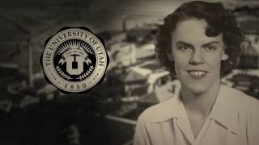

WASPs
Fifinella was the mascot for the WASPs. She was created by Disney and used in recruitment videos.

Slide 4
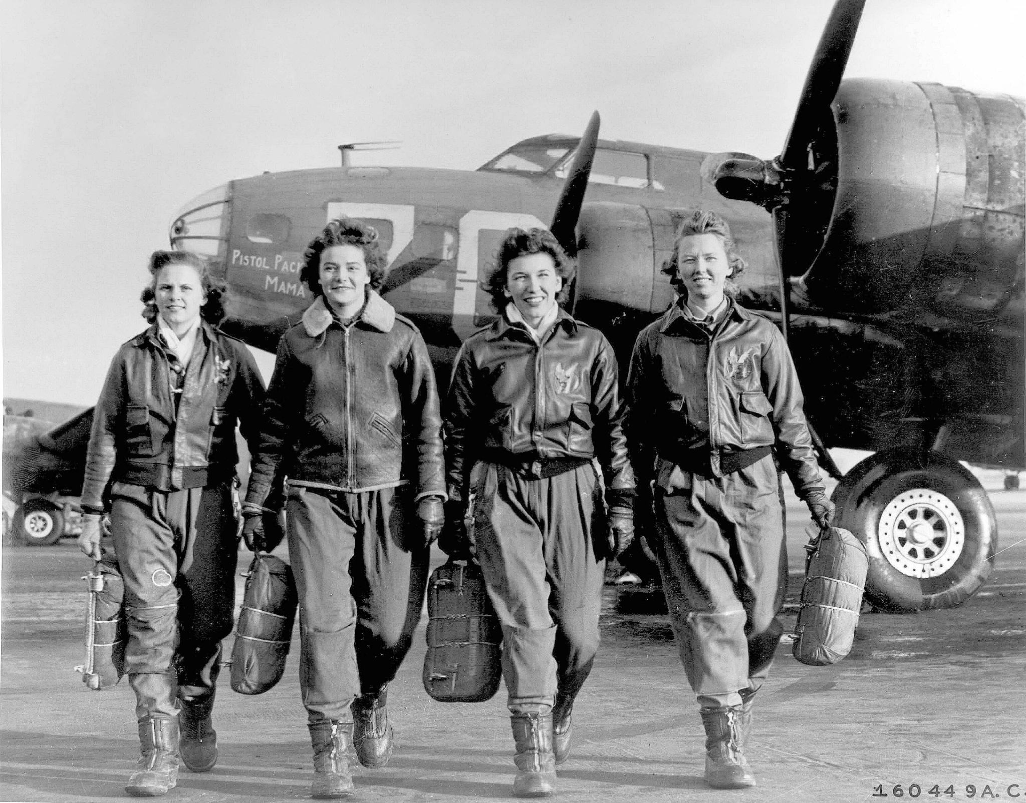
WASPs
Piloted every type of mission flown by their male Army Air Force counterparts except combat.
During World War II, women pilots flew 80% of all ferrying missions. They delivered over 12,000 aircraft. WASP pilots freed around 900 male pilots for combat duty.
They knew Morse code, meteorology, military law, physics, aircraft mechanics and navigation.
They were U.S. federal civil service employees and had no military standing or benefits and were not originally recognized as veterans. Each WASP member paid for her own transportation costs to training sites, for her dress uniforms, and for room and board.They were not granted veteran status until 1977.

Slide 5
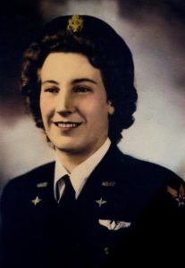
Utah WASPs: Marjorie Redding Christiansen
Marjorie flew non-flying officers on administrative duty and flew cross-country many times.
One time before takeoff, she noticed that the steering cables on her plane were put on backward. The mechanics didn’t believe her but they checked and found that she was right.
After the war she settled in Enoch with her husband and had 6 children. Marjorie died in 2008, only a few years before President Obama awarded WASP members with the Congressional Gold Medal.
More information on Marjorie found HERE

Slide 6
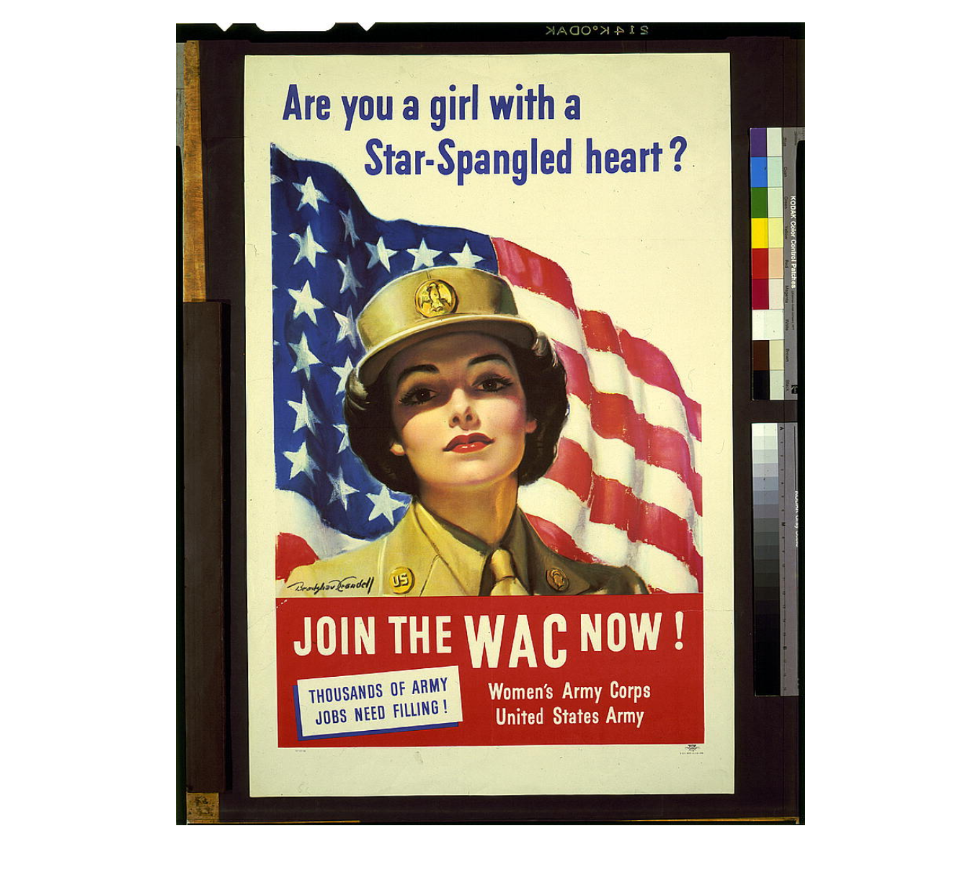
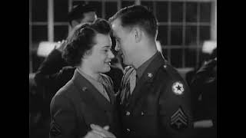
WACs
WAC Recruitment Video (8:52)

Slide 7
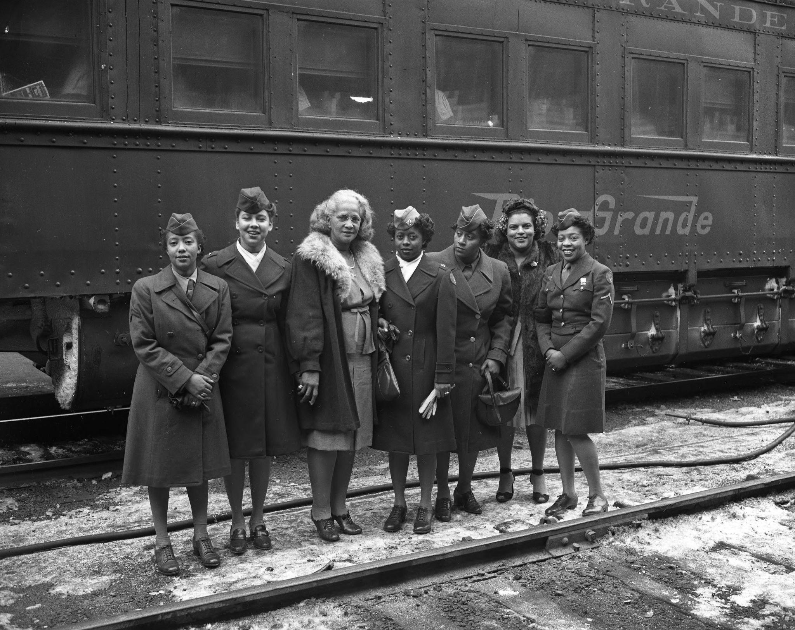
WACs
Women in the WACs received full military benefits like their male counterparts.
General Douglas MacArthur called them “My best soldiers” because they worked harder, complained less, and had more discipline than many of the men.
Despite facing resistance and discrimination, more than 150,000 women served in the Women’s Army Corps. They paved the way for women’s permanent inclusion in the US military.

Slide 8
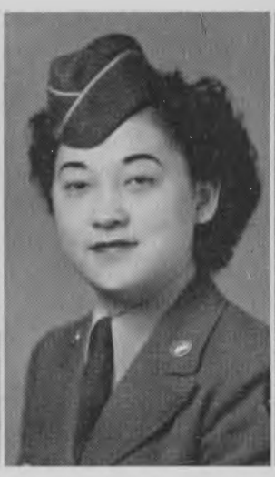
Utah WACs: Priscilla Yasuda
Priscilla’s parents immigrated to the United States from Japan. She was born in the United States.
At the time Priscilla was serving in the WACs, the government was forcing people of Japanese descent into incarceration camps. One of those camps was in Utah (Topaz).
Priscilla wrote about her experience HERE, on page 6.

Slide 9
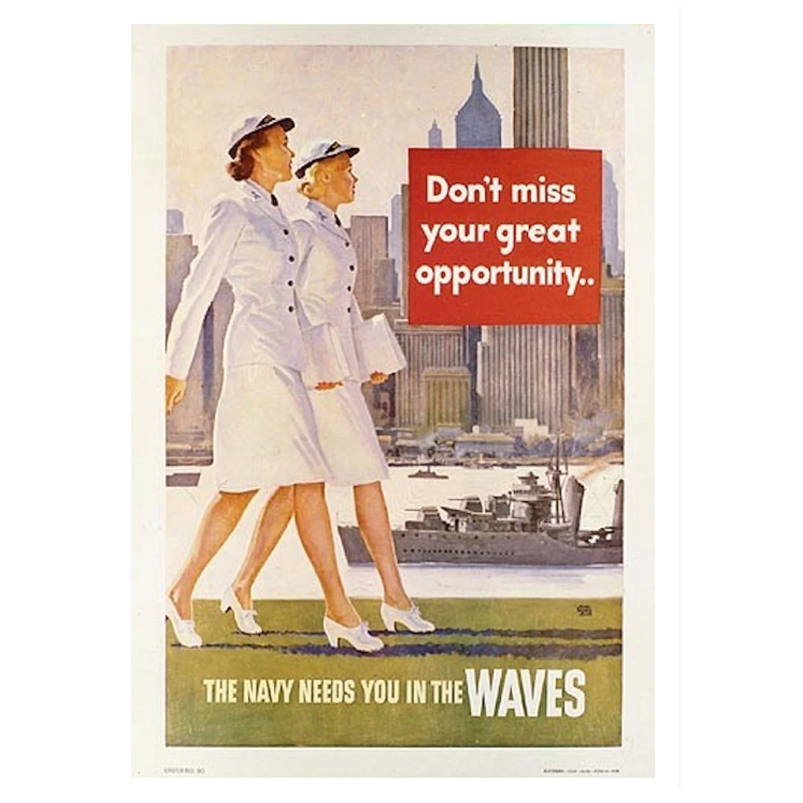
WAVES
The US Navy established the Women Accepted for Volunteer Emergency Service (WAVES) on July 30, 1942. They were not an auxiliary unit but an official part of the Navy with full military status, pay, and benefits equal to their male counterparts. They were restricted to non combat roles. They took on administrative, communications, and aviation support roles.
Many women mentioned that they chose the WAVES over other military opportunities because their uniforms were designed by a famous New York fashion house at the time (Mainbocher).

Slide 10
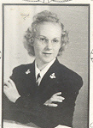
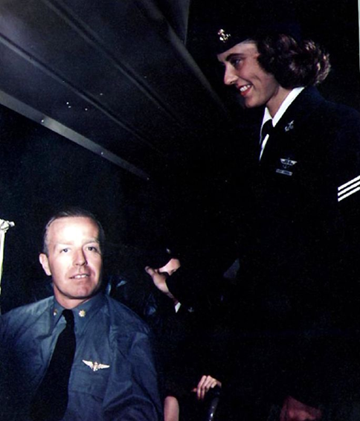
Utah WAVES: Kathryn Klaveano & Eula Kimber
Kathryn told her recruiters, “I will go AWOL before I’ll be a secretary.” She worked on military flights to transport wounded soldiers, military personnel, and supplies.
Eula Kimber wanted to travel the world and chose the WAVES because she loved their uniforms.

Slide 11
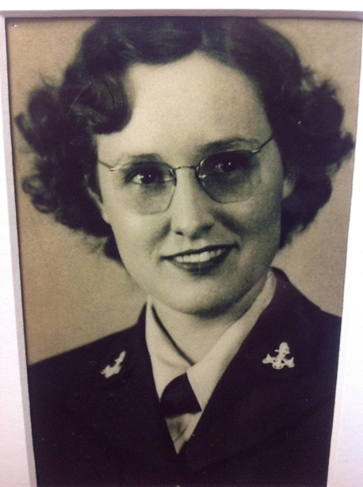
Utah WAVES: Ruth Klein
Ruth had 3 brothers fighting in the war and said, “As long as my brothers were in, I did too.” She grew up pheasant hunting with her dad and brothers. She became a gunnery specialist. She would train men at the skeet-shooting range. She often challenged them to a shooting contest. She would out-shoot the men and they quickly grew to respect her.
She taught soldiers how to determine if an aircraft was American, British, German, or Japanese in less than one second.

Slide 12
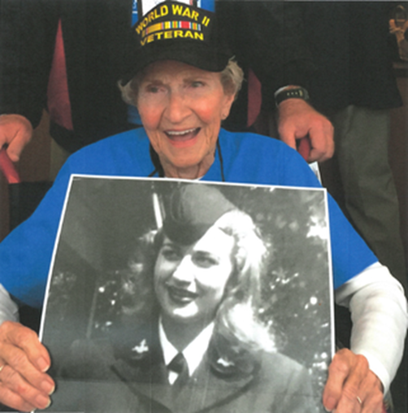
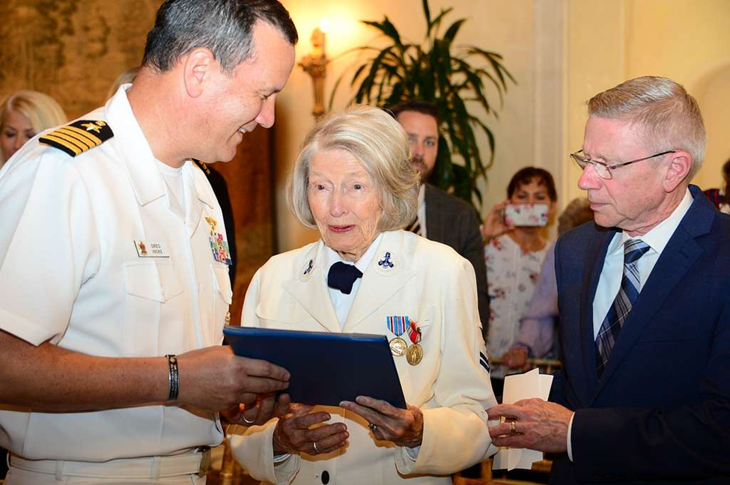
Utah WAVES: Marjorie Campbell & Rosalind Johnson-Henneman
Marjorie had a friend who was shot down and died over England. She joined the WAVES in his honor and to finish out his service.
Rosalind joined the WAVES because one of her brothers was unable to fight in the military. She wanted to join in his place.

Slide 13
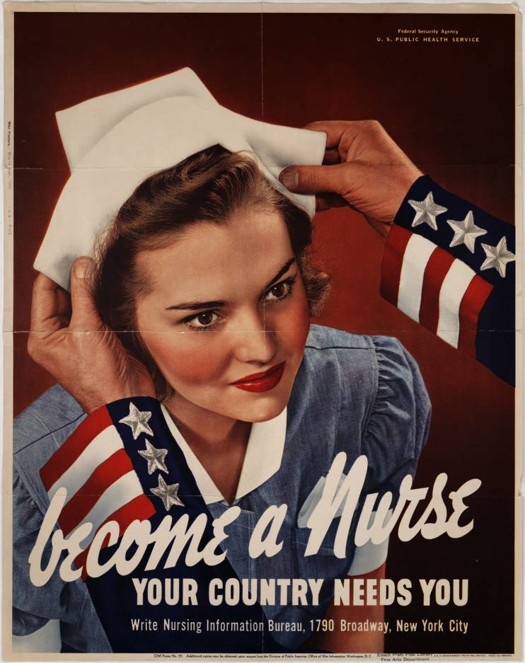
Army Nurse Corps
More than 59,000 women served as commissioned officers in the US Army as nurses. They provided care in field hospitals, evacuation hospitals, hospital trains and ships, and sometimes near the front lines..

Slide 14
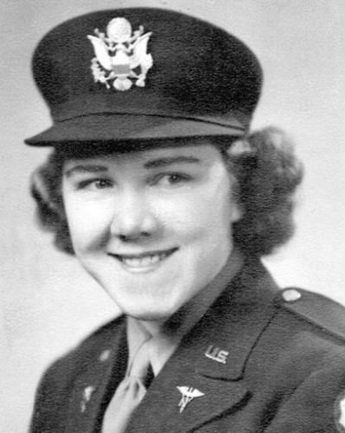
Utah Army Nurse Corps: Ora Mae Hyatt
Ora wanted to become an airline stewardess and one requirement was to be a registered nurse.
She joined the Army after Pearl Harbor.
Ora served on a hospital ship and treated wounded soldiers, including men from the Bataan Death March.
She also served at a field hospital just behind the front lines in Okinawa, where she earned a battle star. “We didn’t dwell on the danger we were in,” she later recalled.
When the war ended, she helped care for wounded soldiers overseas so that they could make the trip back to the United States.

Slide 15
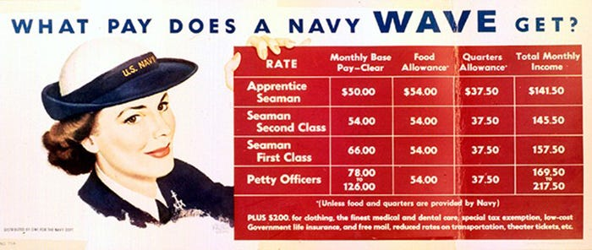
How did military service allow women to step into new roles, challenge gender norms, and create a sense of purpose and identity?

Slide 16
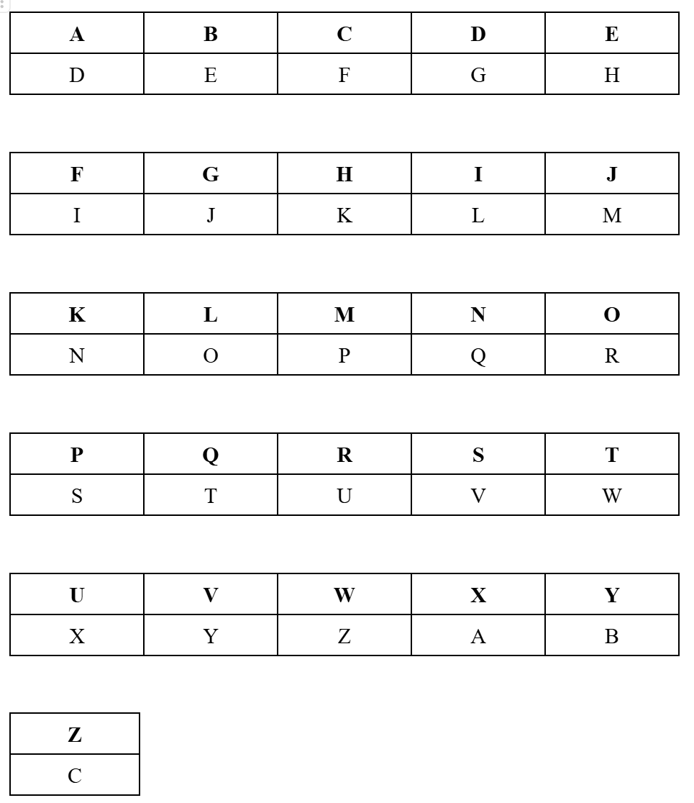
Codebreaking for the War Effort
Objective: You are a woman in the military during WWII. You have come across a coded message that you need to break so that you know where to drop off your load of supplies. Use a Caesar Cipher to break this code.
Gurs lq wkh ilsog qhdu wkh idupkrxvh. Eb wkh eoxh iodj.
Notes:
Answer is: Drop in the field near the farmhouse. By the blue flag.

