Slide 1
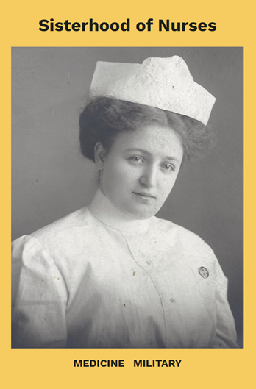
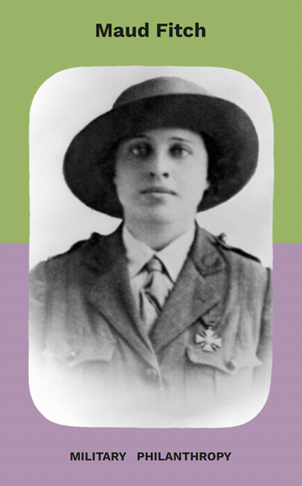
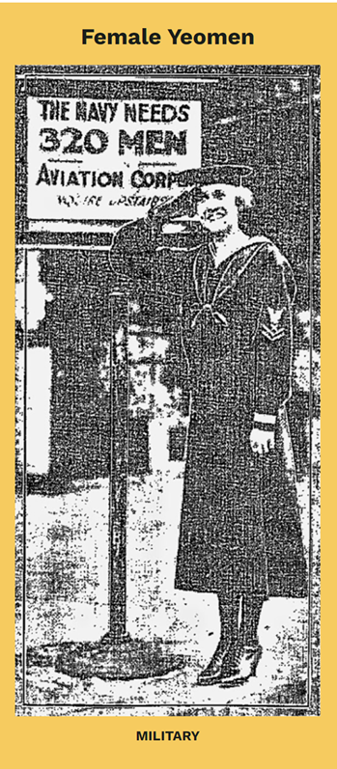
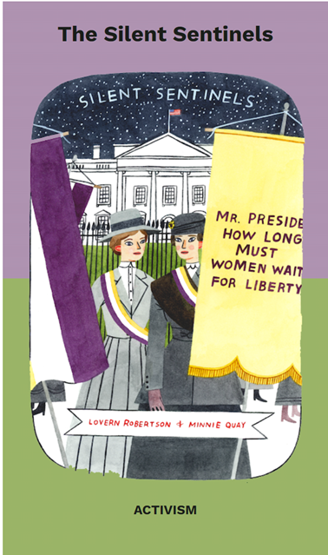

UTAH WOMEN’S roles IN wwi

Slide 2
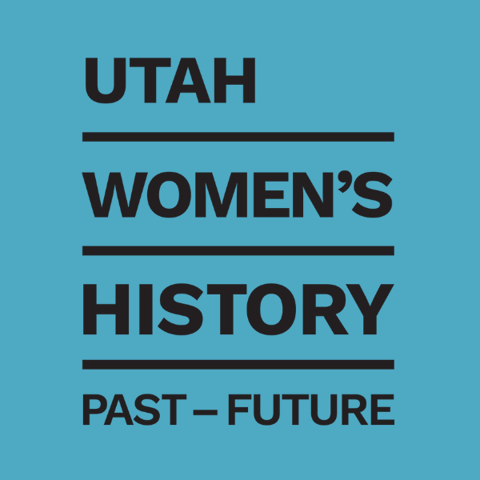
UT Studies State Standard: 3.2. 3.3
Students will use primary sources and/or oral histories to analyze the impact of a national/global event such as World War I, the Spanish flu epidemic, the Great Depression, World War II, and Japanese American internment on an individual or community in Utah. (history)
Students will describe the effects of events, movements, and innovations on Utah's economic development, such as the organized labor movement, farming and industrial improvements, the World Wars, and the Great Depression. (economics)

Slide 3
Learning Objectives:
Understand the broad impact of WWI on the United States, particularly Utah.
Appreciate the diverse roles women played during WWI.
Recognize the changes in society and women's rights that resulted from WWI.
Develop research skills by exploring different women's stories.

Slide 4
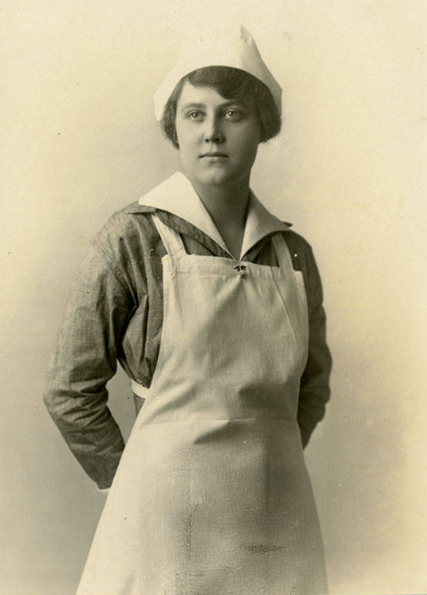
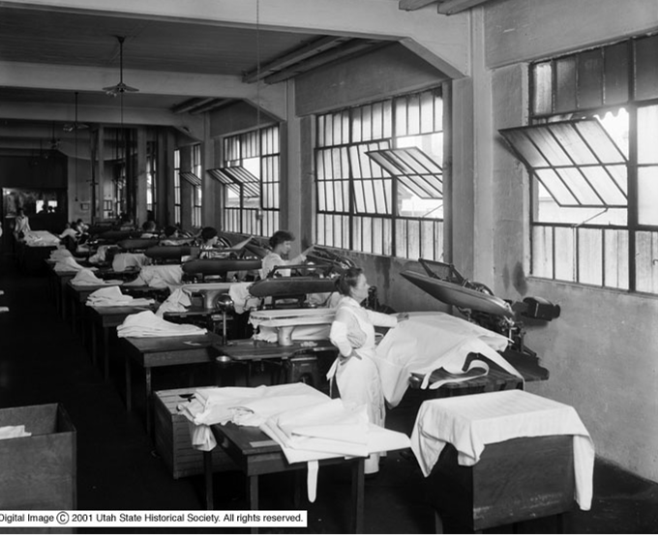
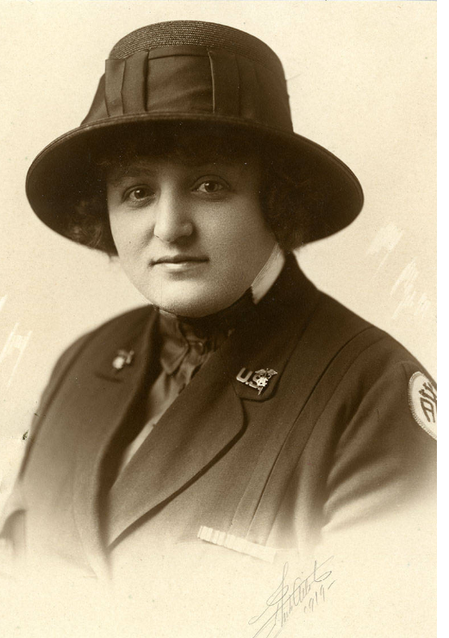
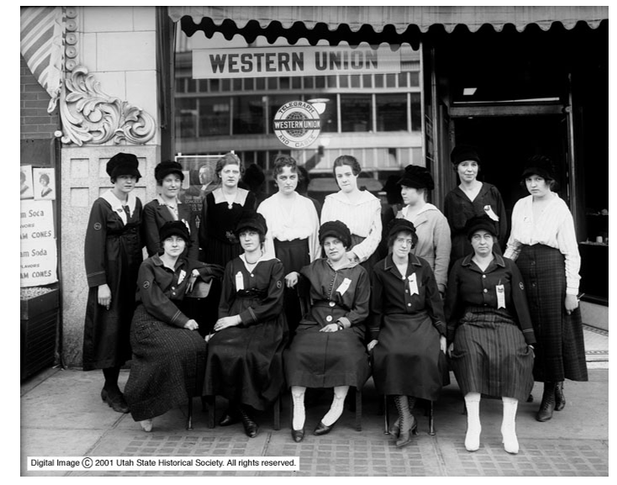
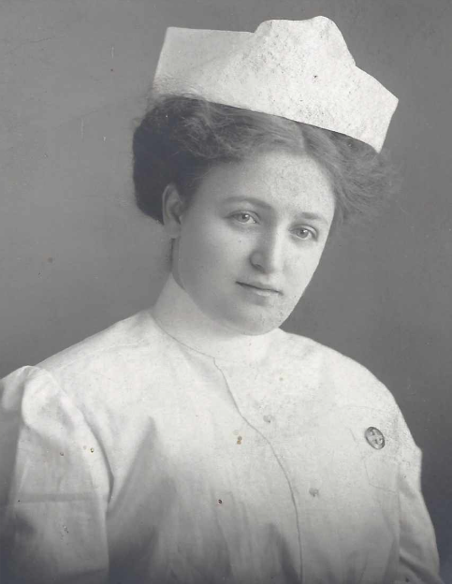
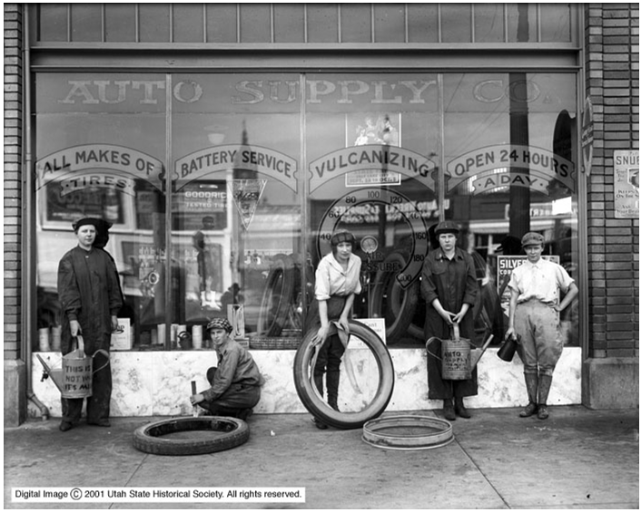
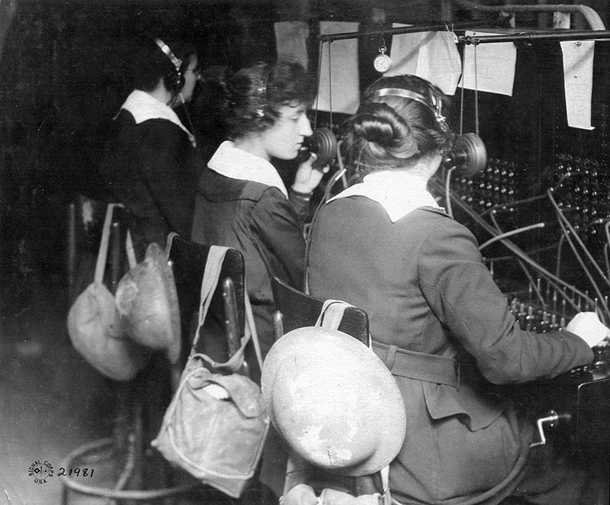
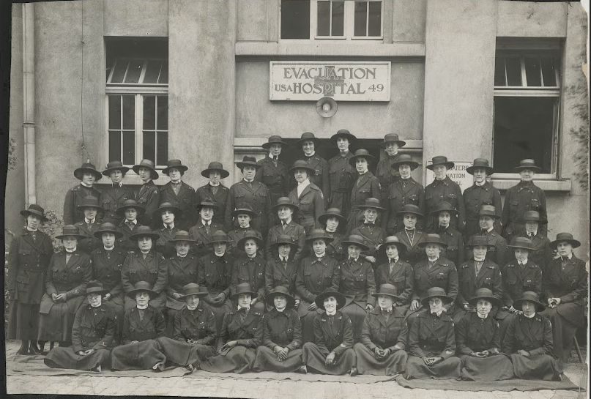

Slide 5

US Involvement in WWI
For a long time, the United States wanted to stay out of the war. This is called being neutral. The United States joined the British and French troops (Allies) in 1917. Over 4 million American men were drafted into service. The fresh American troops and resources provided a much-needed boost to the worn-out Allied forces. Their involvement helped tip the balance towards the Allies, leading to the end of the war in 1918.

Slide 6
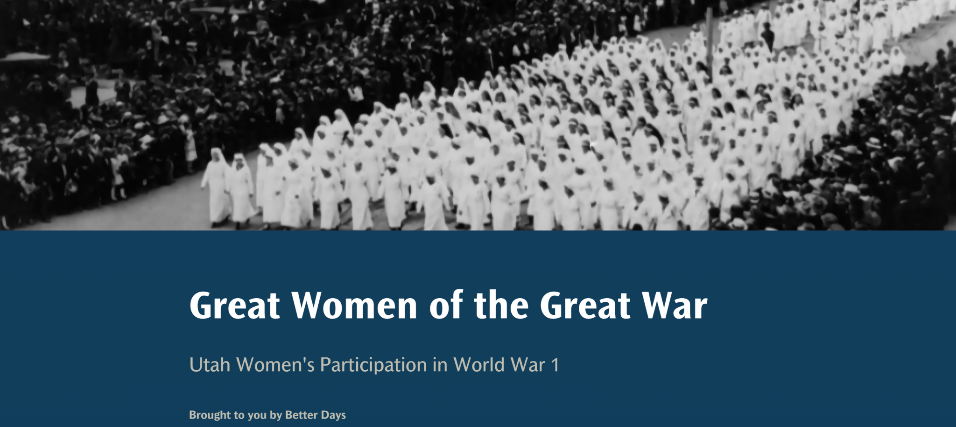
WW1 Virtual Exhibit

Slide 7
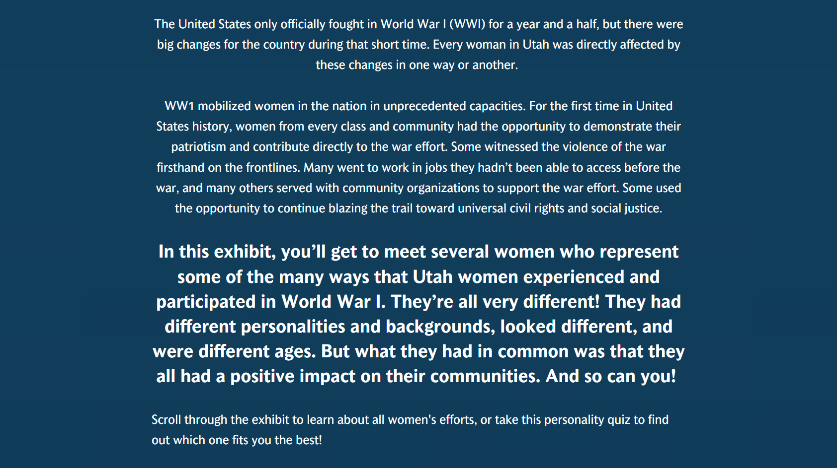

Slide 8
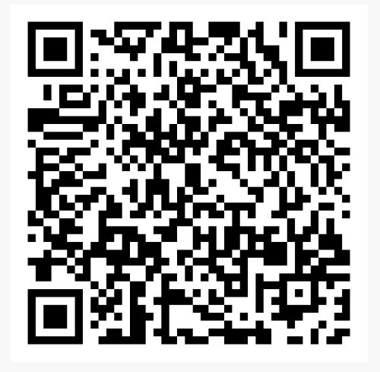
Utah Women in Wartime
Take the WW1 Personality Quiz!

Slide 9
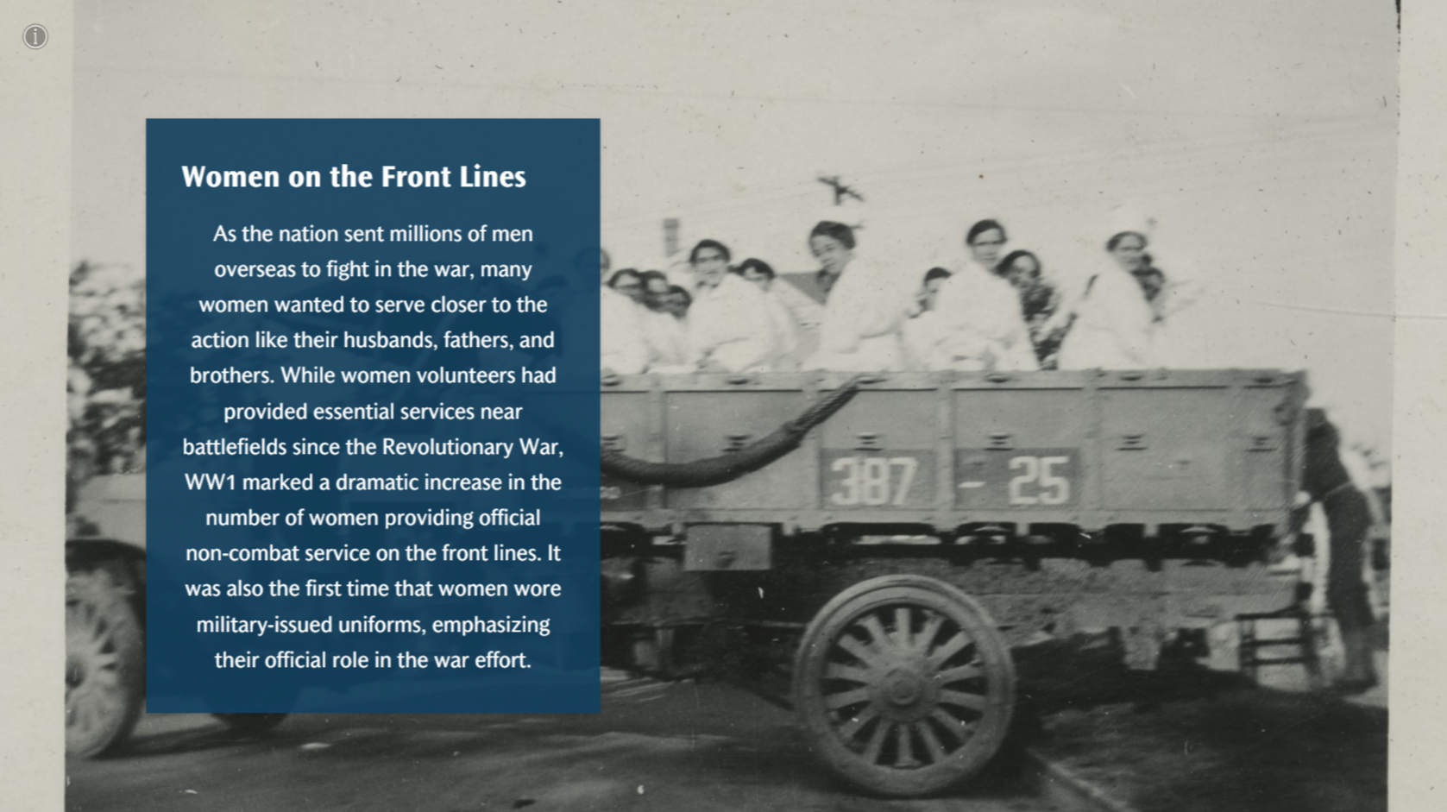

Slide 10
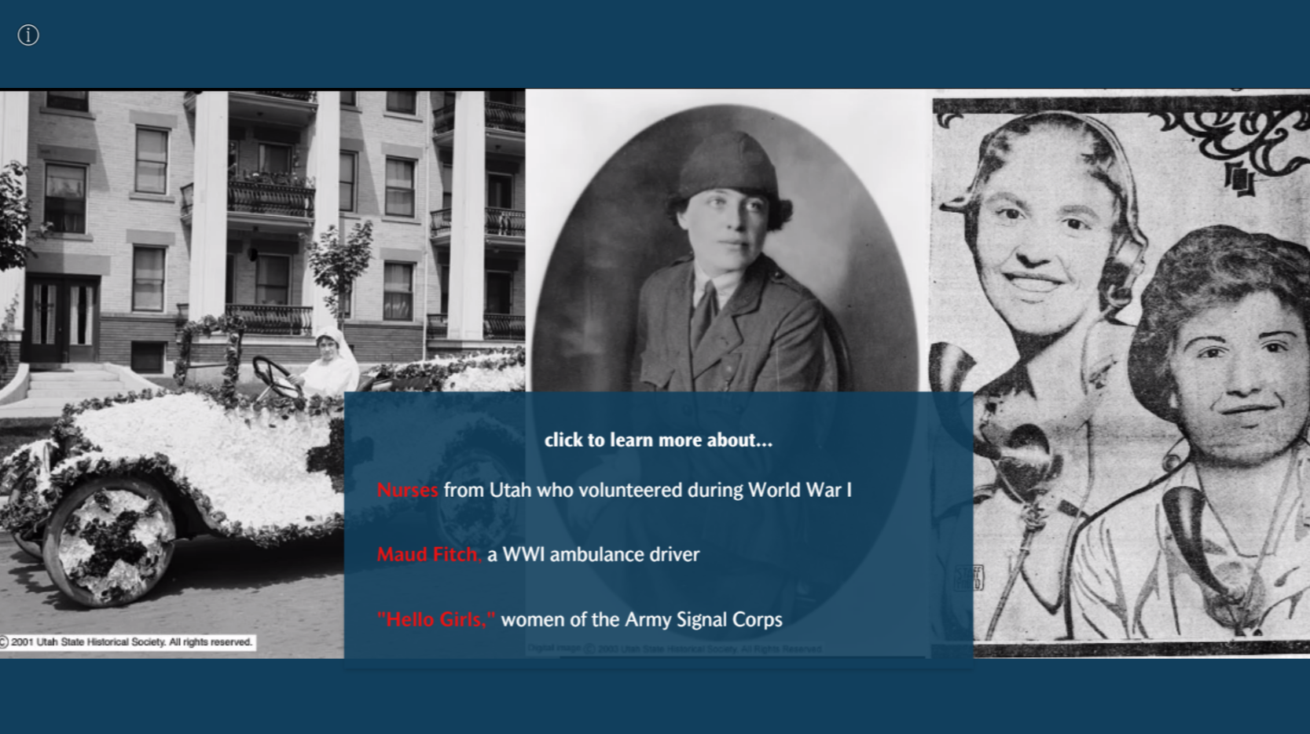

Slide 11
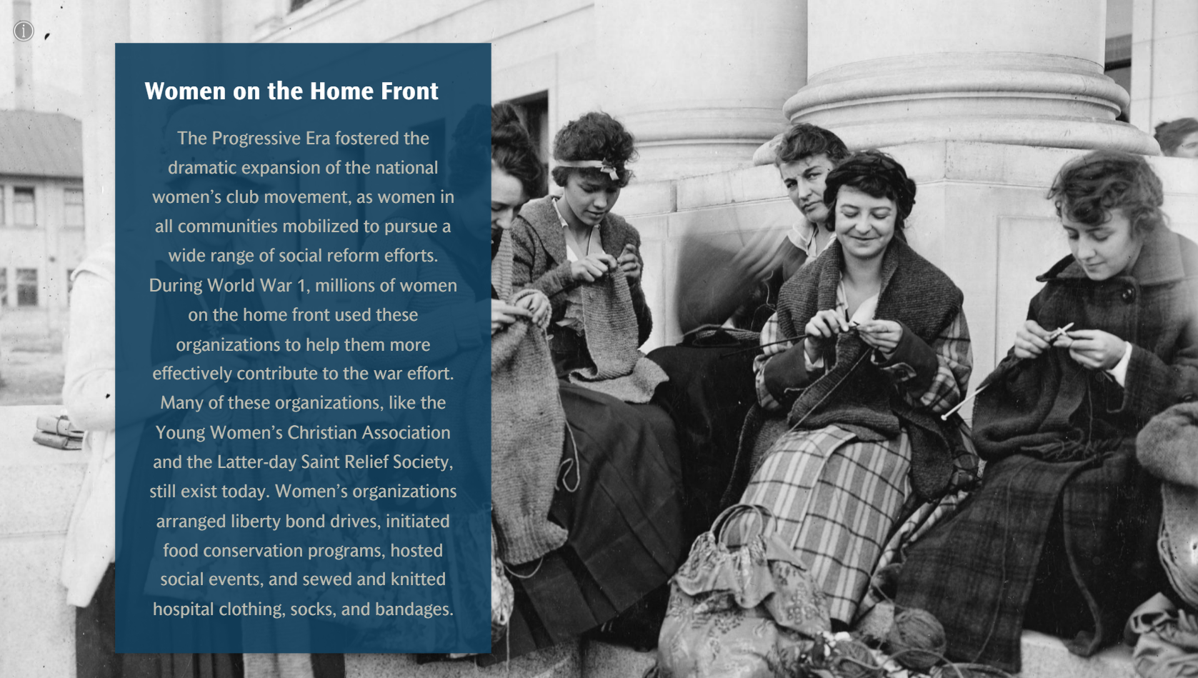

Slide 12
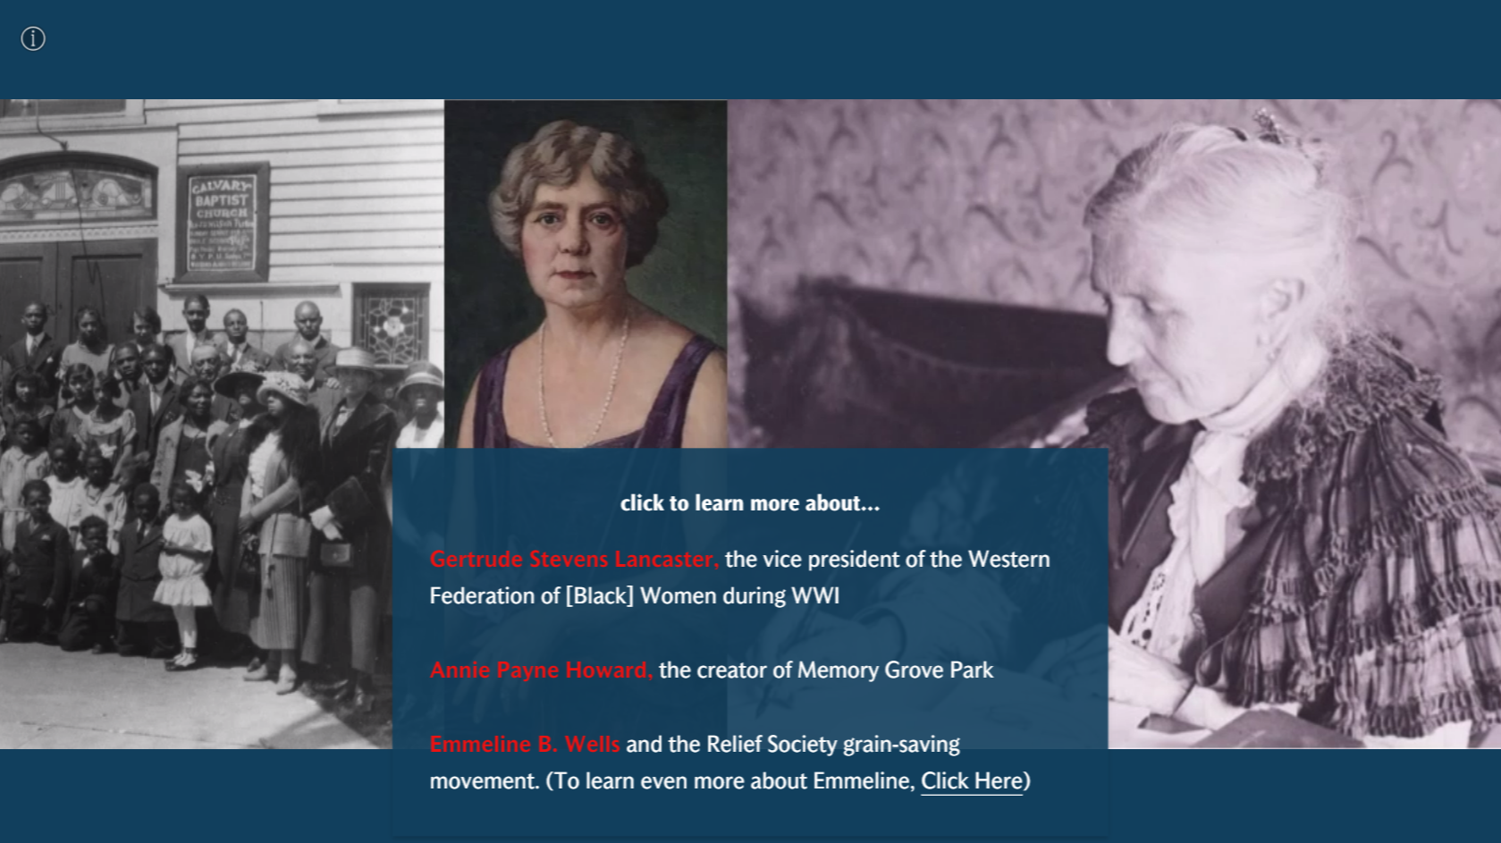

Slide 13
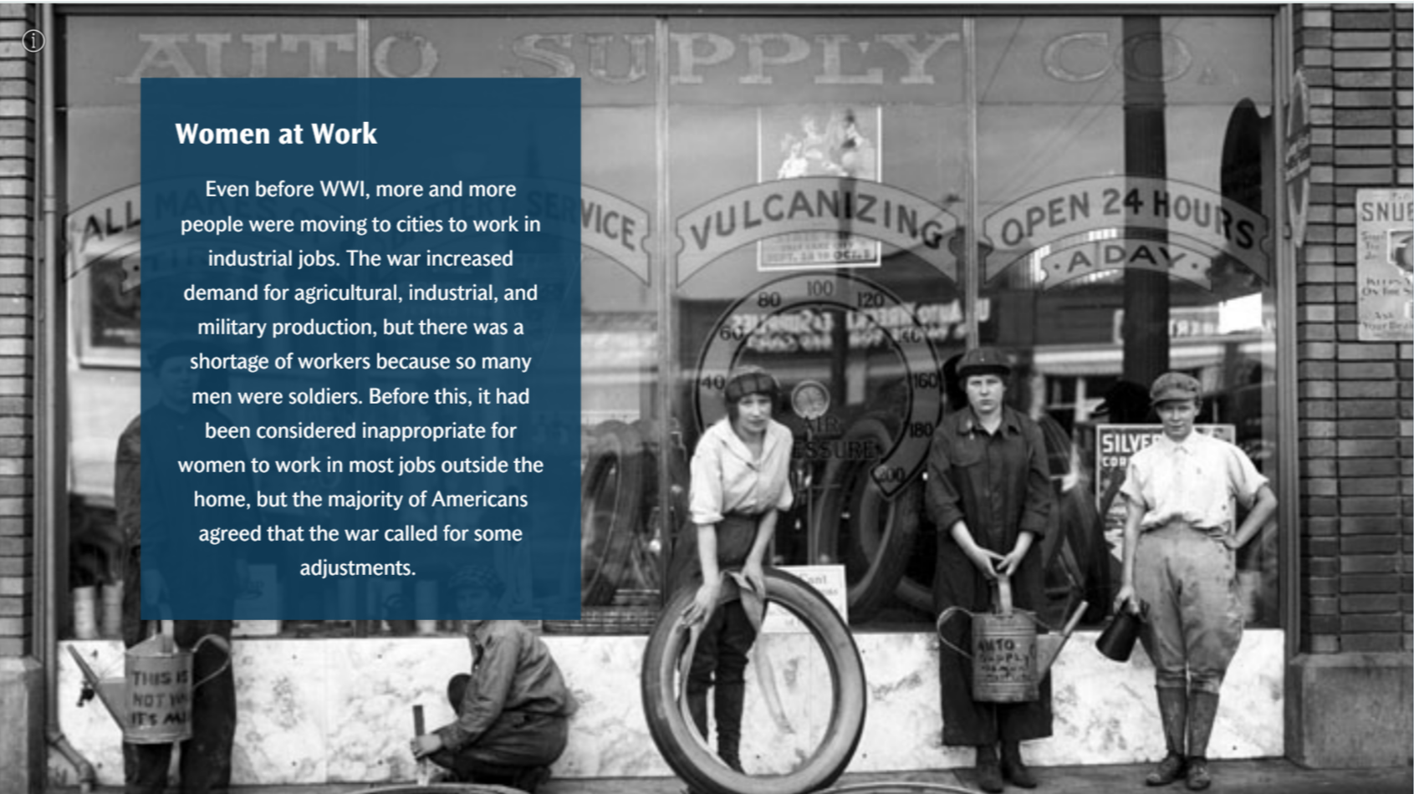

Slide 14
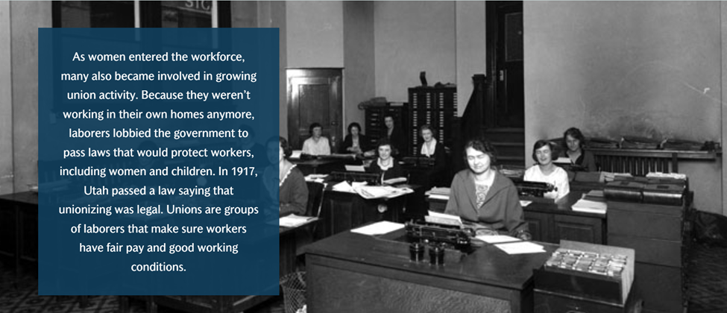

Slide 15
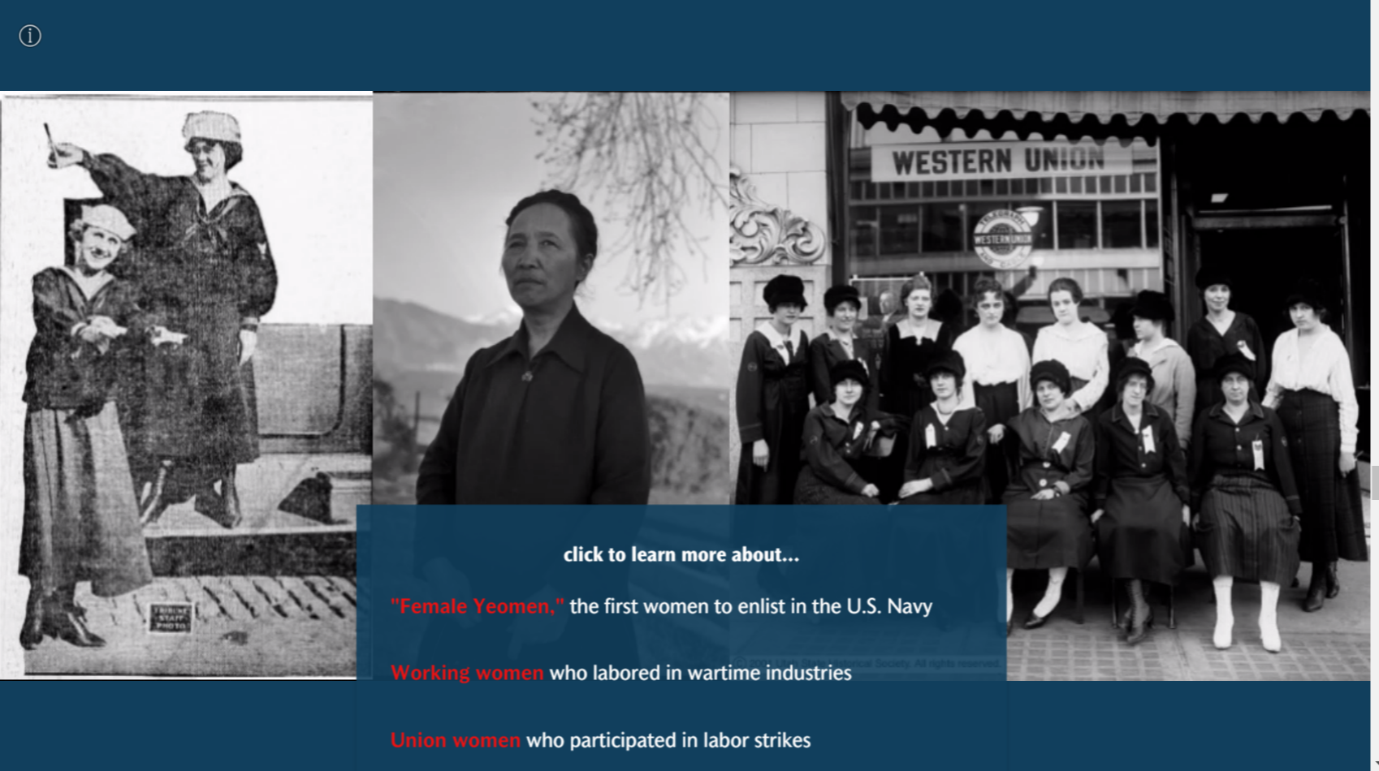

Slide 16
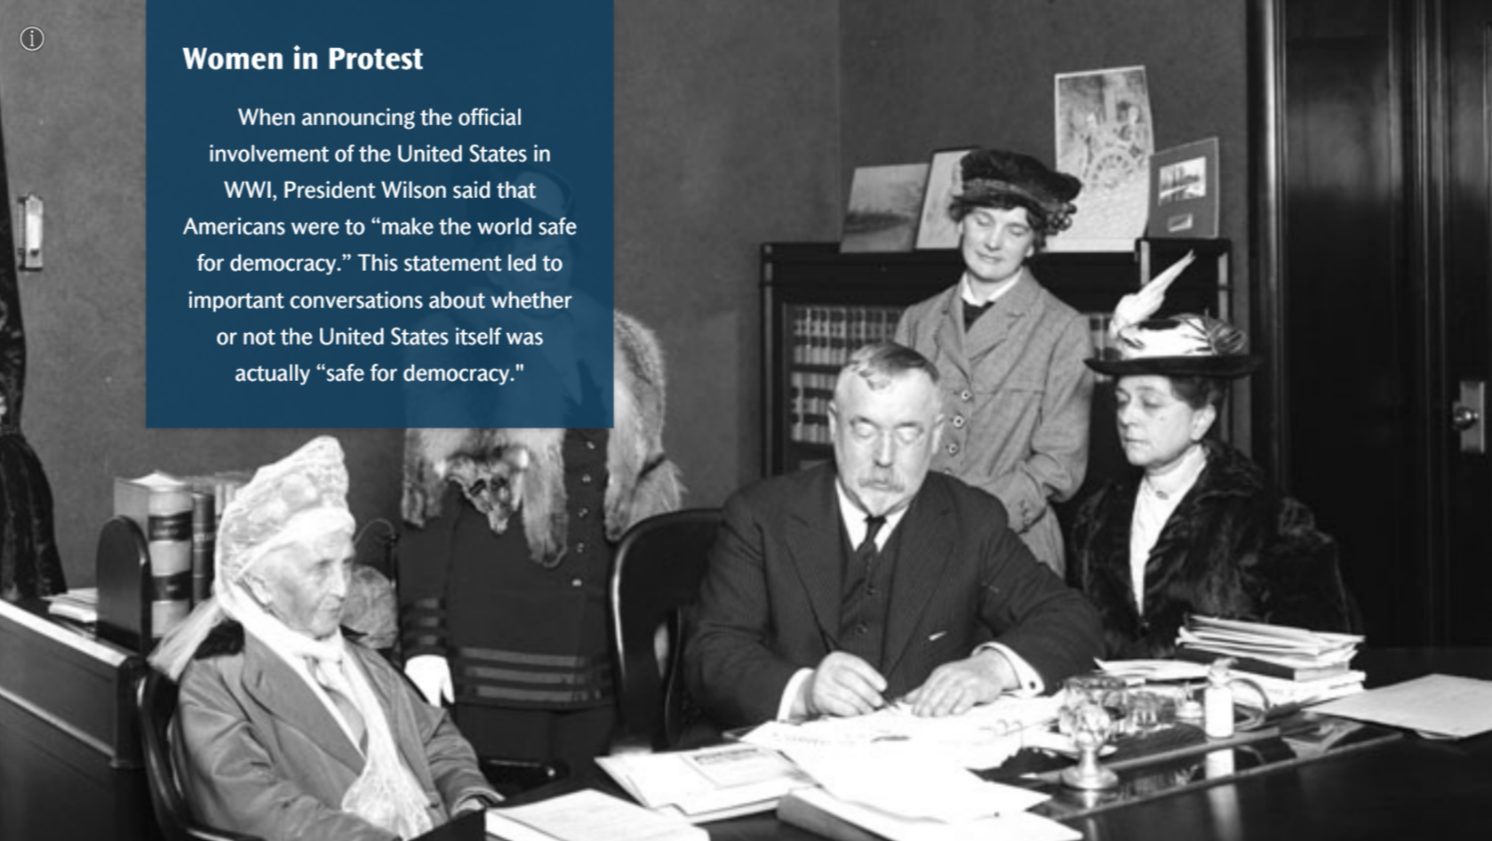

Slide 17
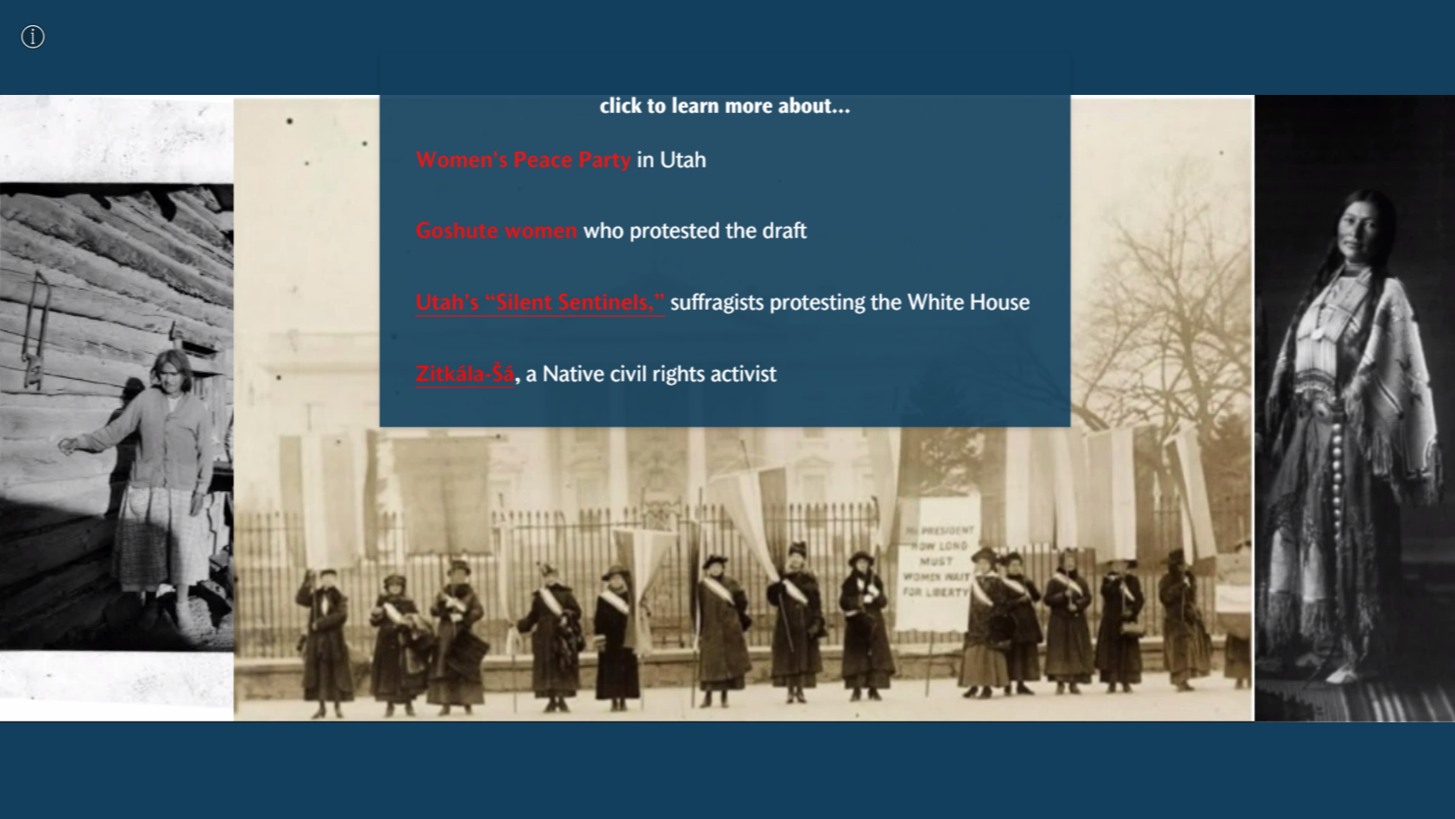

Slide 18
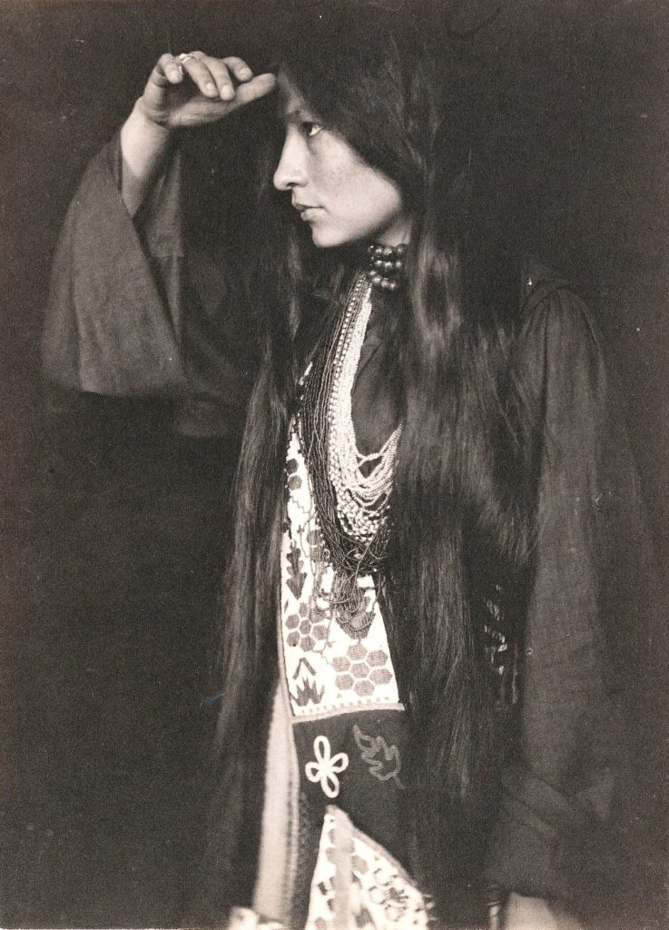
Zitkála-Šá
Advocate for Native American civil rights and citizenship
Lived in Utah for 14 years
Composed an opera with BYU professor about Native American culture
Helped secure Indian Citizenship Act of 1924
Founded and served as president of National Council for American Indians
Will be featured on upcoming quarter

Slide 19
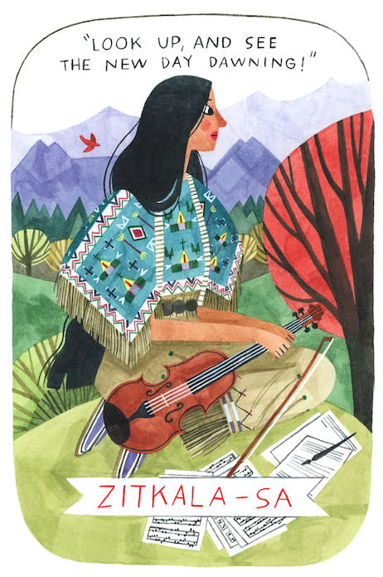
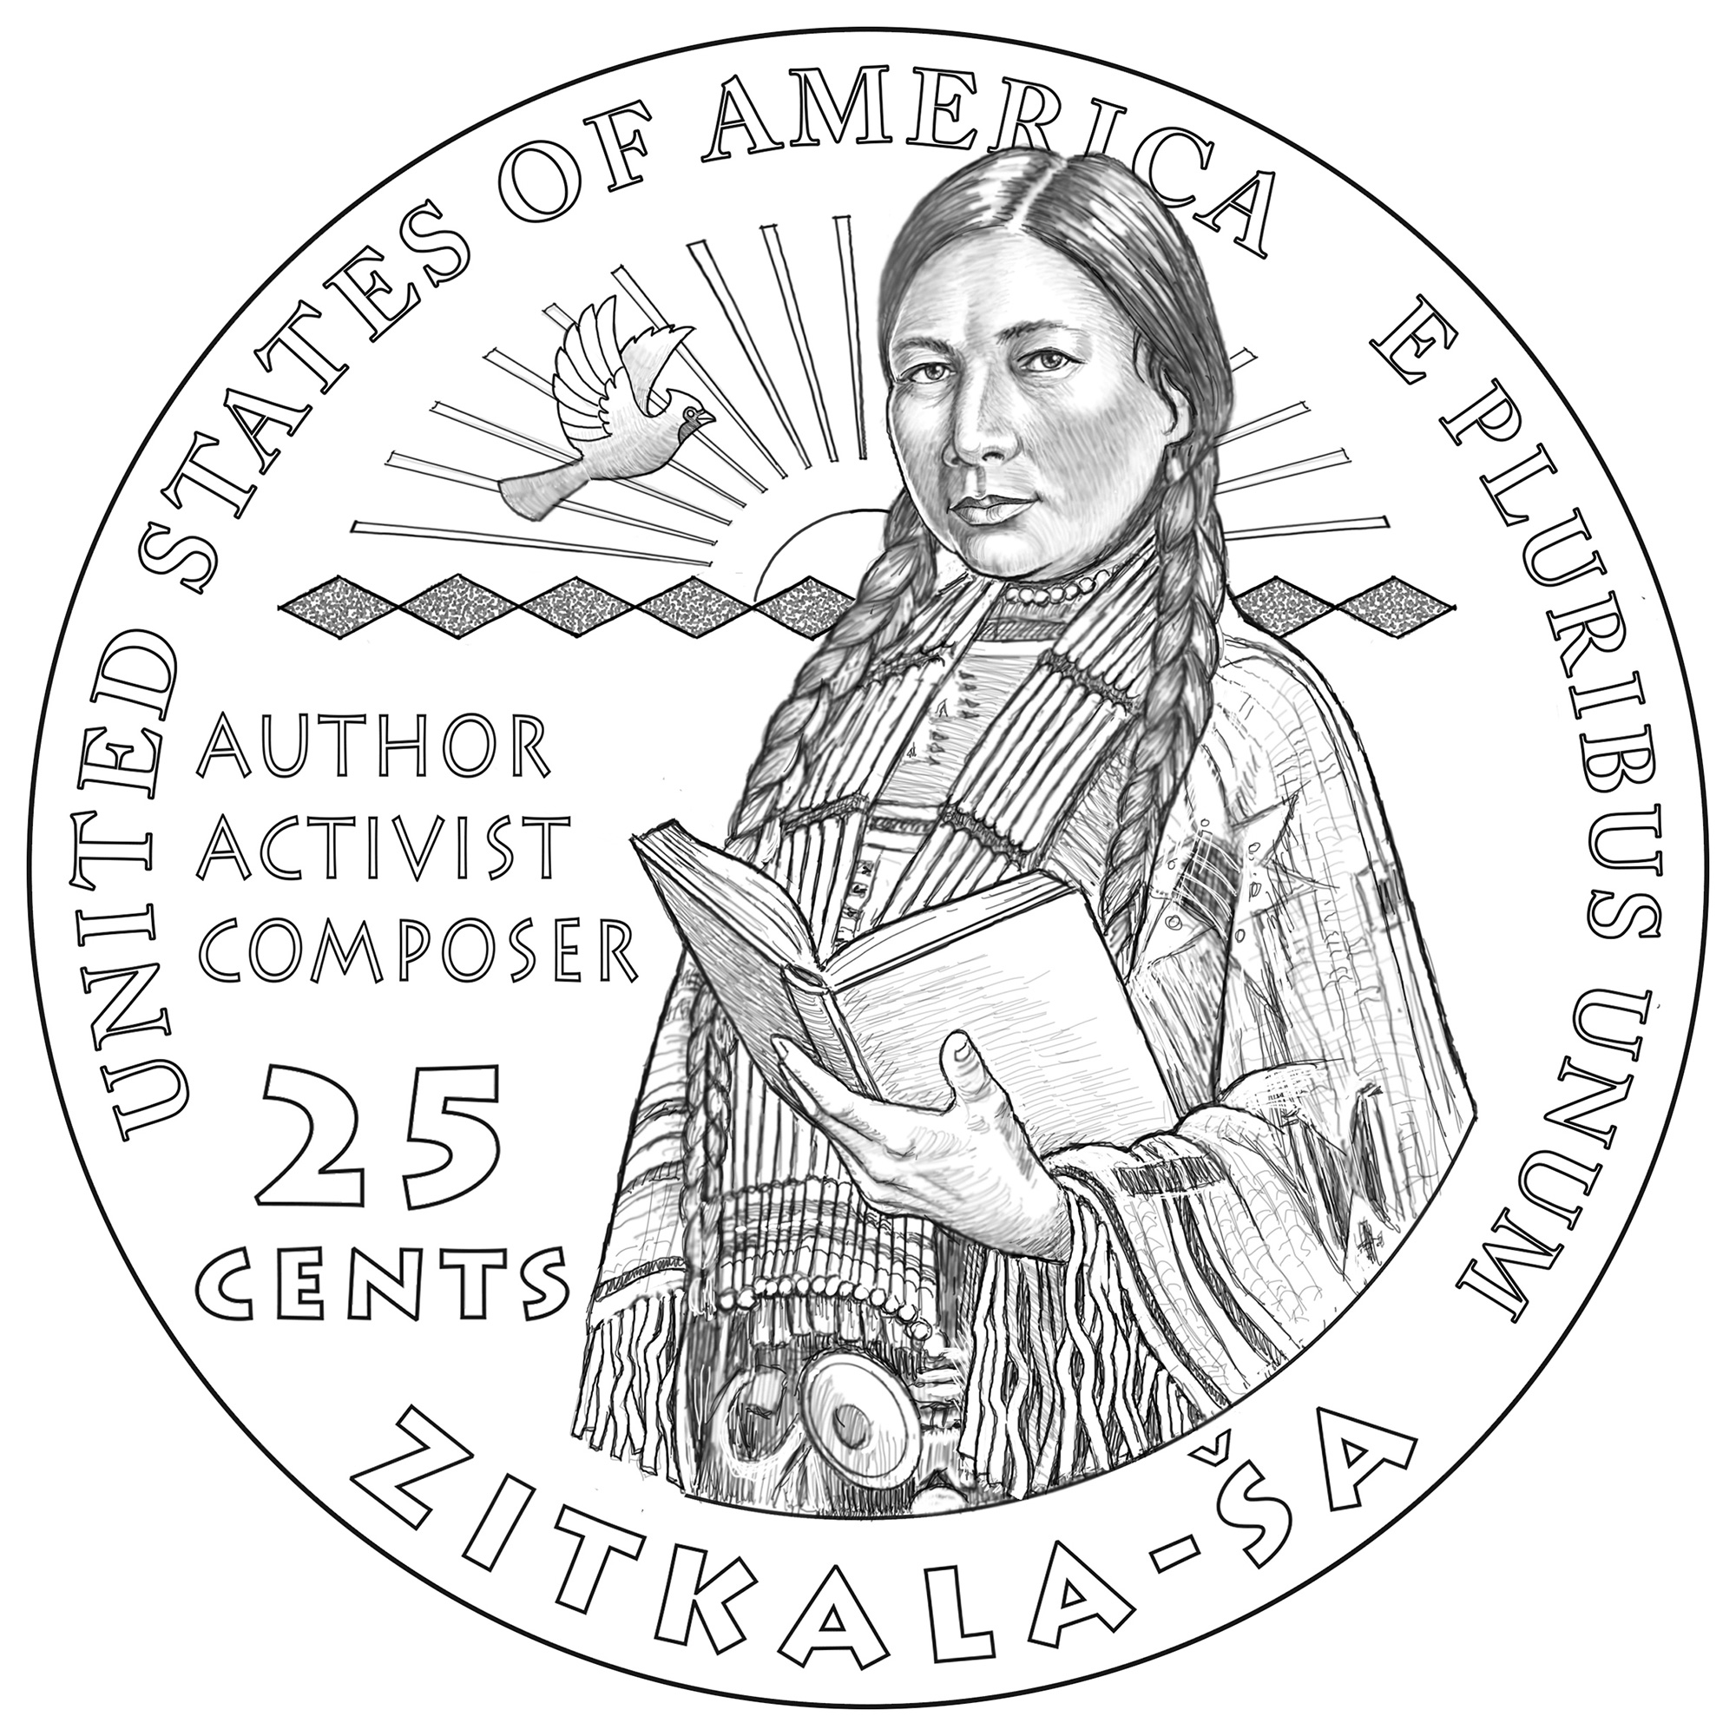
Zitkála-Šá - Centennial of Indian Citizenship Act of 1924

Slide 20

Activity- Design A Quarter

Slide 21
Biographies

Slide 22
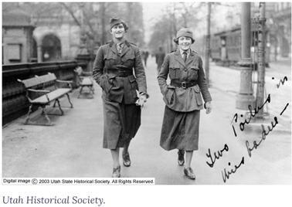
Maud Fitch
Maud, a Utah native, volunteered as a WWI ambulance driver, spurred by a longing for adventure. Her service, exemplifying women's courage at the war front, earned her a French medal. Unlike most Utah women, who served as nurses, Maud's driving and repair skills led her to join a group of elite women in New York, destined for France. Initially working at a Red Cross station, she later joined the British women’s ambulance group.

Slide 23
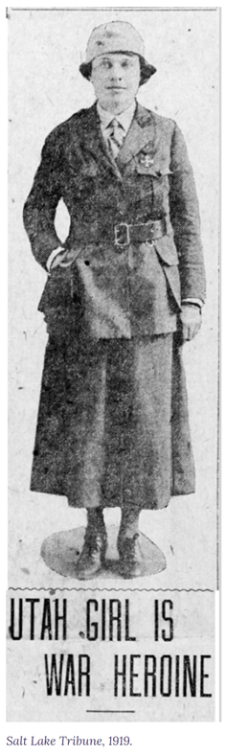
Maud Fitch
Maud's daily tasks involved ferrying wounded soldiers from front-line aid booths to hospitals, a 40-mile journey. She enjoyed the thrill and did not shy from the challenges she faced. Despite the army officers' condescension, she proved her competence, like other unpaid female drivers. Her dedication and courage was recognized when she was awarded the French Cross after just a month of driving. The citation praised her for her calm and bravery as she got a wounded man out during a heavy bombardment. After 14 months of service, Maud returned to Eureka as a war hero when WWI ended.

Slide 24
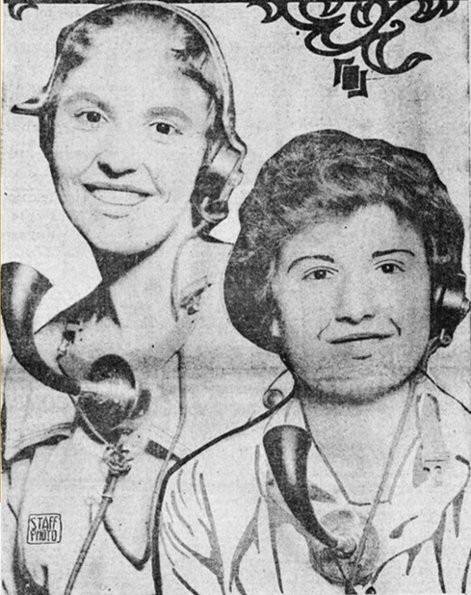
Hello Girls
During World War 1, the U.S. Army recruited 223 women, including Utah natives Emelia Lumpert and Mary Marshall, as "Hello Girls." These women, proficient in French and skilled in operating telephones, helped rebuild France's destroyed phone system and facilitated vital communications near war zones.

Slide 25
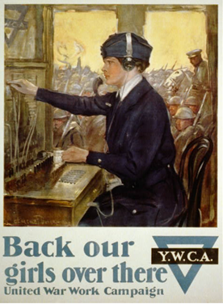
Hello Girls
Despite facing dangers like air raids and initial disrespect, they proved invaluable, connecting hundreds of calls an hour, translating messages, using codes, and even training men. Despite their hard work, the U.S. government didn't recognize their service until many years later. Now, people in Utah are advocating for the “Hello Girls” to be honored with the Congressional Medal – an effort that you can join here!

Slide 26
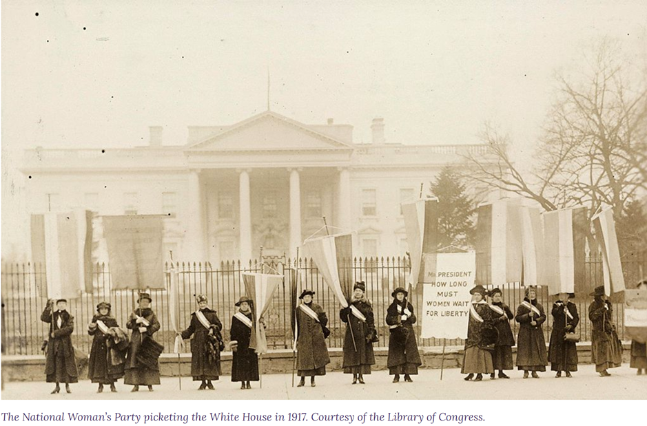
The Silent Sentinels
Utah suffragettes Lovern Robertson and Minnie Quay were among the "Silent Sentinels'' protesting for women's rights at the White House from 1917 to 1919. Robertson and Quay were among 41 women arrested and sentenced to 30 days in prison for obstructing traffic during their demonstrations. While there, they were subjected to harsh treatment during the infamous "Night of Terror.”

Slide 27
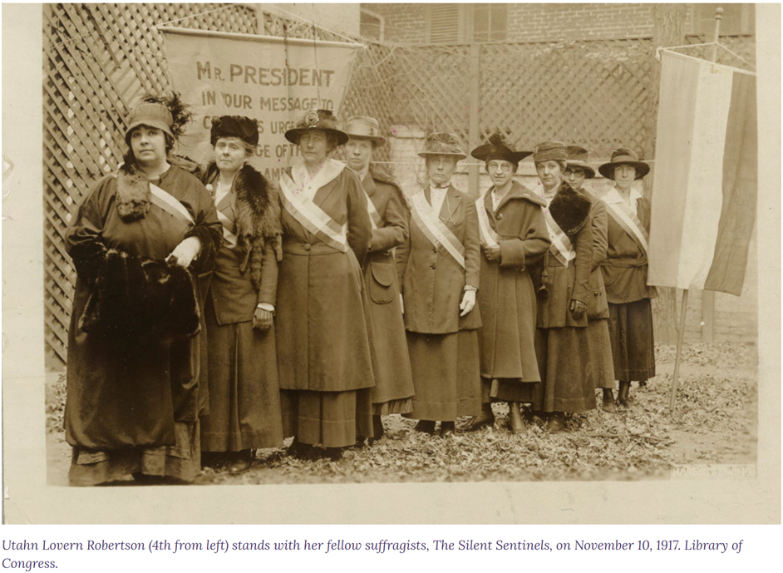
The Silent Sentinels
Their conviction to be steadfast and committed to the suffrage cause with nearly 2000 other women fueled public sympathy, influencing President Wilson to support women's suffrage. The suffrage amendment passed in 1920, vindicating their efforts and setting a precedent for future civil disobedience.

Slide 28
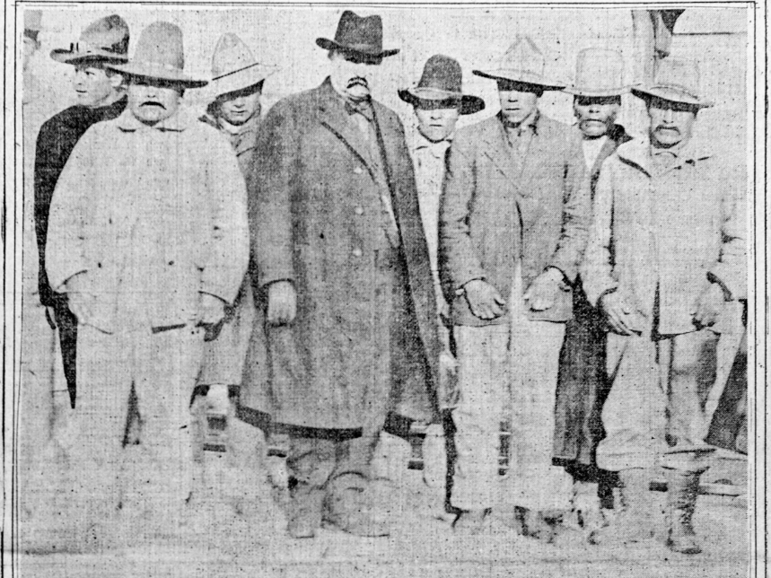
Goshute Women Protesters
Native Americans, previously confined to reservations and denied voting rights, were compelled to register for the draft during WWI, leading to over 10,000 serving in the military. This service was praised as patriotic assimilation. Yet, some Natives saw this as a violation of their freedom and treaty rights, opposing the idea of sacrificing for a government that had oppressed them.

Slide 29
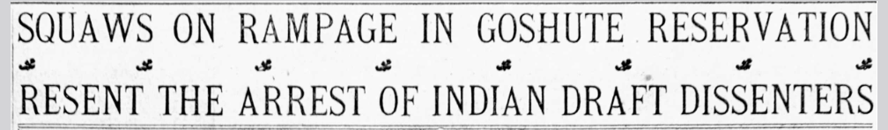
Goshute Women Protesters
On Utah's Goshute Reservation, numerous men resisted registration, leading to arrests. Goshute women protested these actions and sought to expel white officials enforcing the law. Among the arrested, three registered for the draft, while others agreed to farm for the military in exchange for their release. Today, Native women protest against injustices such as child removal and industrial pollution, contributing to a more equitable society.

Slide 30
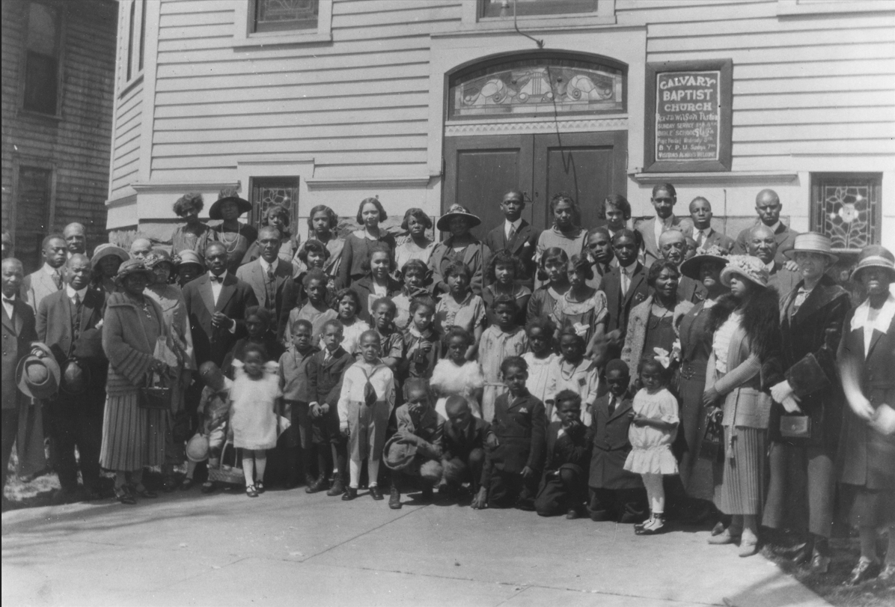
Gertrude Stevens Lancaster
Gertrude Stevens, a prominent figure in Salt Lake City's Black community in the early 20th century, contributed significantly to World War I efforts and local community-building initiatives. She participated in the Booker T. Washington War Savings Association, where she helped raise funds for the war by selling government-issued stamps.

Slide 31
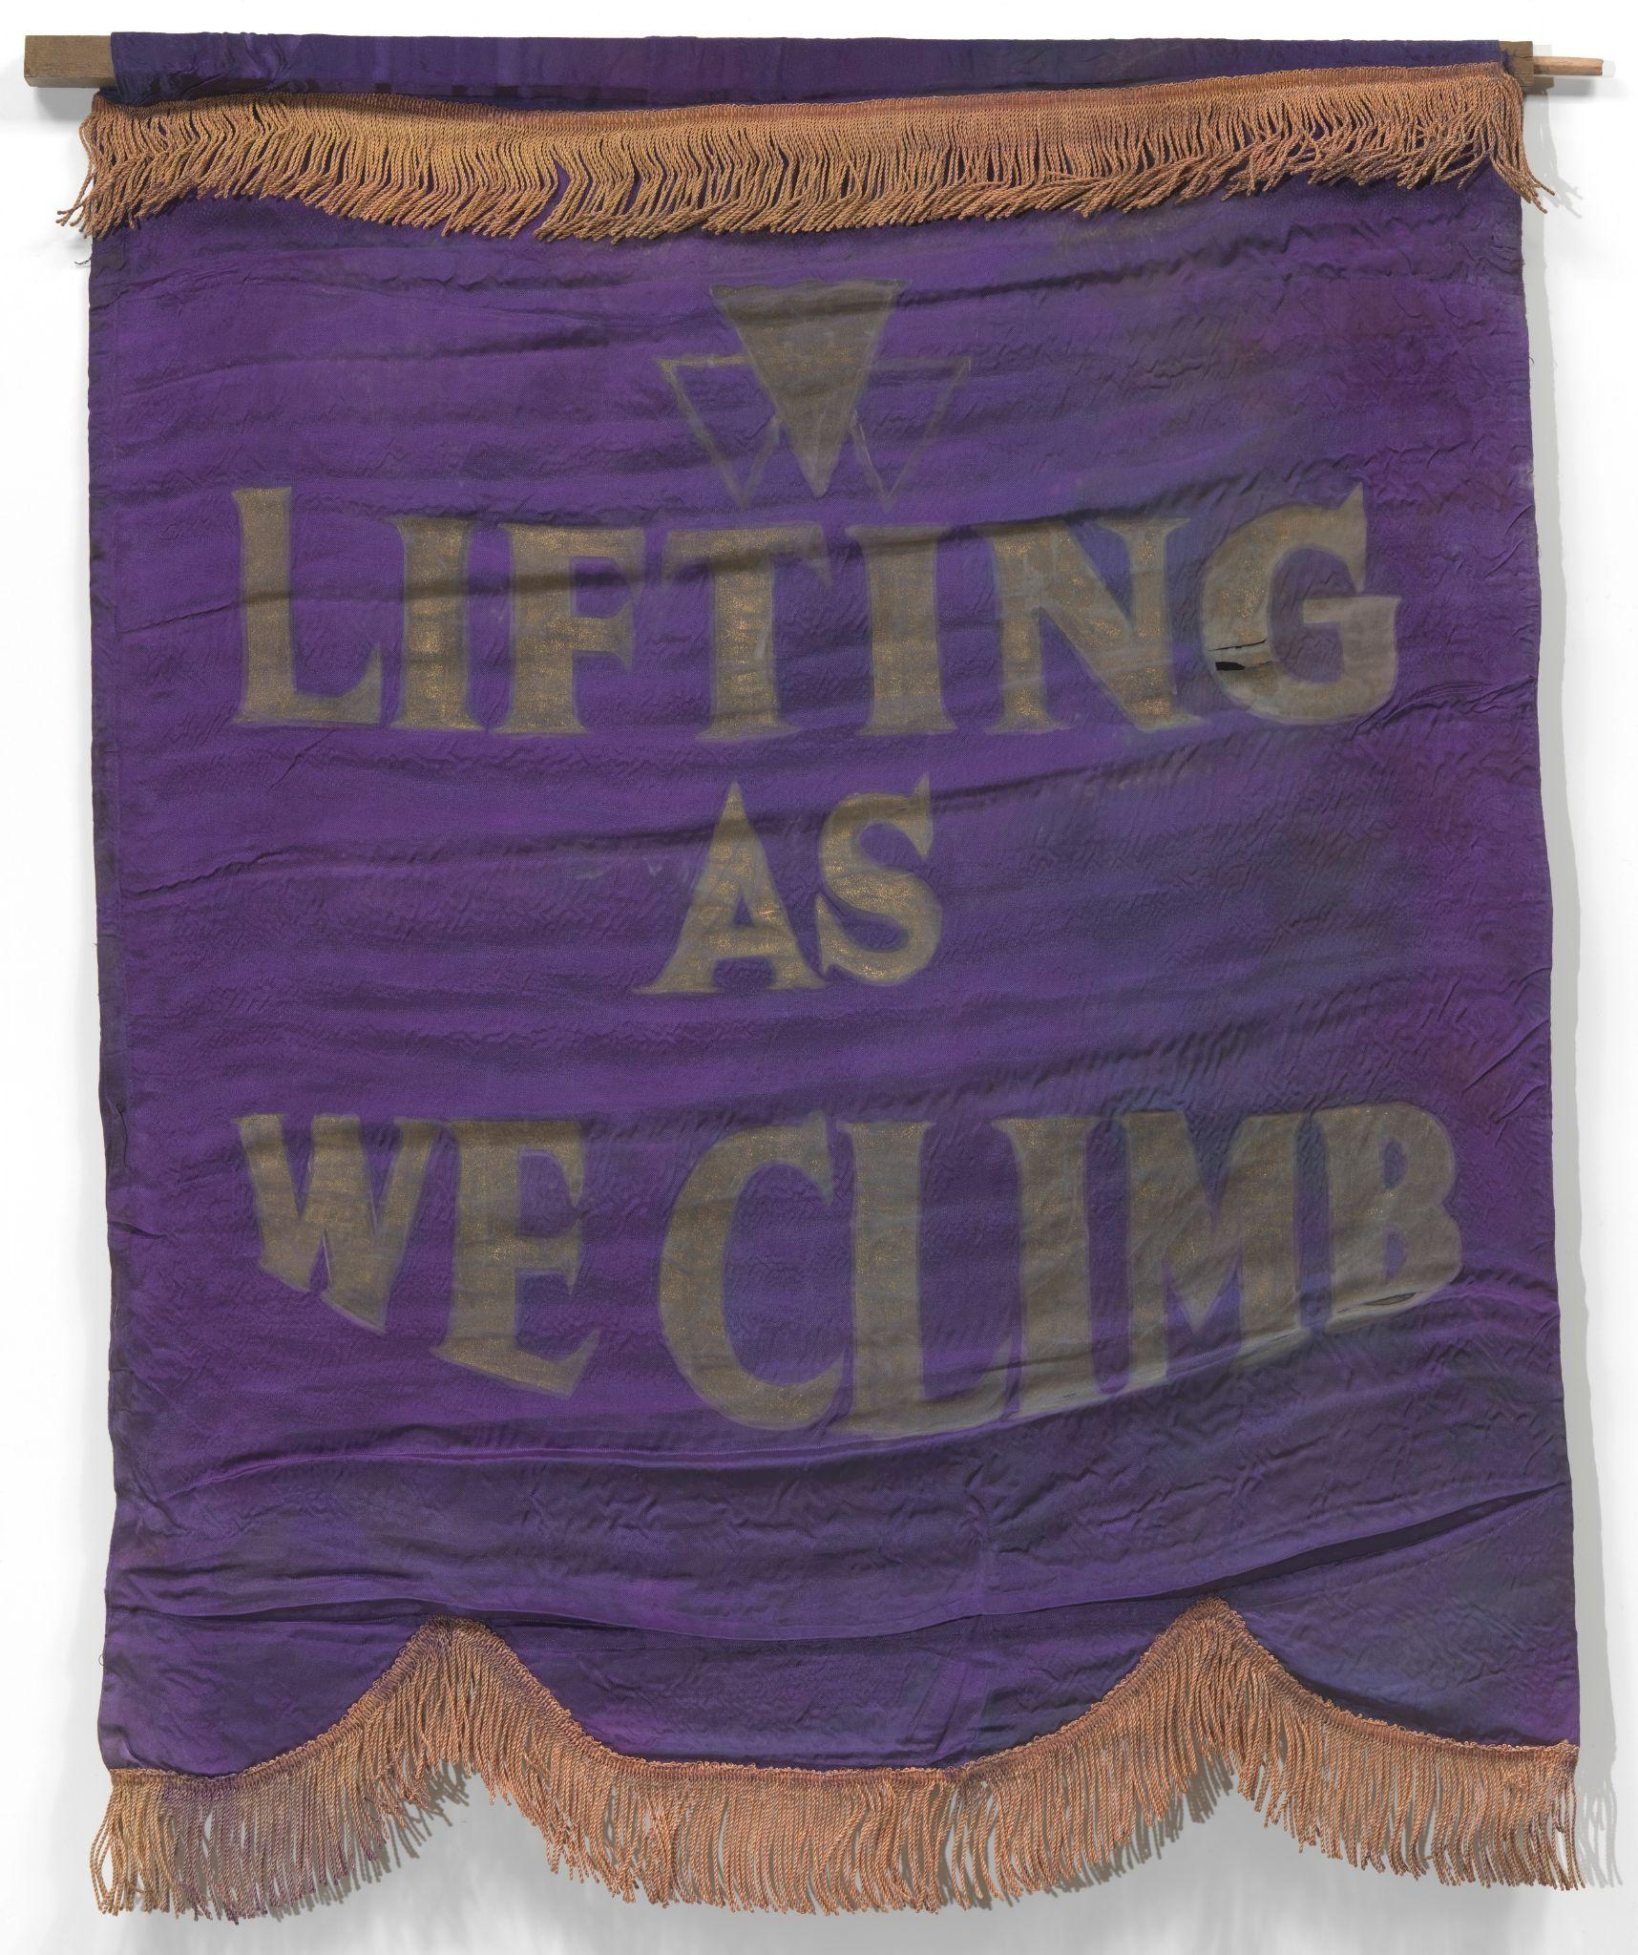
Gertrude Stevens Lancaster
As a leader in the Western Federation of Colored Women, she facilitated the cooperation of local Black women's clubs, with up to 250 women involved in charity work. She was also part of Amity, a segregated Red Cross unit, where women gathered weekly to knit and sew supplies for soldiers and managed their households in ways supportive of the war effort. This included going without certain foods like milk and eggs so they could go to the soldiers instead. This community provided friendship and empowerment for Black women like Gertrude.

Slide 32
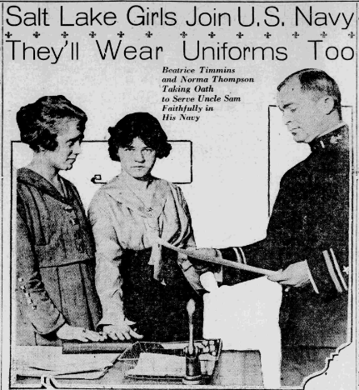
Utah’s Female Yeomen
In response to German U-boat threats, President Woodrow Wilson signed the Naval Act of 1916, unintentionally allowing women into the U.S. Navy due to ambiguous language. Interpreting "all persons" as inclusive of women, the Navy Secretary saw an opportunity to free men for combat. Naval districts began recruiting women, marking their first formal inclusion in the U.S. Military. The women would enroll as yeoman second class and be referred to as “female yeoman” or “yeoman (F).” They underwent the same training and received equal pay as men. This historic change saw thousands of women, including five from Utah, join the Navy, primarily in clerical roles.

Slide 33
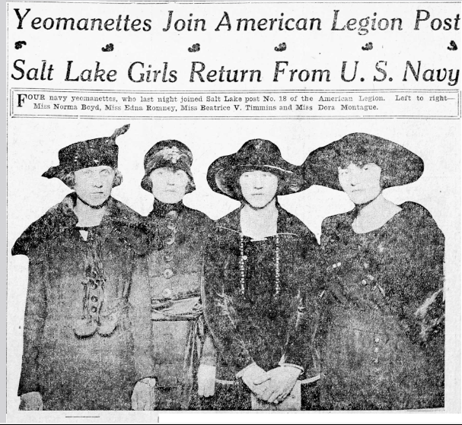
Utah’s Female Yeomen–Beatrice Viola Timmins and Norma Bessie Long
Two female yeomen from Utah, Beatrice Viola Timmins and Norma Bessie Long, were friends before the war.
Both graduated as qualified stenographers and applied to do similar work for the U.S. Navy. Norma is listed in one Utah newspaper as the first woman in America to ever wear the Navy uniform.
The Navy continued to be part of both women’s lives after the war. Viola participated in a celebration of the Armistice on the U.S.S. Wasatch, where she was asked to “christen the ship with a bottle of the strongest liquid obtainable.”

Slide 34

Christina Jacobs, Education Coordinator
christina@betterdays2020.org
www.utahwomenshistory.org
Follow us @betterdays2020

