Slide 1
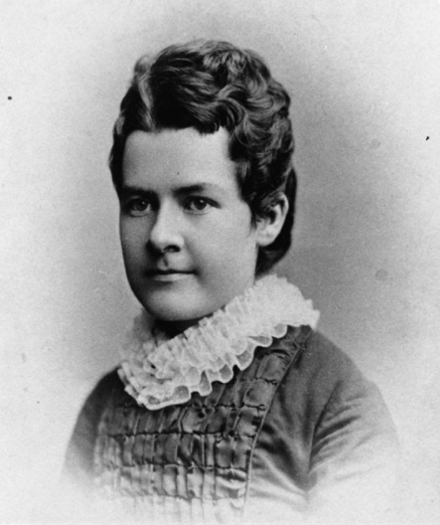
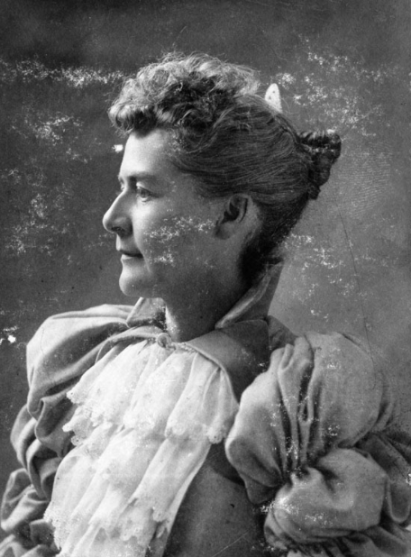
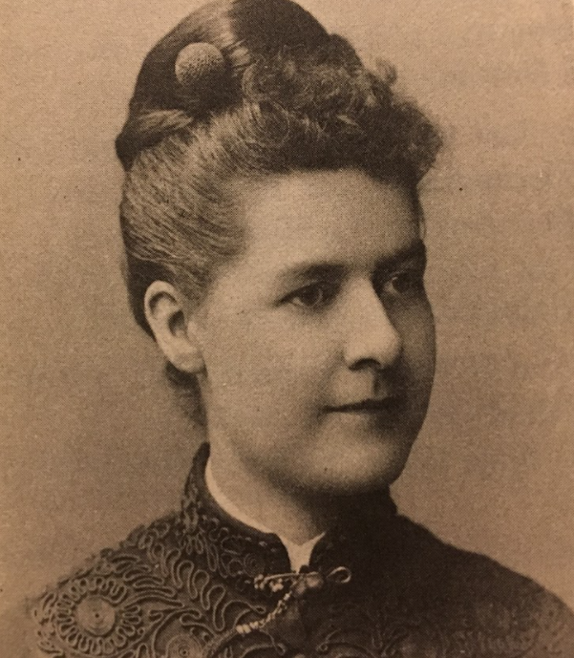
Images courtesy of USHS

Slide 2
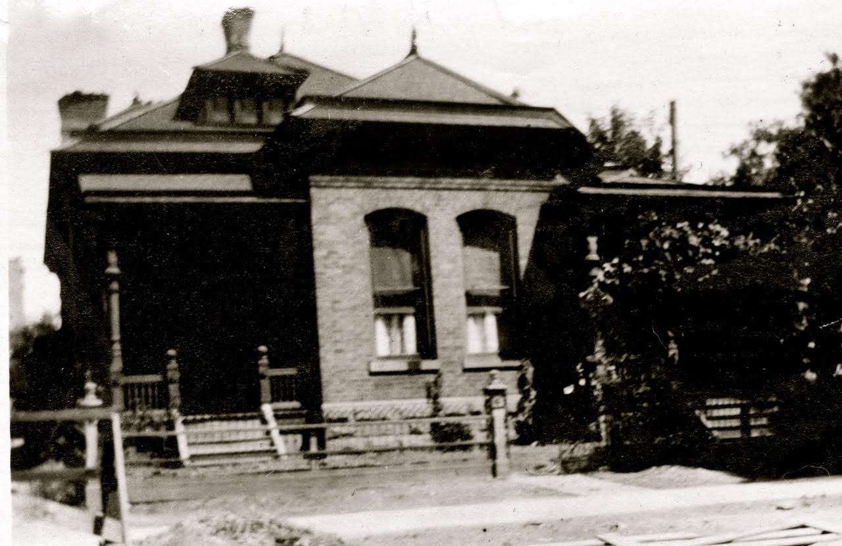
Home and Office of Martha Hughes Cannon
Salt Lake City
Image Courtesy of Ron Fox

Slide 3
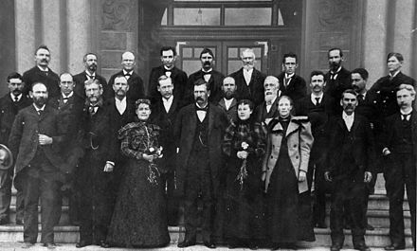
1897 Utah Legislature
Image Courtesy of Utah State Historical Society

Slide 4
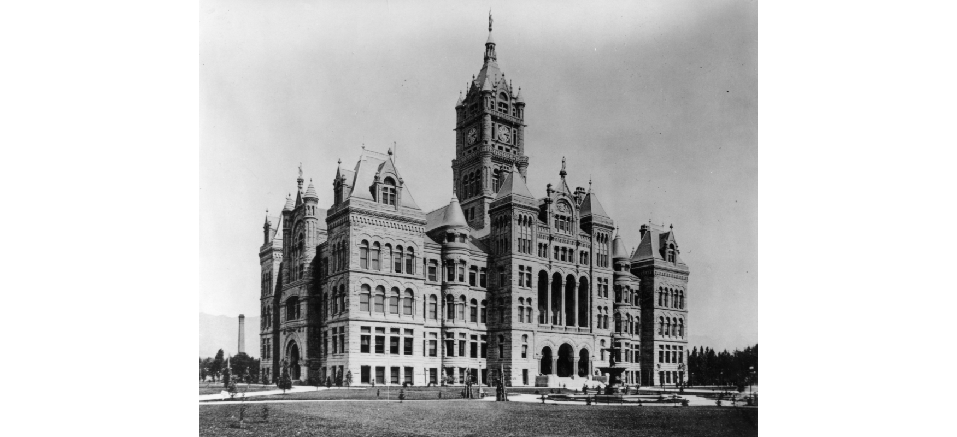
City and County Building where first Utah legislature met
Salt Lake circa 1896
Image Courtesy of Utah State Historical Society

Slide 5
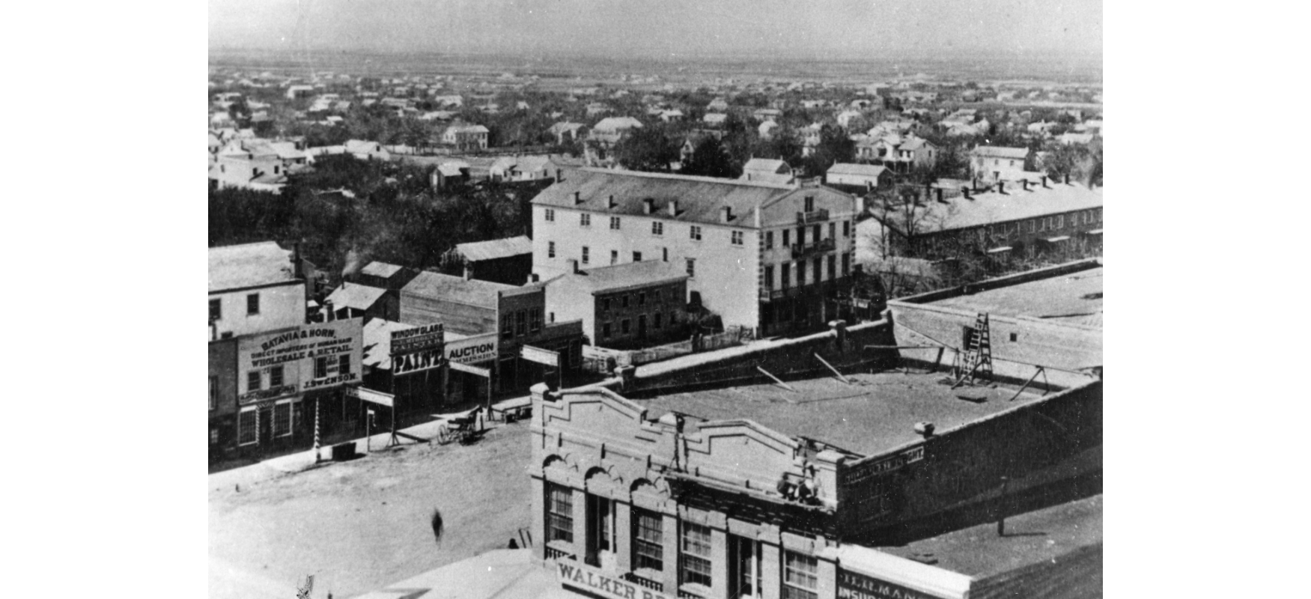
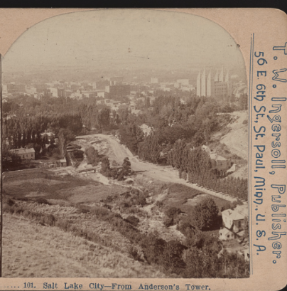
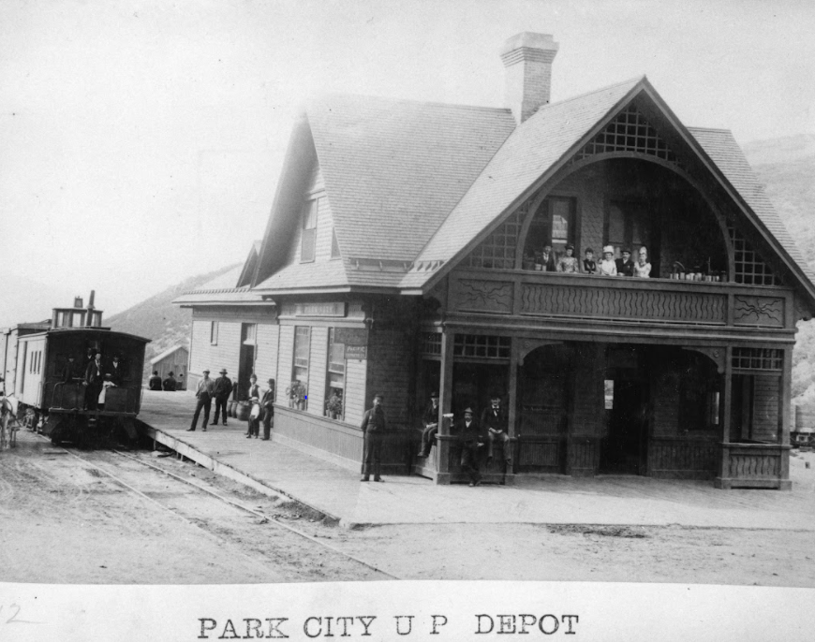
Salt Lake City circa 1890’s
Image Courtesy of Utah State Historical Society
Salt Lake City circa 1890’s
Image Courtesy of LOC
Park City Train Station 1890’s
Image Courtesy of Utah State Historical Society

Slide 6
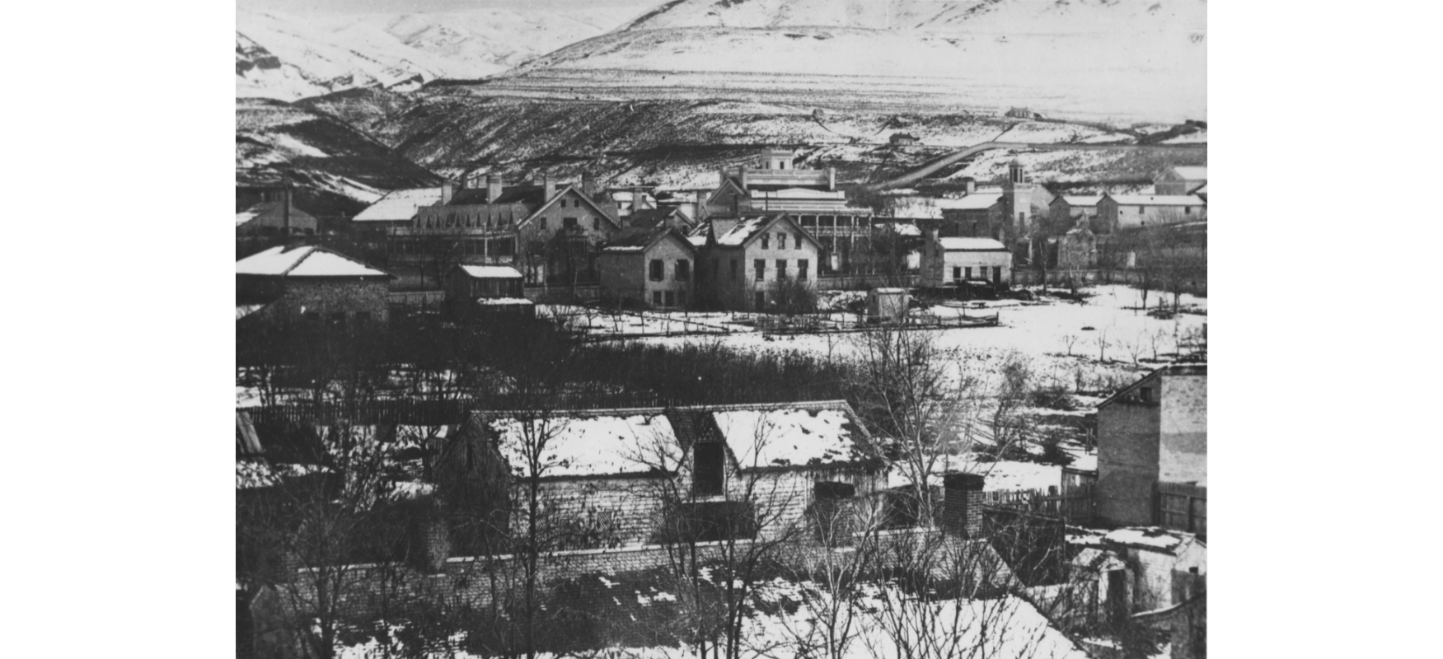
Salt Lake City circa 1860-1890
Image Courtesy of Utah State Historical Society

Slide 7
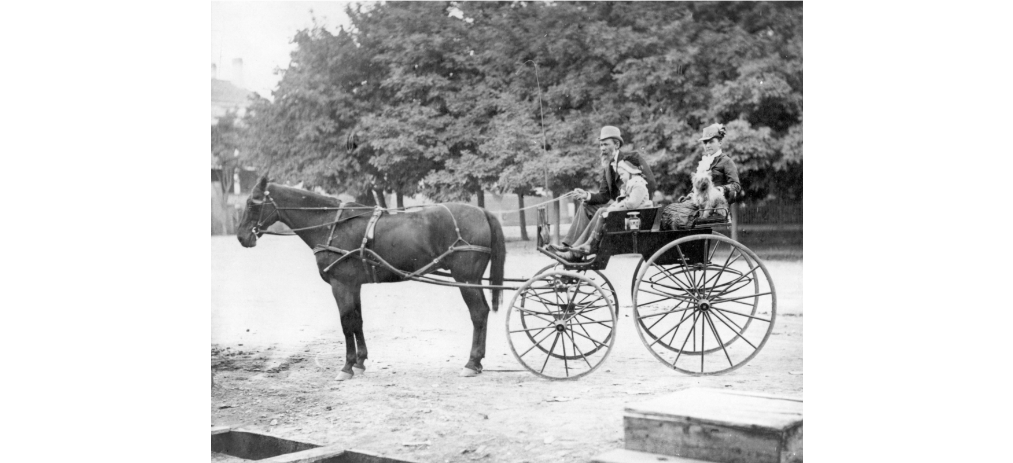
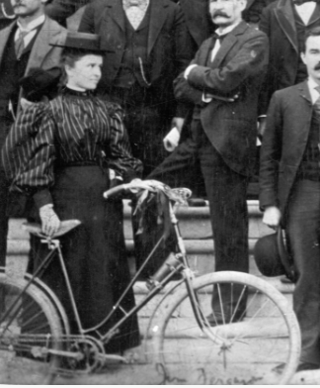
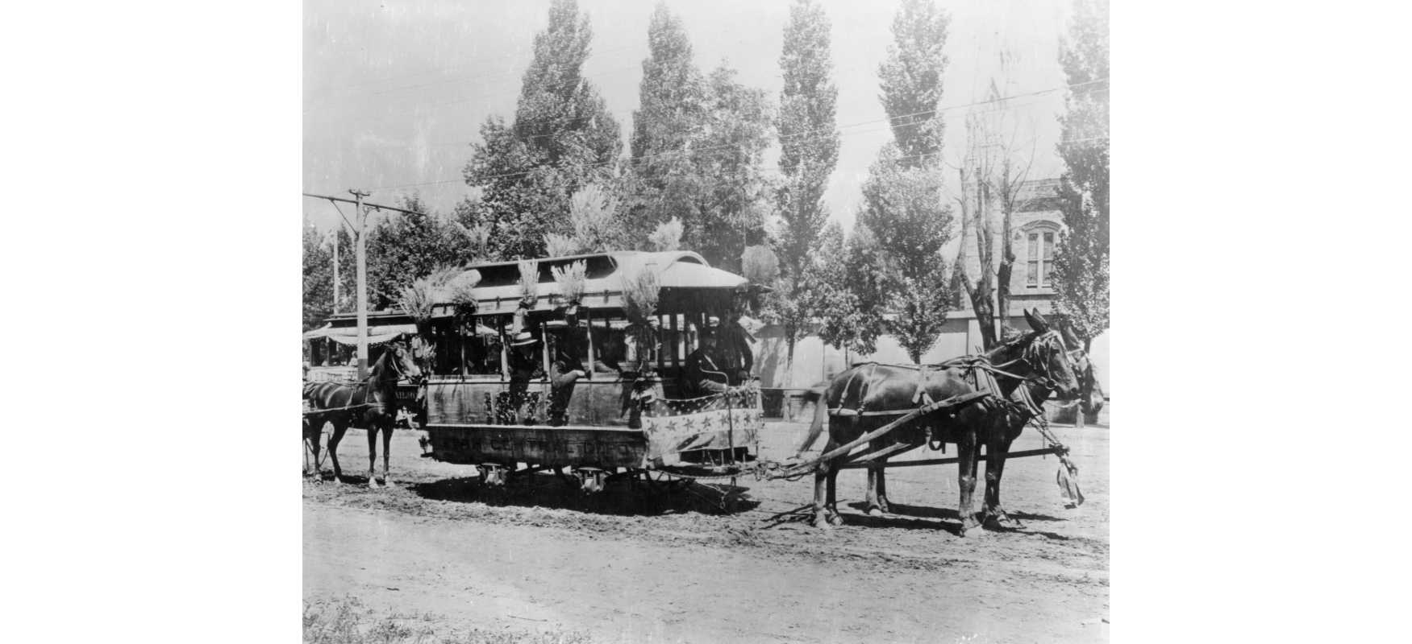
Transportation in SLC circa 1890’s
Images Courtesy of USHS

