Slide 1
Writing Poetry to Connect with the Past:
A Special Lesson with Utah Poet Laureate Lisa Bickmore
Ekphrastic Poetry

Slide 2
Ekphrasis
“Description” in Greek. An ekphrastic poem is a vivid description of a scene or, more commonly, a work of art. Through the imaginative act of narrating and reflecting on the “action” of a painting or sculpture, the poet may amplify and expand its meaning.
Definition from the Poetry Foundation

Slide 3
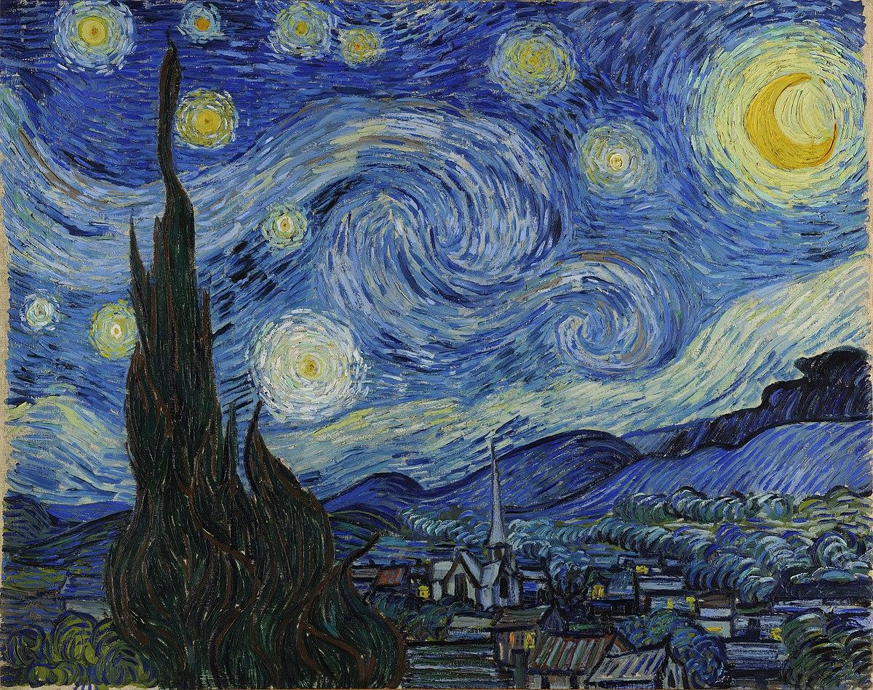
Staring at the Night
Honor Moorman
Perhaps he too once stood just here head tilted eyes licking the orangey crescent moon exploding stars flaming cypress swirling silver sky
his imagination suspended in the silent city beneath quaking black mountains secret recesses of a tender growing night
Van Gogh whispering to his soul with furious brushstrokes as I cannot with this trickle of words he will never read
The Starry Night
By Vincent Van Gogh

Slide 4
The Starry Night
By Vincent
Van Gogh

Slide 5
Staring at the Night
Honor Moorman
Perhaps he too once stood just here head tilted eyes licking the orangey crescent moon exploding stars flaming cypress swirling silver sky
his imagination suspended in the silent city beneath quaking black mountains secret recesses of a tender growing night
Van Gogh whispering to his soul with furious brushstrokes as I cannot with this trickle of words he will never read

Slide 6
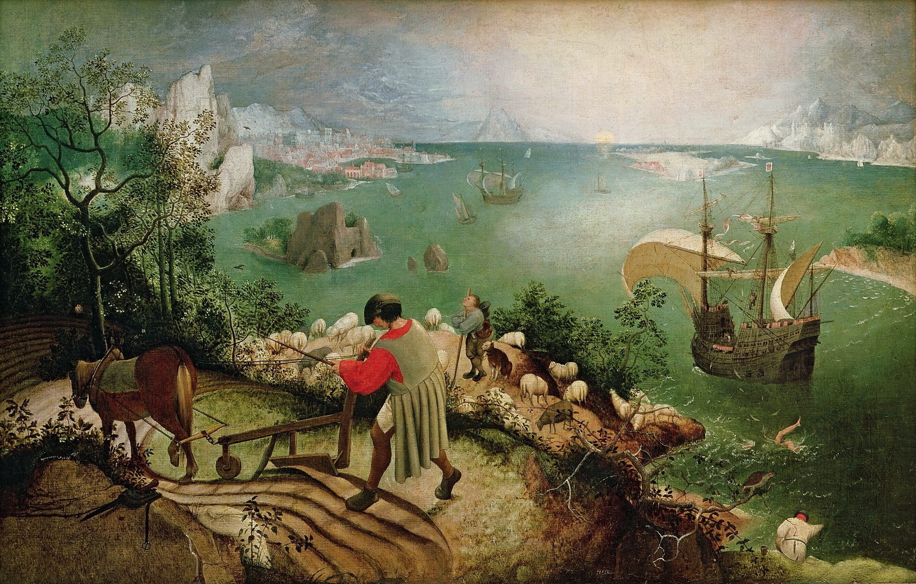
Landscape with the Fall of Icarus
William Carlos Williams
According to Brueghel when Icarus fell it was spring
a farmer was ploughing his field the whole pageantry
of the year was awake tingling with itself
sweating in the sun that melted the wings' wax
unsignificantly off the coast there was
a splash quite unnoticed this was Icarus drowning
Landscape with the Fall of Icarus
by Pieter Bruegel

Slide 7
Landscape with the Fall of Icarus
By Pieter Breugel

Slide 8
Landscape with the Fall of Icarus
William Carlos Williams
According to Brueghel when Icarus fell it was spring
a farmer was ploughing his field the whole pageantry
of the year was awake tingling with itself
sweating in the sun that melted the wings' wax
unsignificantly off the coast there was
a splash quite unnoticed this was Icarus drowning

Slide 9
Write Your Own Ekphrastic Poem
You could describe the setting where you encounter Martha Hughes Cannon’s statue.
You could describe the statue.
You could imagine yourself speaking to the statue.
You could imagine the statue speaking back to you – giving the statue a voice. What would you expect the statue to say, and what surprising things might the statue say?
You could ask questions to the statue.
You could imagine a dialogue between yourself and the statue, or a dialogue between Martha Hughes Cannon and another historical figure.

Slide 10
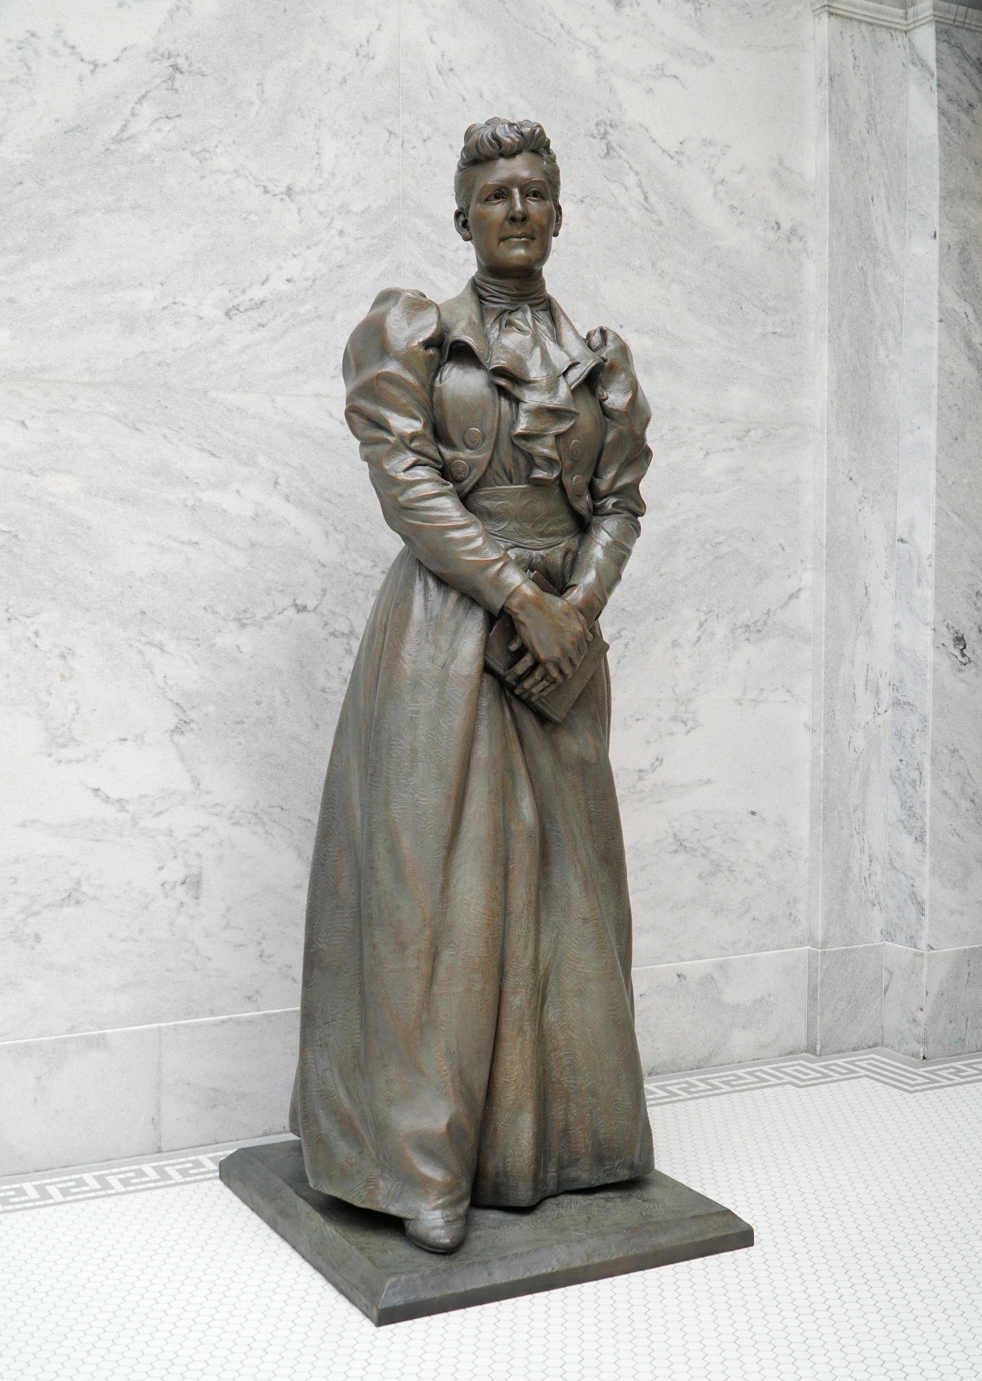
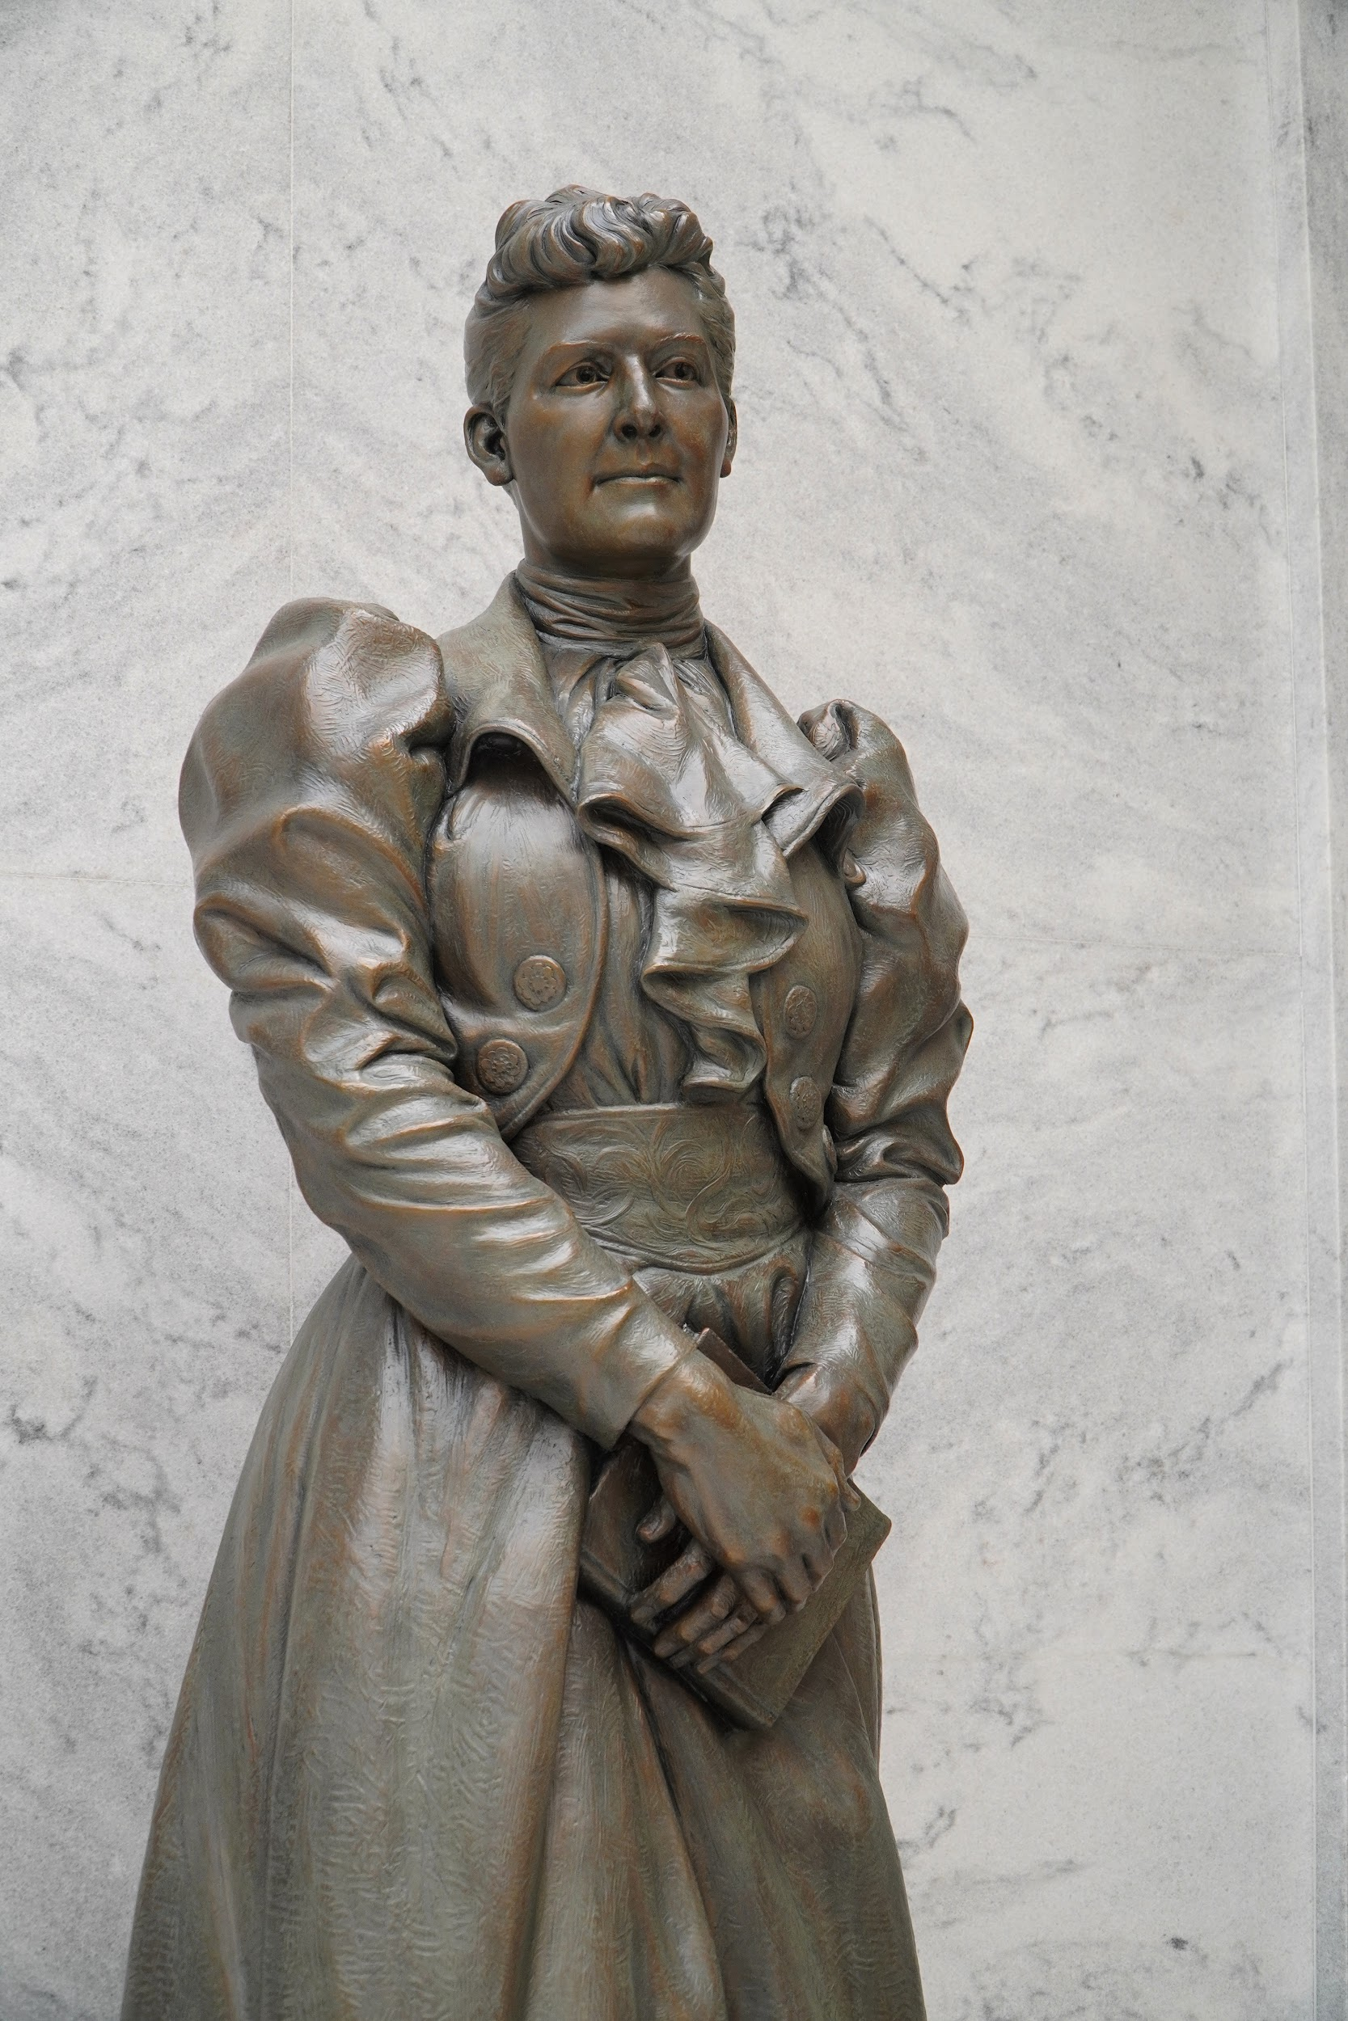
Martha Hughes Cannon
Sculpted by Ben Hammond

Slide 11
Martha Hughes Cannon
Illustrated by
Brooke Smart

