Slide 1
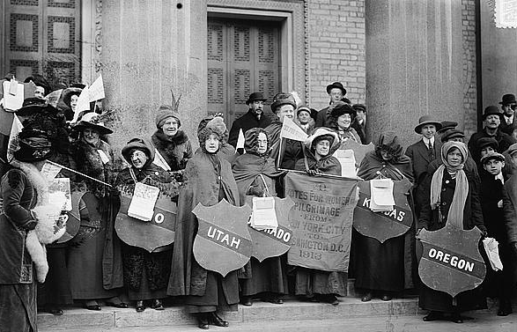
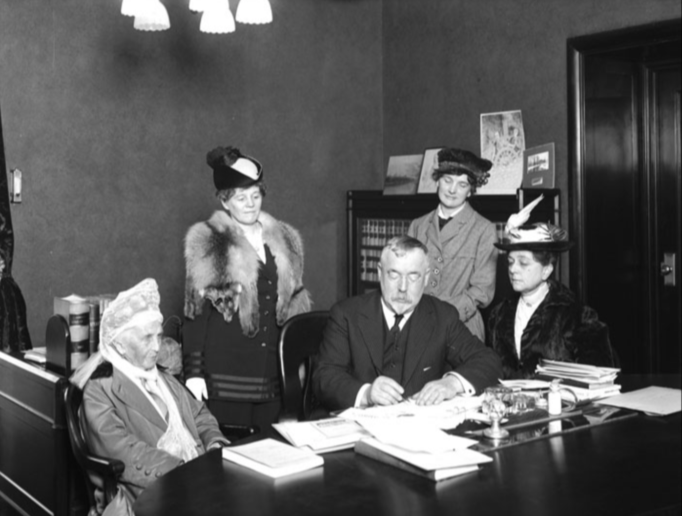
Examining Tactics and Strategies Used in the Women’s Suffrage Movement

Slide 2
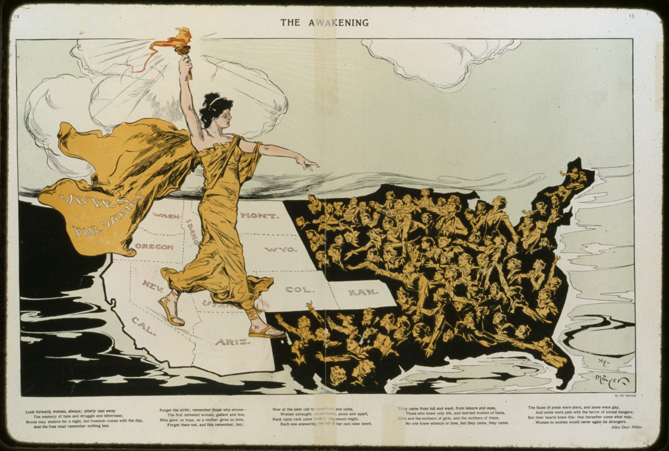
Notes:
Courtesy of Library of Congress

Slide 3
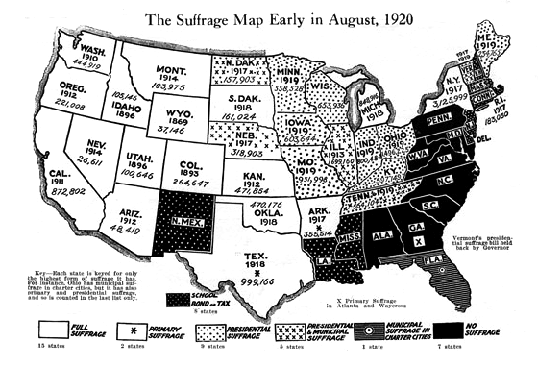

Slide 4
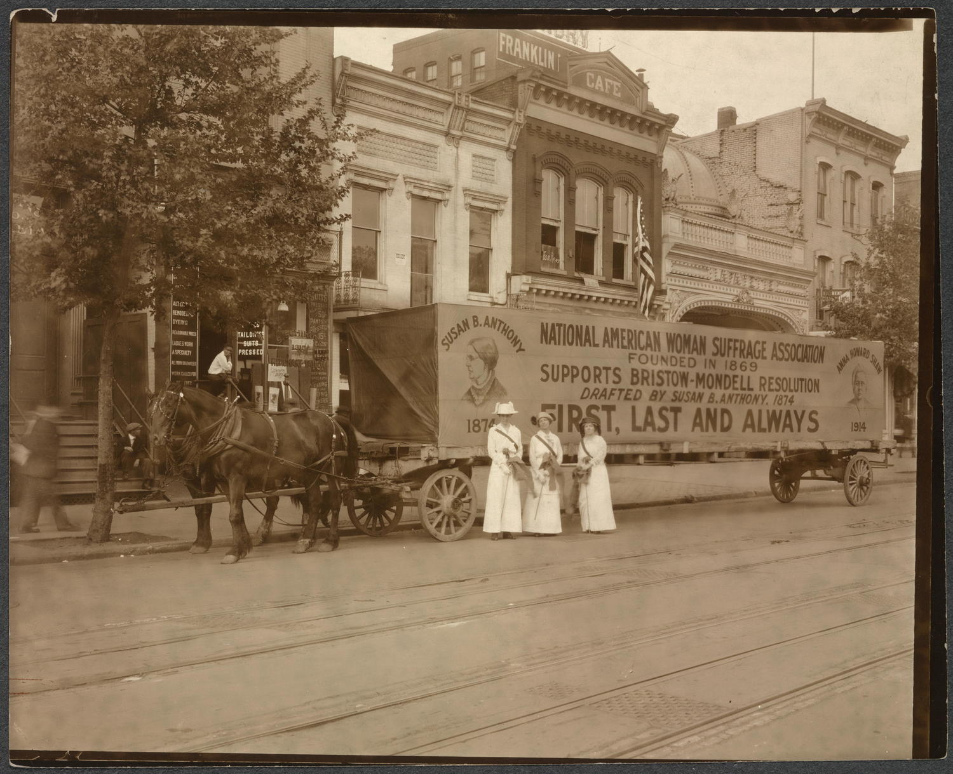
National American Woman Suffrage Association (NAWSA)
Notes:
Image courtesy of Library of Congress

Slide 5
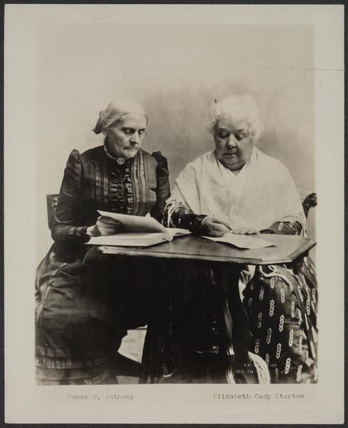
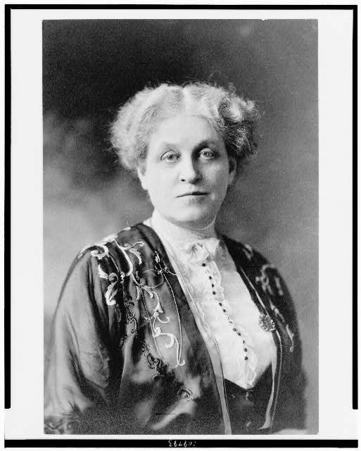
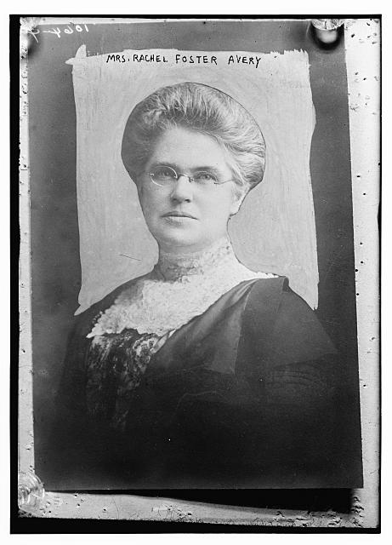
Key Leaders
Susan B. Anthony & Elizabeth Cady Stanton
Carrie Chapman Catt
Rachel Foster Avery
Notes:
All images courtesy of Library of Congress

Slide 6
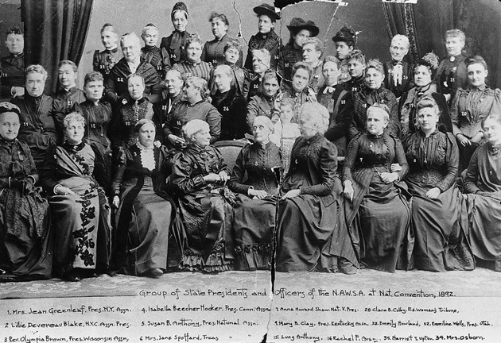
Group of State Presidents and Officers of the N.A.W.S.A. at National Convention, 1892. Courtesy of Bryn Mawr Special Collections.
5. Susan B. Anthony, Pres.
7. Rev. Anna Howard Shaw, VP
10. Sarah M. Kimball, Utah
12. Emmeline Wells, Pres. Utah
31. Emily S. Richards, Utah

Slide 7
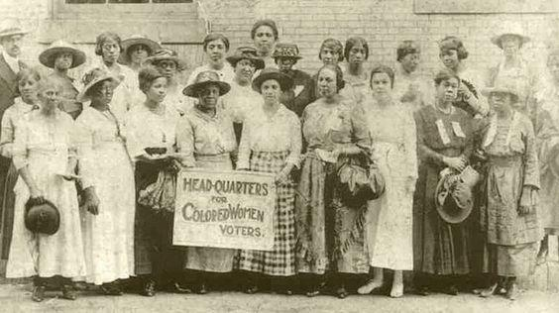
National Association of Colored Women’s Clubs (NACWC)

Slide 8
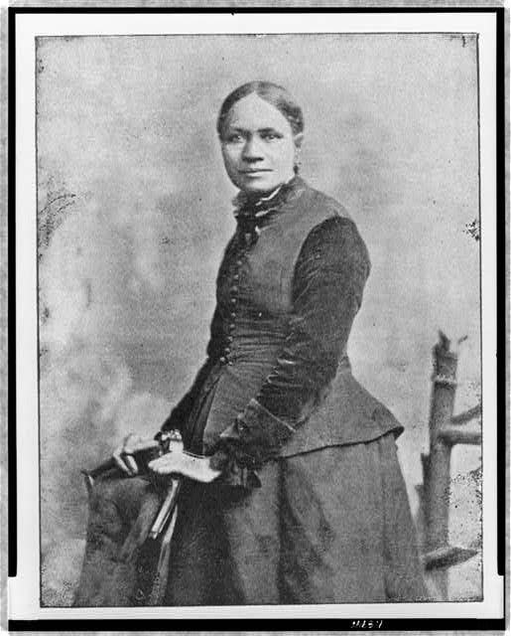
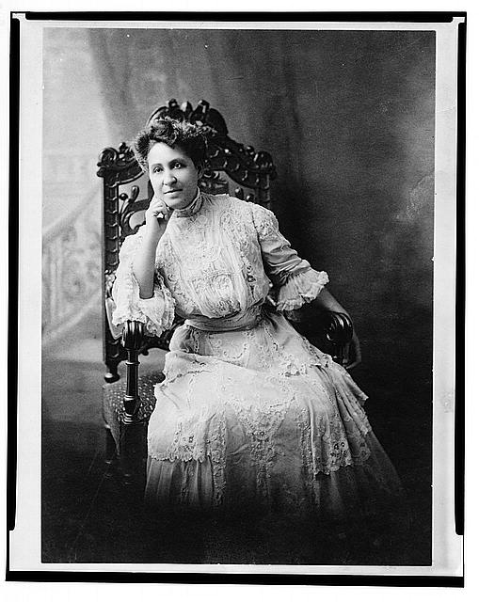
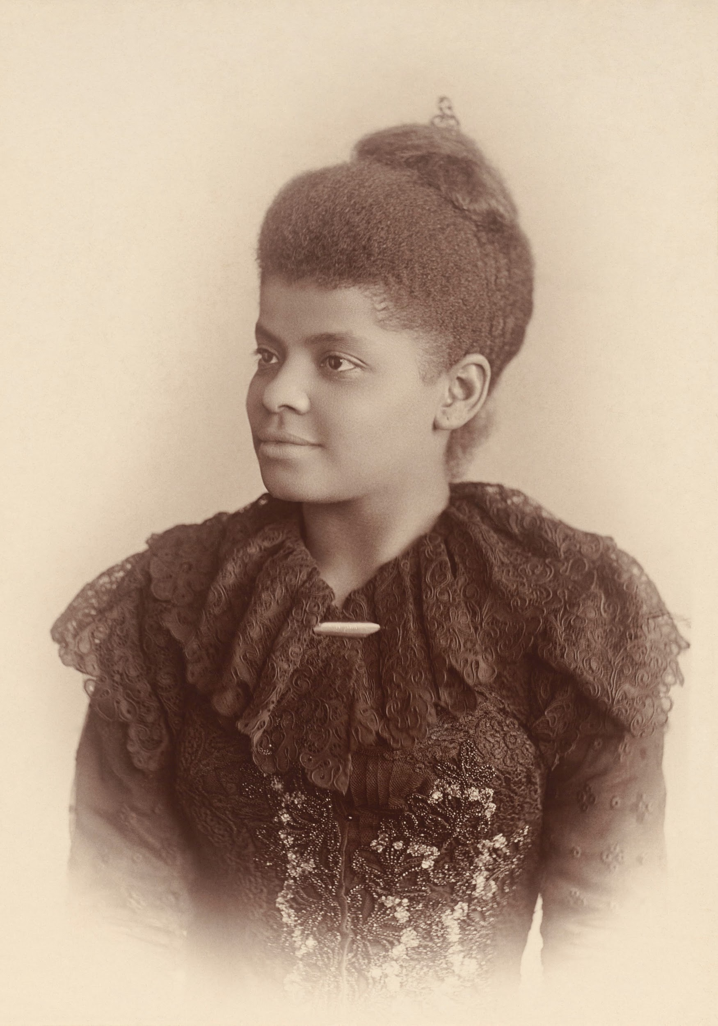
Key Leaders
Frances E. W. Harper
Mary Church Terrell
Ida B. Wells-Barnett
All images courtesy of Library of Congress
Notes:
Mary Church Terrell was one of the first African-American women to earn a college degree, and became known as a national activist for civil rights and suffrage. In 1896, she was the first African-American woman in the United States to be appointed to the school board of a major city, serving in the District of Columbia until 1906. Terrell was a charter member of the National Association for the Advancement of Colored People (1909) and the Colored Women's League of Washington (1894). She also helped found the National Association of Colored Women (1896) and served as its first national president, and she also was a founding member of the National Association of College Women (1910).
Ida Bell Wells-Barnett was an African-American investigative journalist, educator, and an early leader in the Civil Rights Movement. In the 1890s, Wells documented lynching in the United States. In 1896, Wells founded the National Association of Colored Women's Clubs and the National Afro-American Council.
Frances Ellen Watkins Harper was an African-American abolitionist, suffragist, poet and author. She was also active in other types of social reform and was a member of the Woman's Christian Temperance Union, which advocated the federal government taking a role in progressive reform. In 1894 she helped found the National Association of Colored Women and served as its vice president.

Slide 9
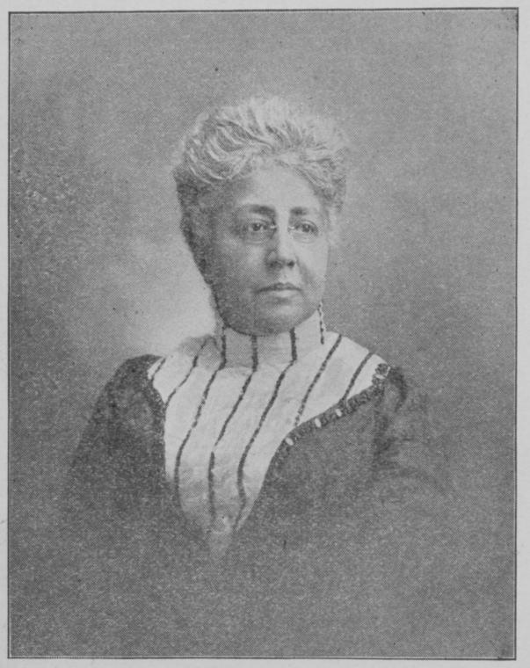
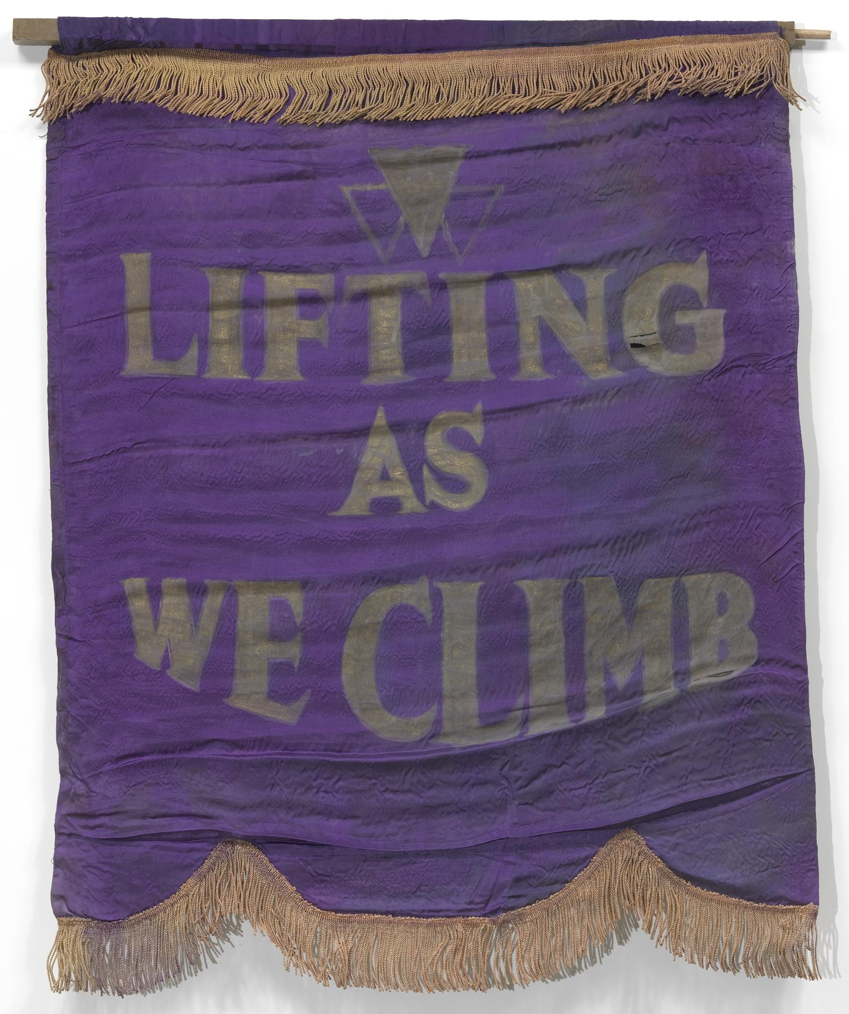
Josephine St. Pierre Ruffin. Courtesy of New York Public Library.
Courtesy of National Museum of African American History & Culture
Notes:
Josephine St. Pierre Ruffin (August 31, 1842 – March 13, 1924) was an African-American publisher, journalist, civil rights leader, suffragist, and editor of the Woman's Era, the first newspaper published by and for African-American women. Vice President of NACW.
Motto and banner used by the NACW.

Slide 10
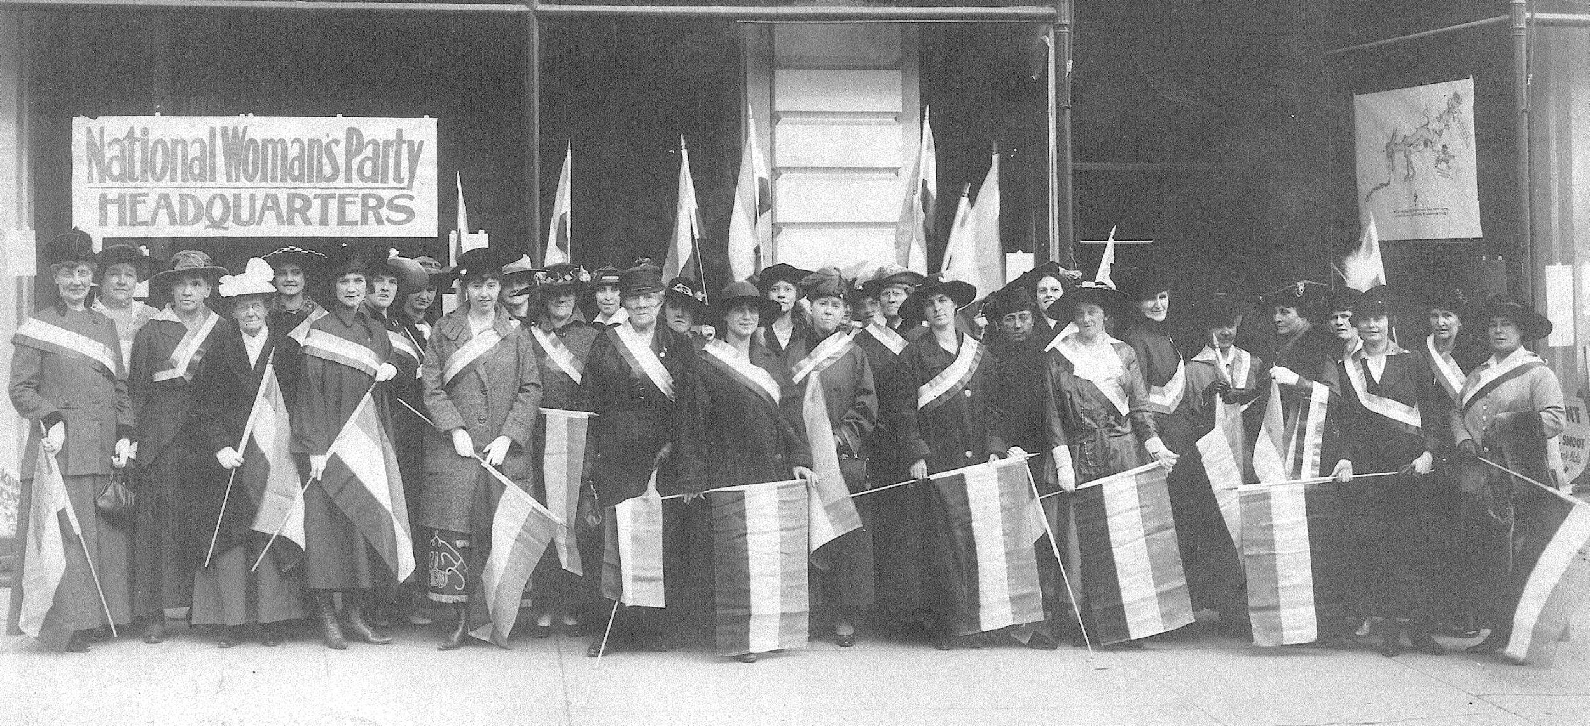
National Woman’s Party (NWP)
National Woman's Party activities outside of Utah state headquarters, 1916. Courtesy of National Woman’s Party.

Slide 11
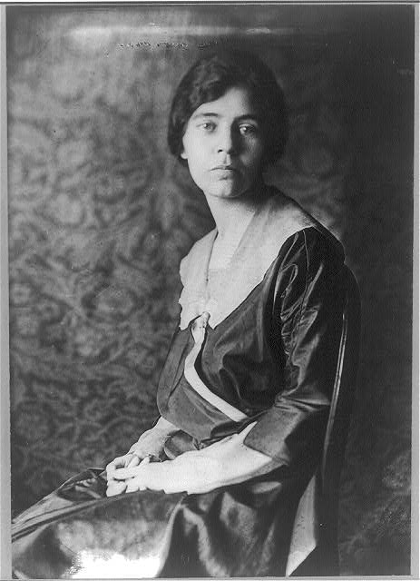
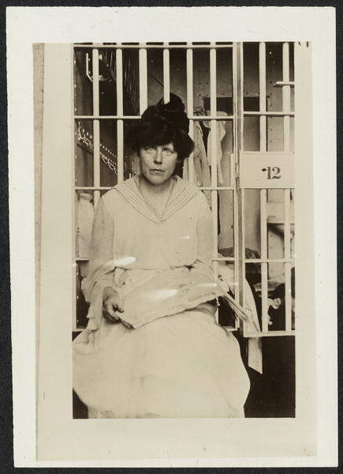
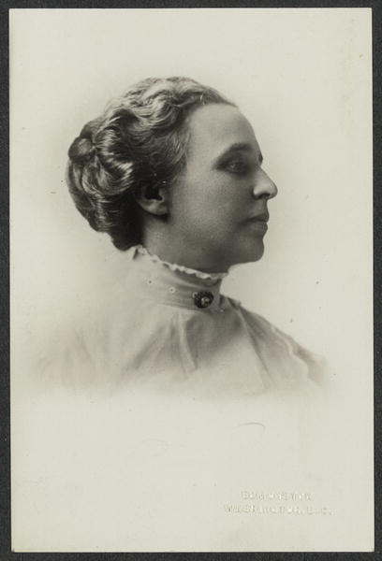
Key Leaders
Margaret Zane Cherdron, State Chairman for National Woman's Party in Utah.
Alice Paul in 1918.
Lucy Burns in the Occoquan Workhouse, 1917.
Notes:
Courtesy of Library of Congress.

Slide 12
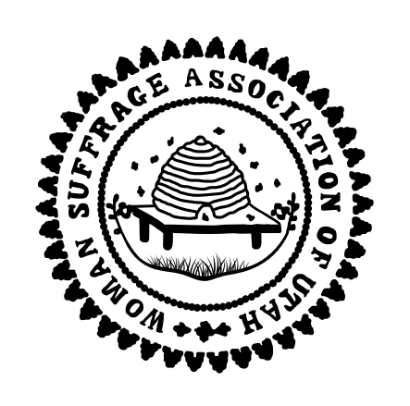
Utah Woman Suffrage Association
Courtesy of LDS Church History Museum

Slide 13
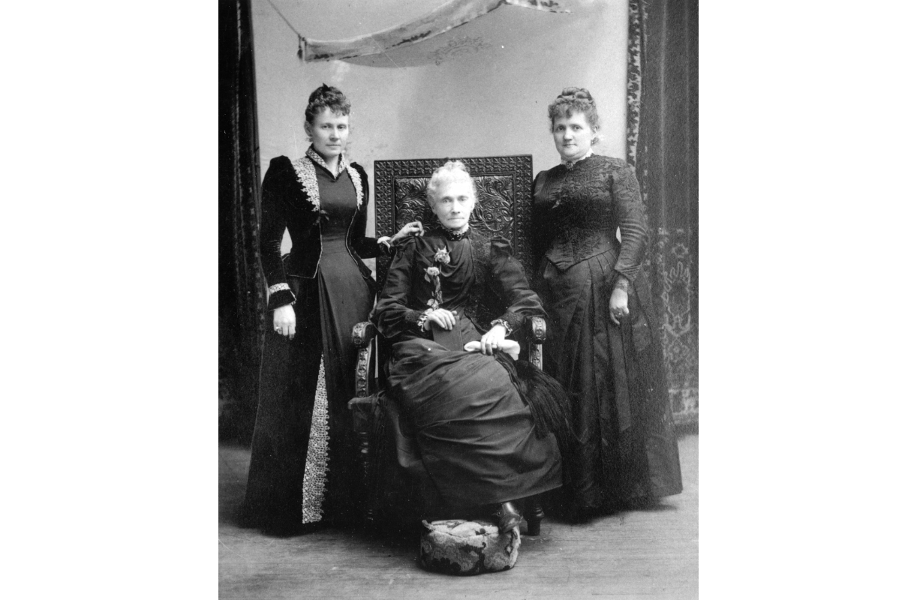
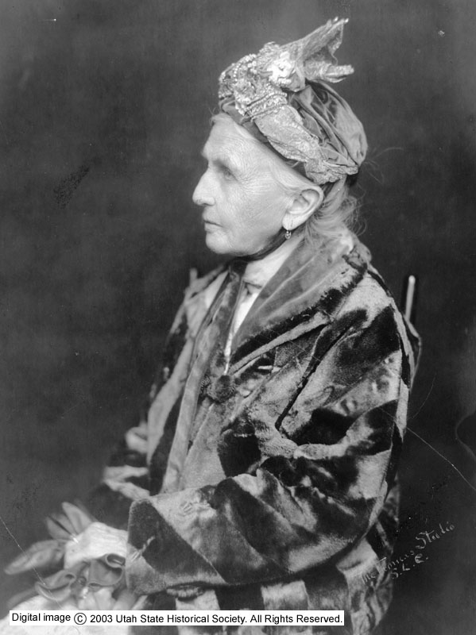
Key Leaders
(L to R) Emily S. Richards (co-founder of UWSA), Phebe Y. Beattie (executive committee chair of UWSA), and Sarah M. Kimball (2nd president of UWSA).
Emmeline B. Wells.
Notes:
Courtesy of Utah State Historical Society.

Slide 14
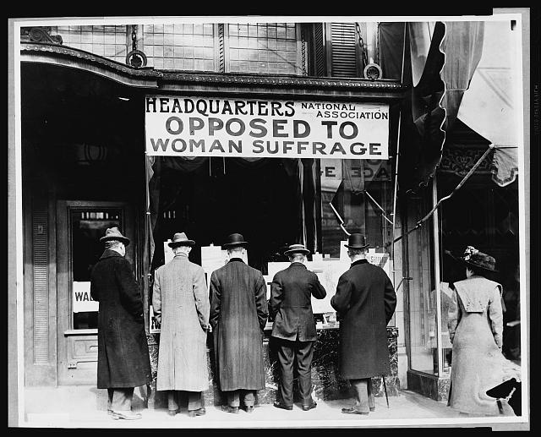
National Association Opposed to Woman Suffrage (NAOWS)
Notes:
Courtesy of Library of Congress.

Slide 15
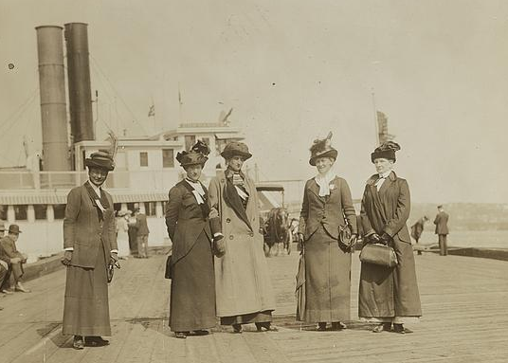
Key Leaders
Some of the anti-suffrage leaders who took 1200 people up the Hudson River for their Decoration Day picnic on May 30, 1913: L to R: Mrs. George Phillips, Mrs. K. B. Lapham, Miss Burnham, Mrs. Everett P. Wheeler, Mrs. John A. Church.
Josephine Dodge
Notes:
Josephine Jewell Dodge was an American educator, an early leader of the day nursery movement, and an anti-suffrage activist. In 1911, she helped found and became president of the National Association Opposed to Woman Suffrage, a post she held for six years; she also edited the organization's publication, "Woman's Protest." She was the target of a verbal attack at a 1915 "riot" between suffrage and anti-suffrage activists in Washington D. C. That same year, she spoke against suffrage in New Jersey, saying "The life of the average woman is not so ordered as to give her first hand knowledge of those things which are the essentials of sound government...She is worthily employed in other departments of life, and the vote will not help her fulfill her obligations therein." She countered accusations that anti-suffrage activists were supported by "liquor interests" in hopes of preventing prohibition. Courtesy of Library of Congress.

Slide 16
Ratification

Slide 17
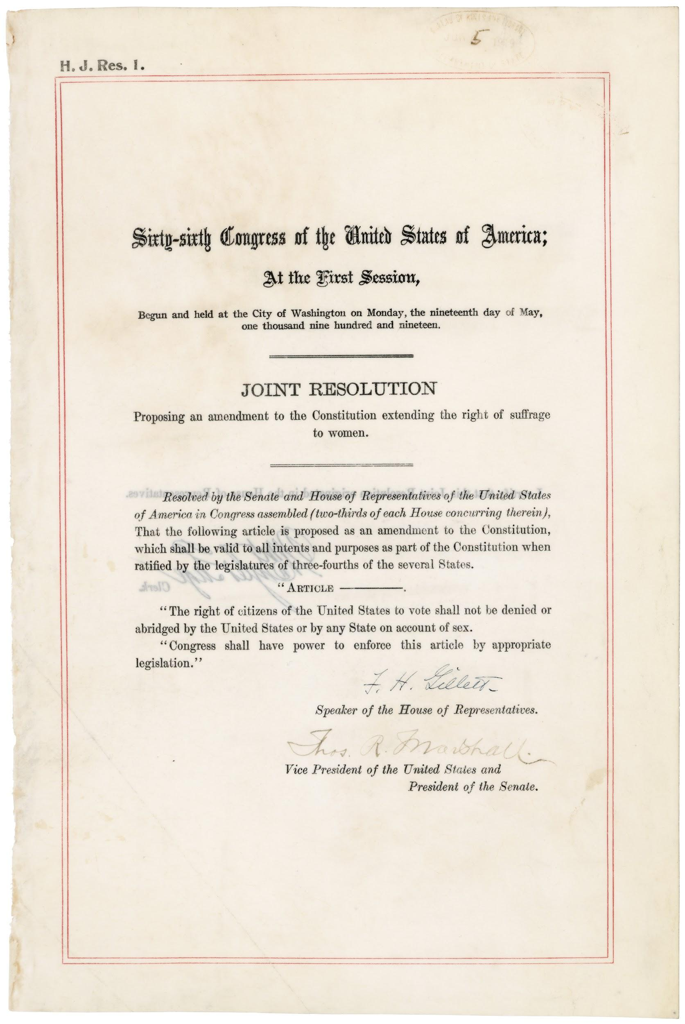
“The right of citizens of the United States to vote shall not be denied or abridged by the United States or by any State on account of sex. Congress shall have power to enforce this article by appropriate legislation.”
Notes:
Courtesy of Library of Congress.

Slide 18
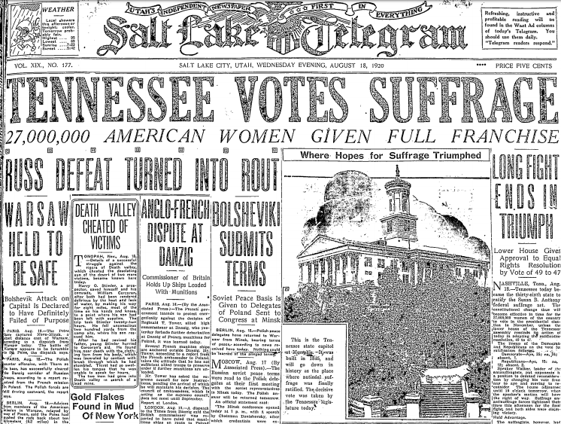
Notes:
Ratification of 19th Amendment in Utah newspaper.

Slide 19
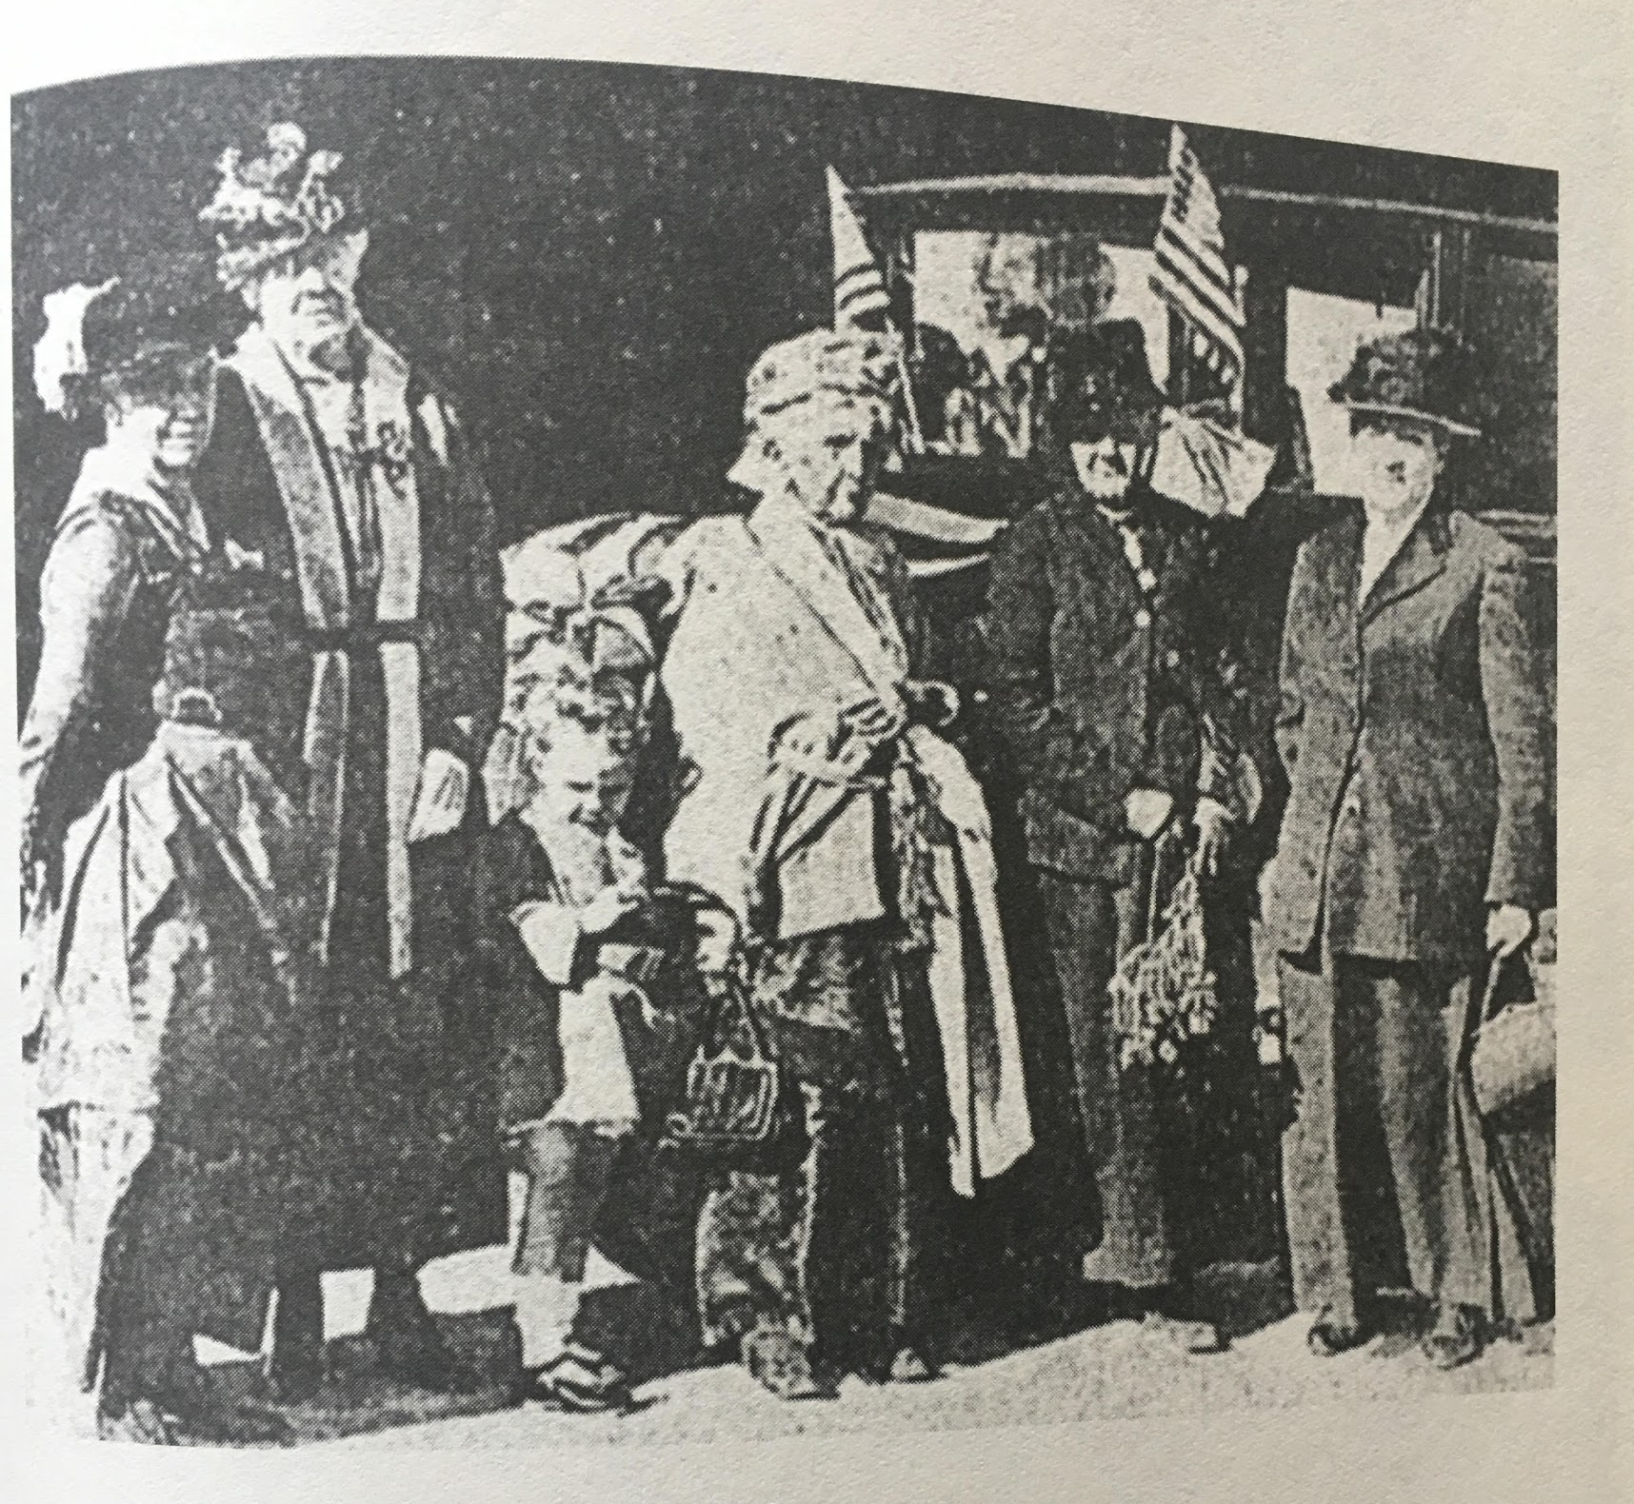
Utah women celebrate the ratification of the 19th Amendment. Emmeline B. Wells in center. From The Salt Lake Tribune.

Slide 20
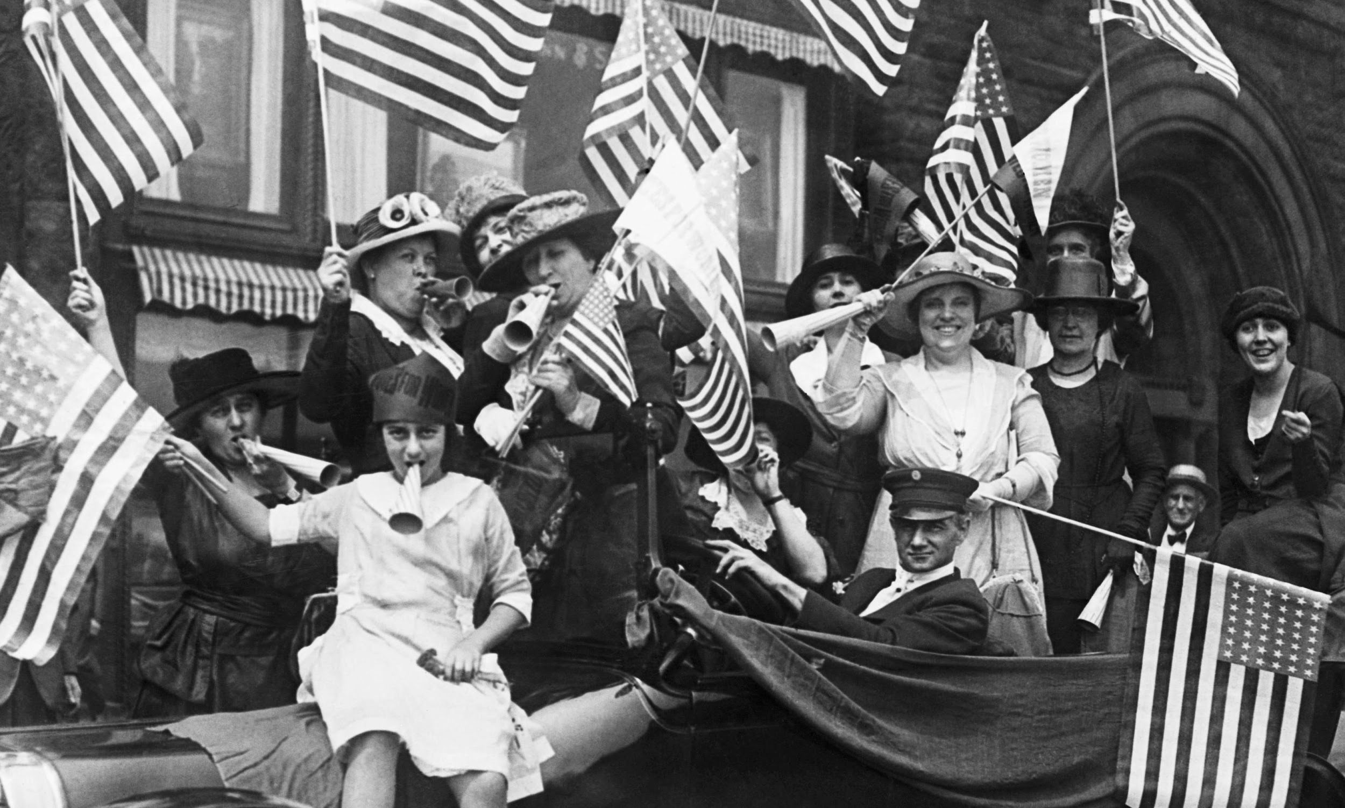
Notes:
Celebrating the 19th Amendment. Courtesy of Library of Congress.

Slide 21
BUT...
American Indians were denied full citizenship and voting rights until Congress passed the Indian Citizenship Act in 1924.
Many Asian immigrants were legally prohibited from becoming citizens (with voting rights) until the passing of McCarran–Walter Act of 1952.
Native Americans in Utah could not vote in state elections until 1956--one of the last state to grant these rights.
Legal barriers put in place by some states made it practically impossible for African Americans to vote until Congress passed the Voting Rights Act of 1965.

