Slide 1
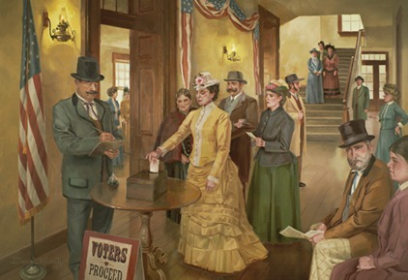
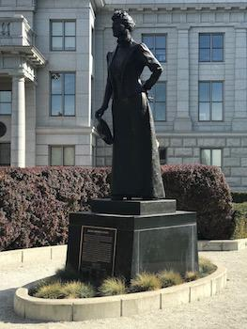
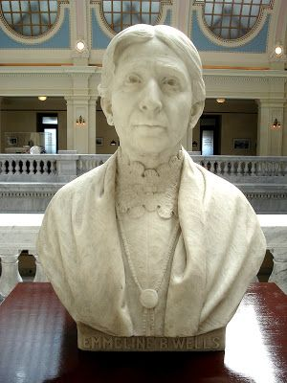
Dr. Martha Hughes Cannon
Mural of Utah women voting on February 14, 1870
Utah Memorials
to Utah Suffragists at the Utah State Capitol
Emmeline B. Wells
This work is licensed under a Creative Commons Attribution 4.0 International License, Better Days 2020

Slide 2
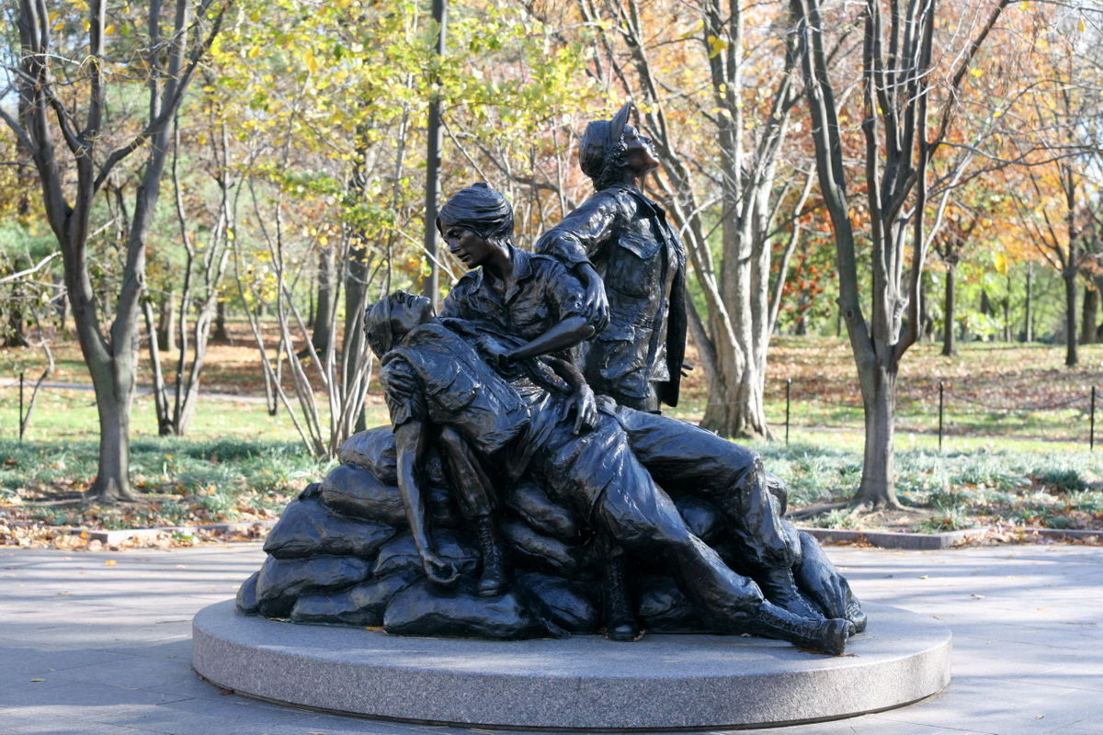
Vietnam Women’s Memorial on the National Mall in Washington, D.C.

Slide 3
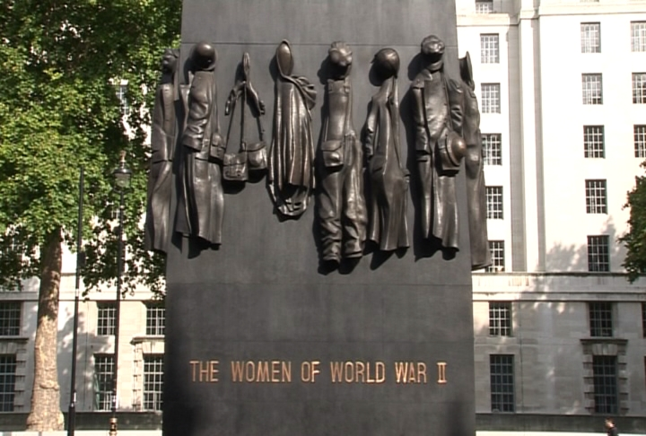
Monument to the Women of World War II
in London, United Kingdom

Slide 4
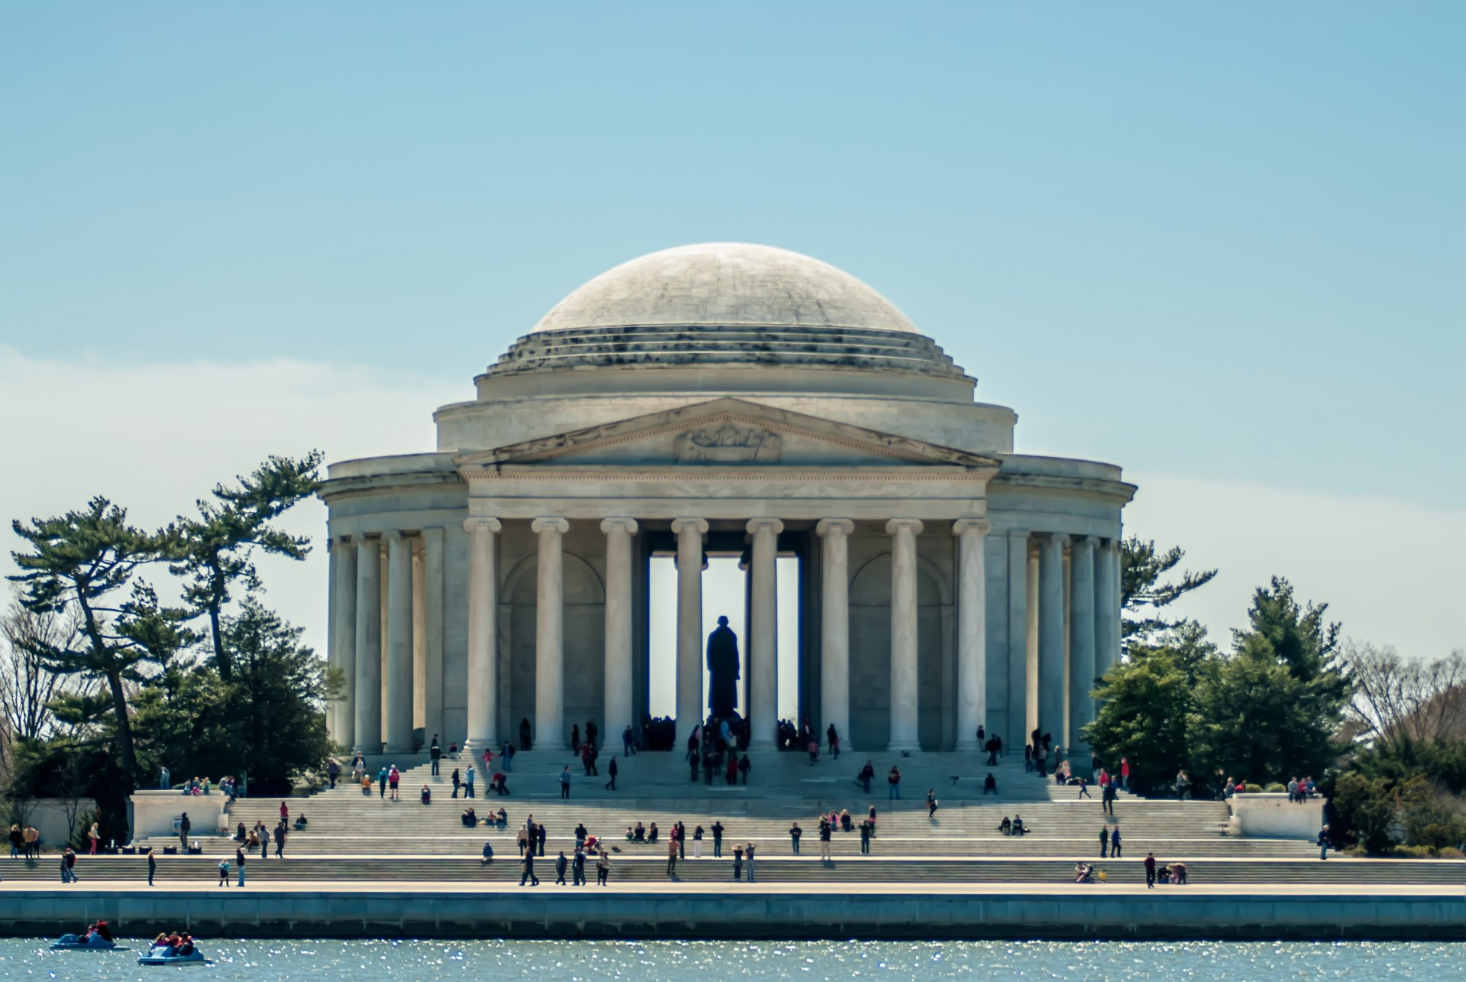
Jefferson Memorial in Washington, D.C.

Slide 5
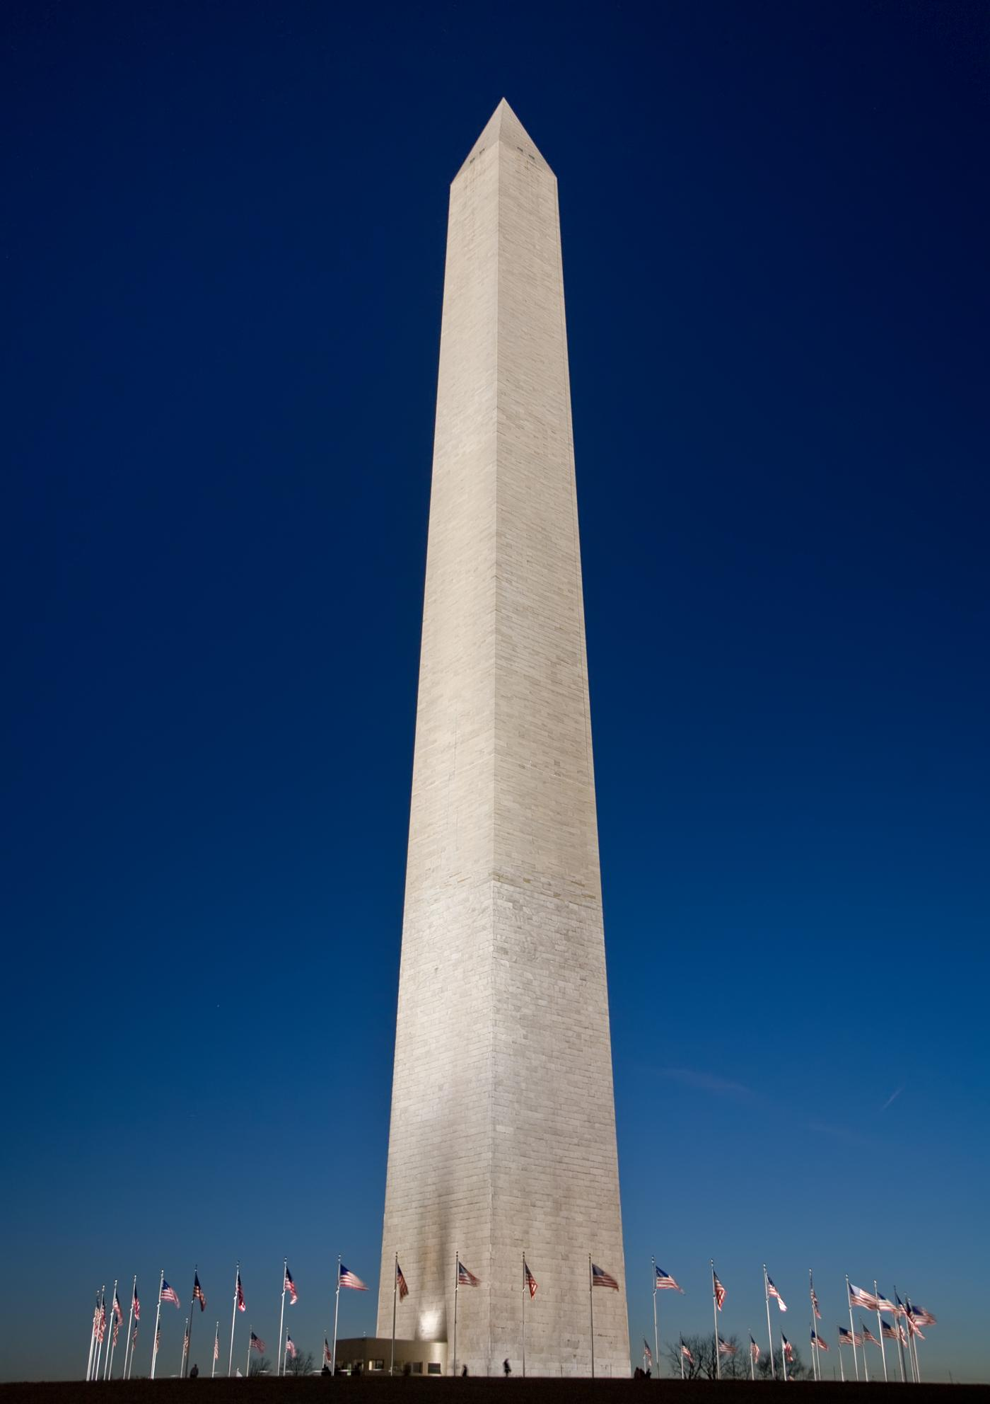
Washington Monument
in Washington, D.C.

Slide 6
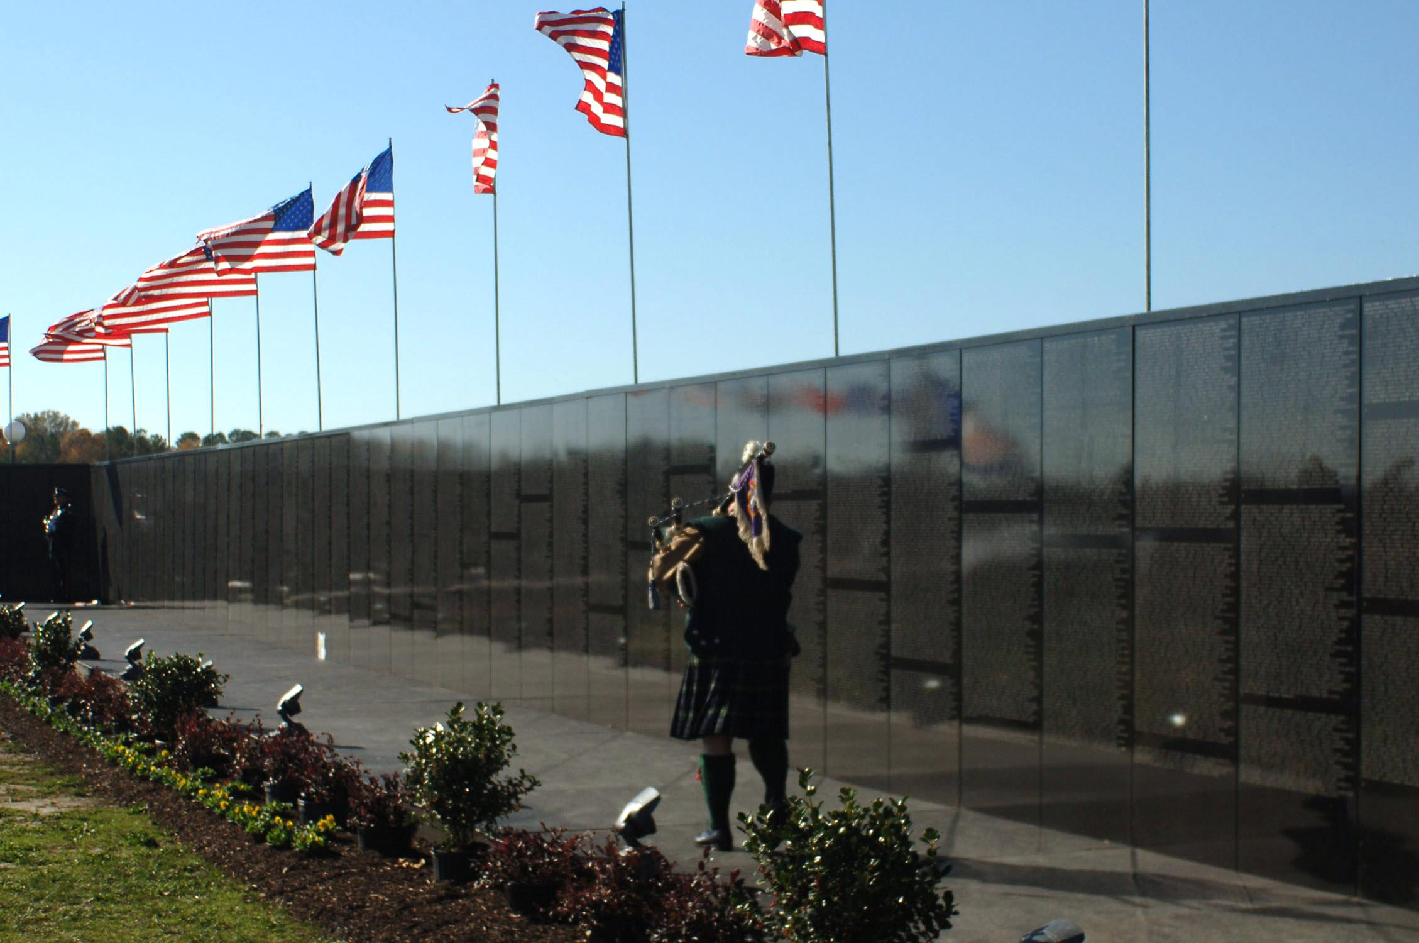
Vietnam War Memorial in Washington, D.C.

Slide 7
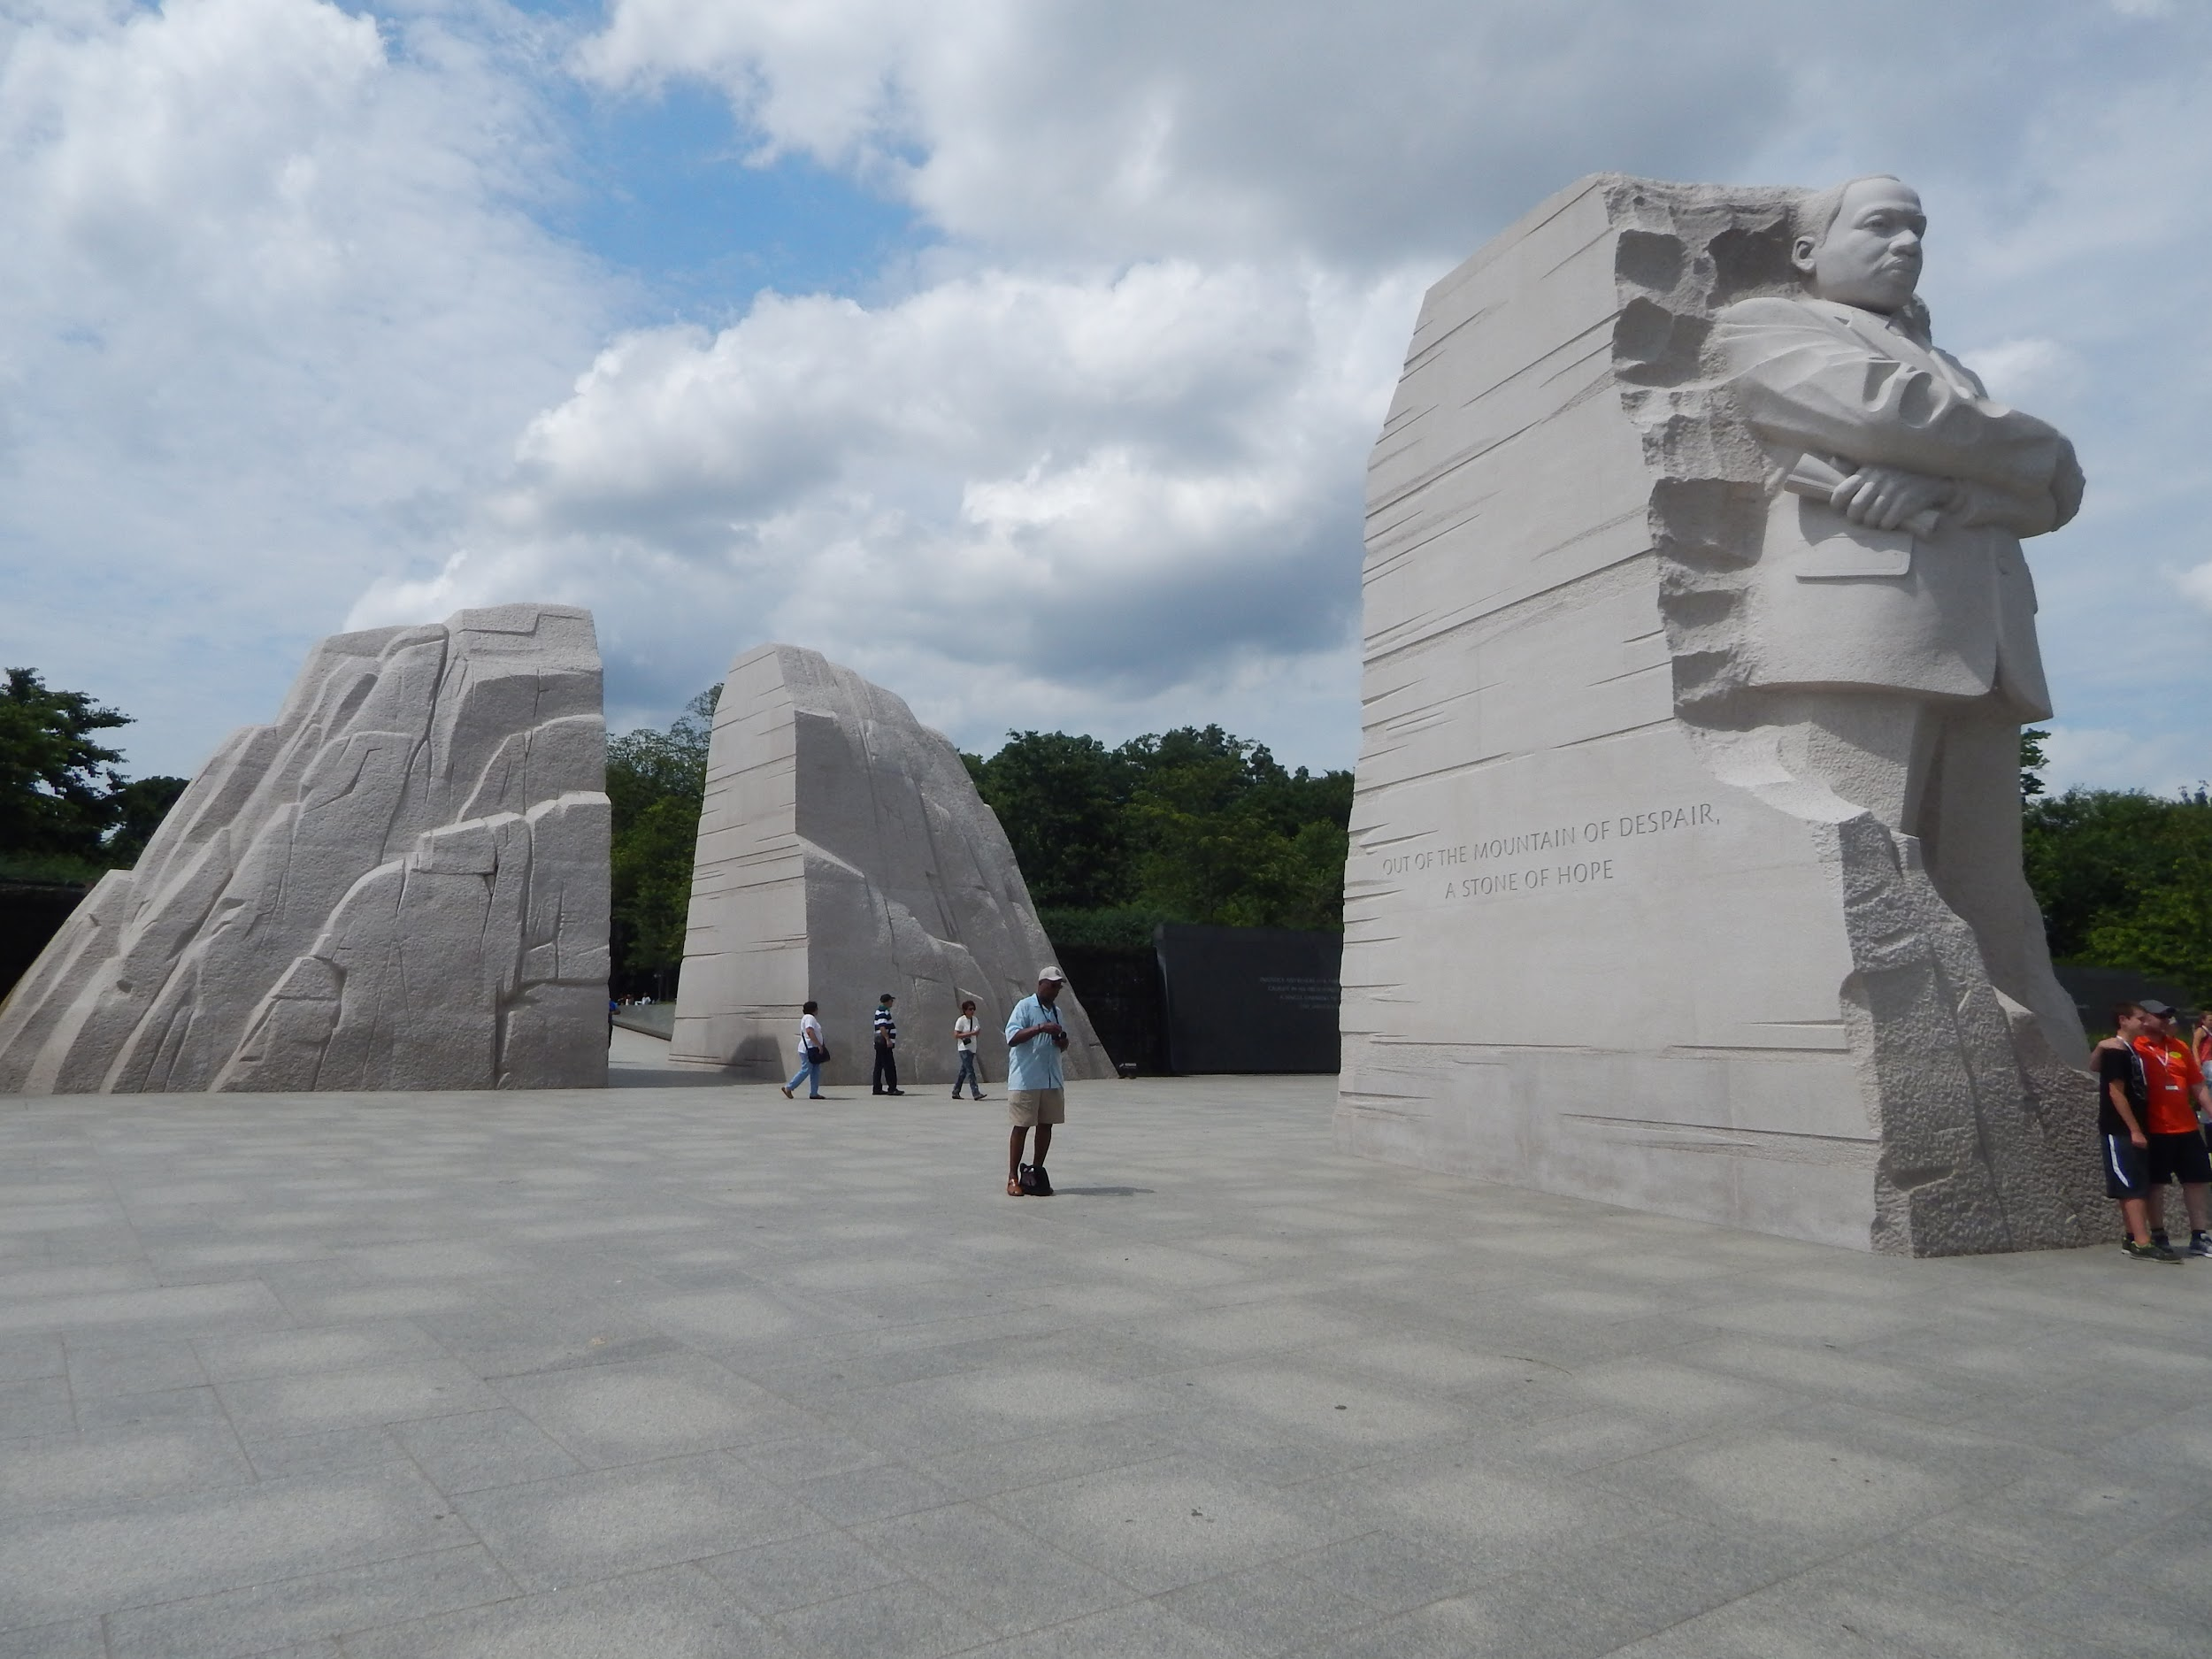
Martin Luther King, Jr. Memorial in Washington, D.C.

