Slide 1
Political Cartoons

Slide 2
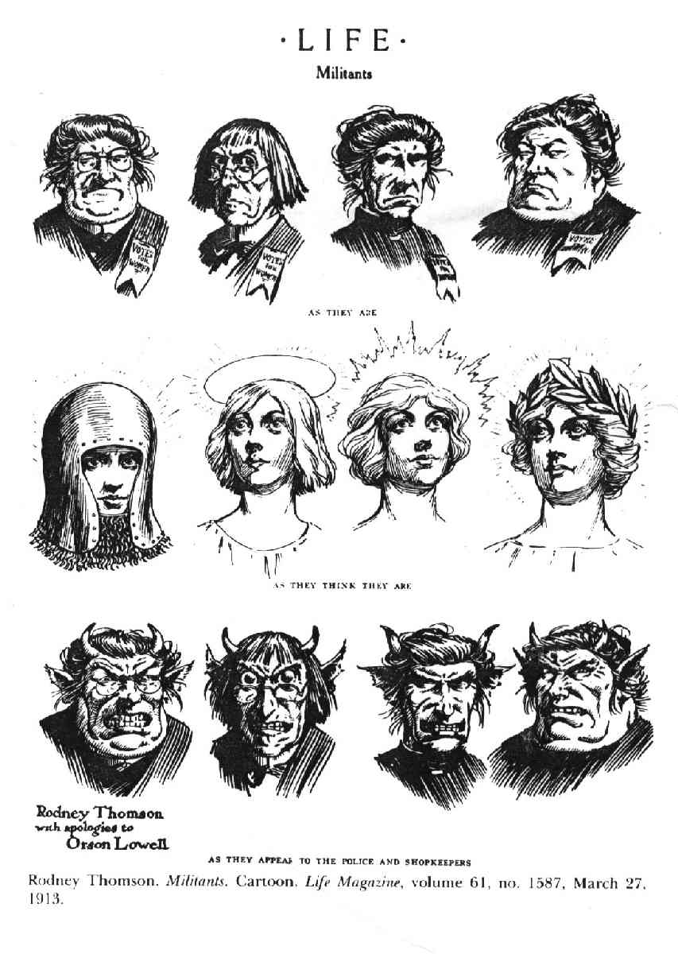
Notes:
Rodney Thomson, “Militants,” (1913)
Captions: “As they are”
“As they think they are”
“As they appear to the police and shopkeepers”

Slide 3
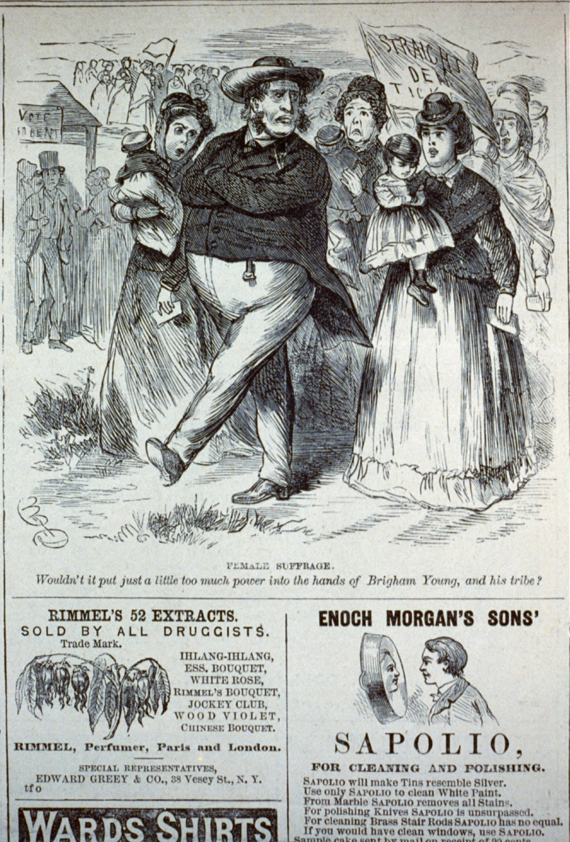
Notes:
Artist unknown, “Female Suffrage,” Frank Leslie’s Illustrated Newspaper, front cover, 1869
Caption: “Wouldn’t it put just a little too much power into the hands of Brigham Young, and his tribe?”

Slide 4
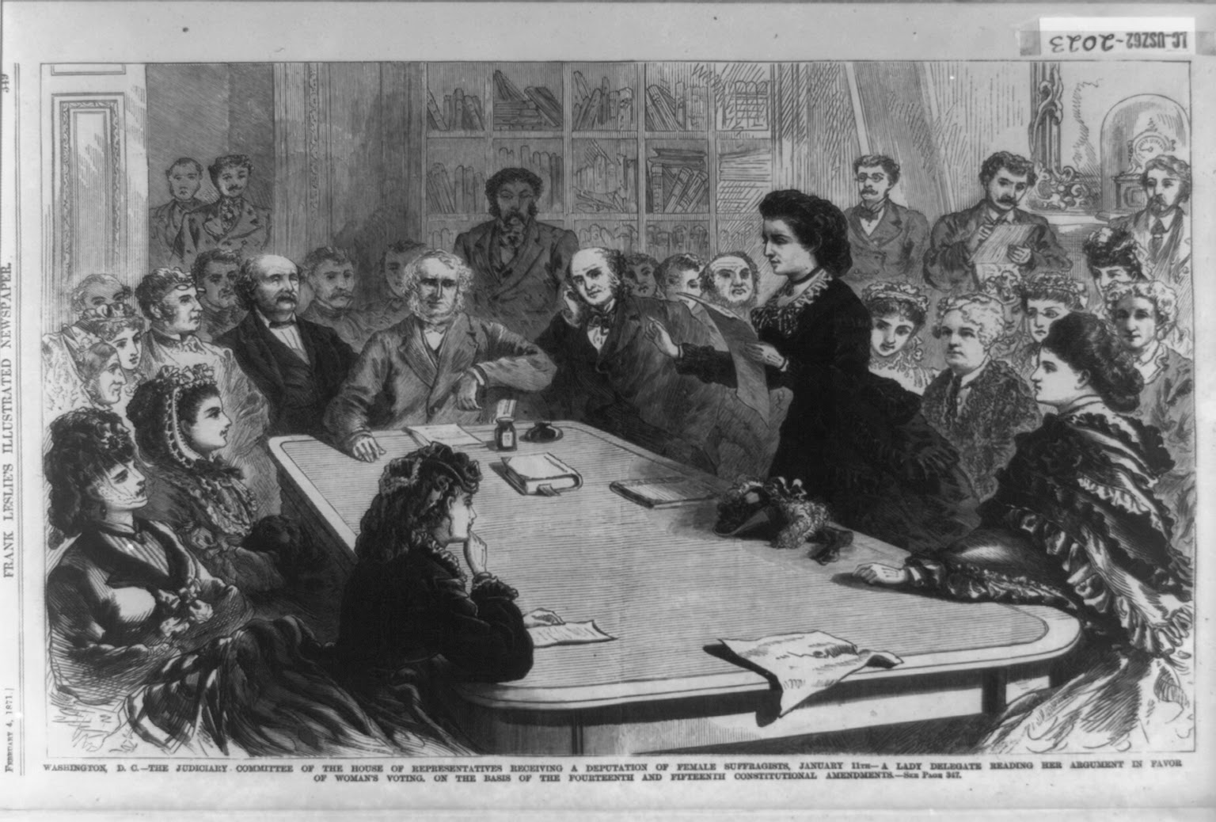
Notes:
Frank Leslie’s Illustrated Newspaper, 1871
Caption: “Washington, D.C.--The Judiciary Committee of the House of Representatives receiving a deputation of female suffragists, January 21--A lady delegate reading her account of favor of woman’s voting, on the basis of the fourteenth and fifteenth Constitutional amendments”

Slide 5
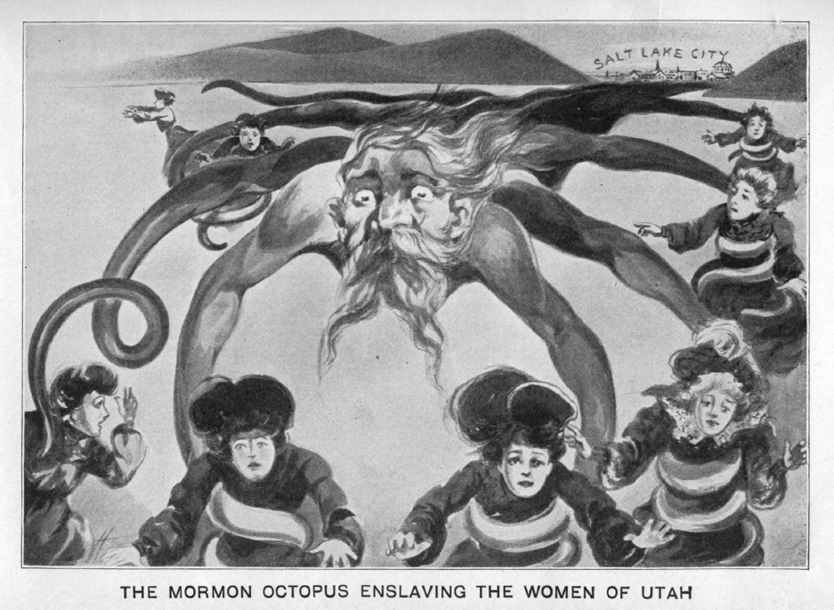
Notes:
Ovando James Hollister, “The Mormon Octopus Enslaving the Women of Utah,” J. H. Beadle, Polygamy; or, the Mysteries and Crimes of Mormonism,” 1882

Slide 6
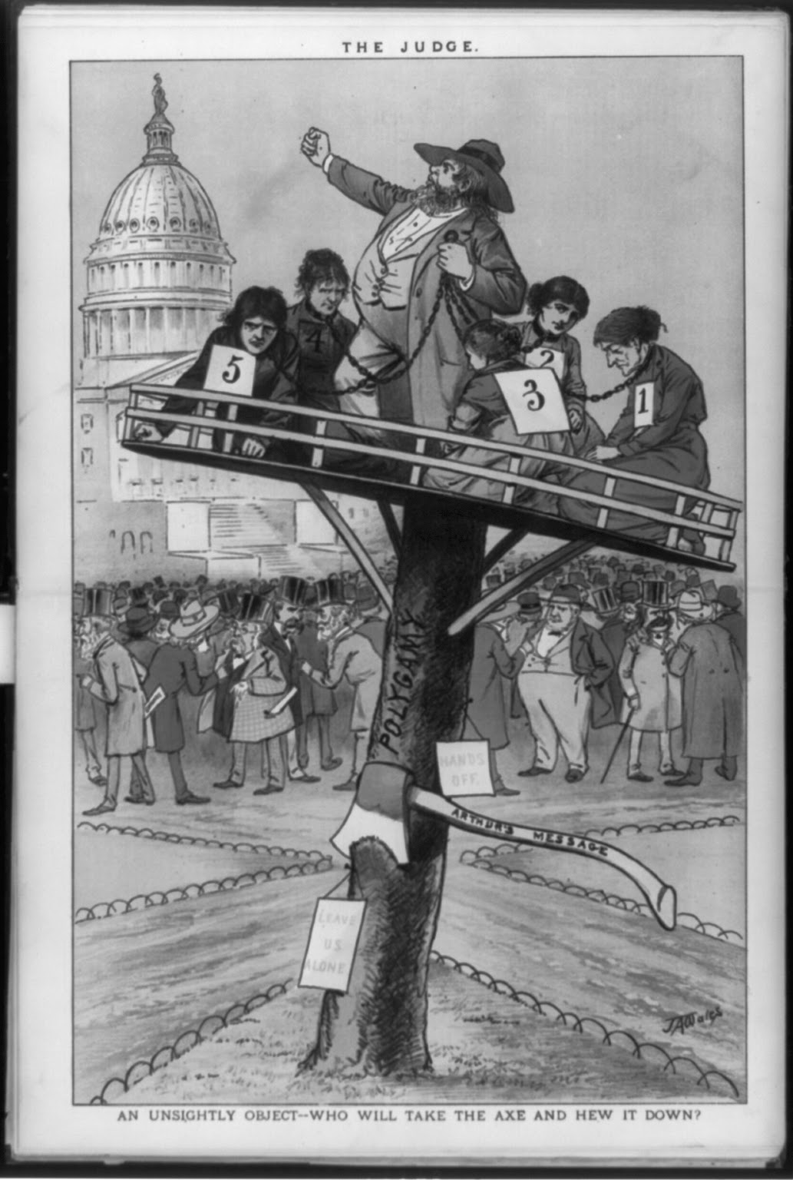
Notes:
Artist unknown, “An Unsightly Object—Who Will Take the Axe and Hew It Down?”, The Judge, 1882

Slide 7
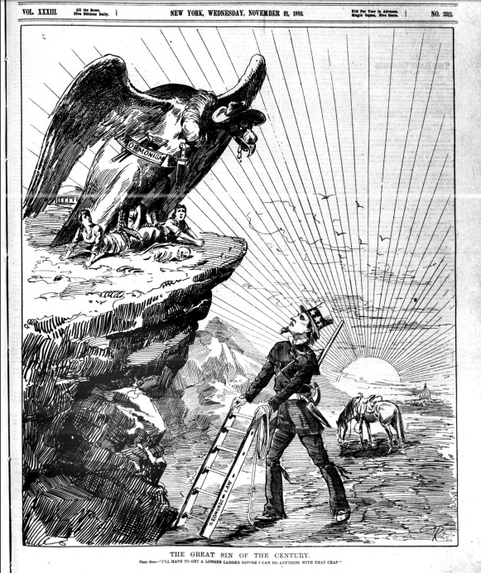
Notes:
Artist unknown, “Great Sin of the Century,” Daily Graphic, 1883
Caption: “Uncle Sam: I’ll have to get a longer ladder before I can do anything with that chap.”

Slide 8
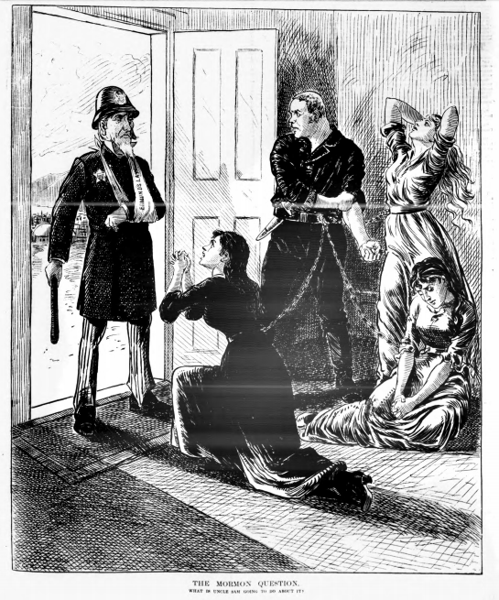
Notes:
Artist unknown, “The Mormon Question. What is Uncle Sam Going to Do About It?” Daily Graphic, 1883.
Caption: “The Mormon Question: What is Uncle Sam Going to Do About It?”

Slide 9
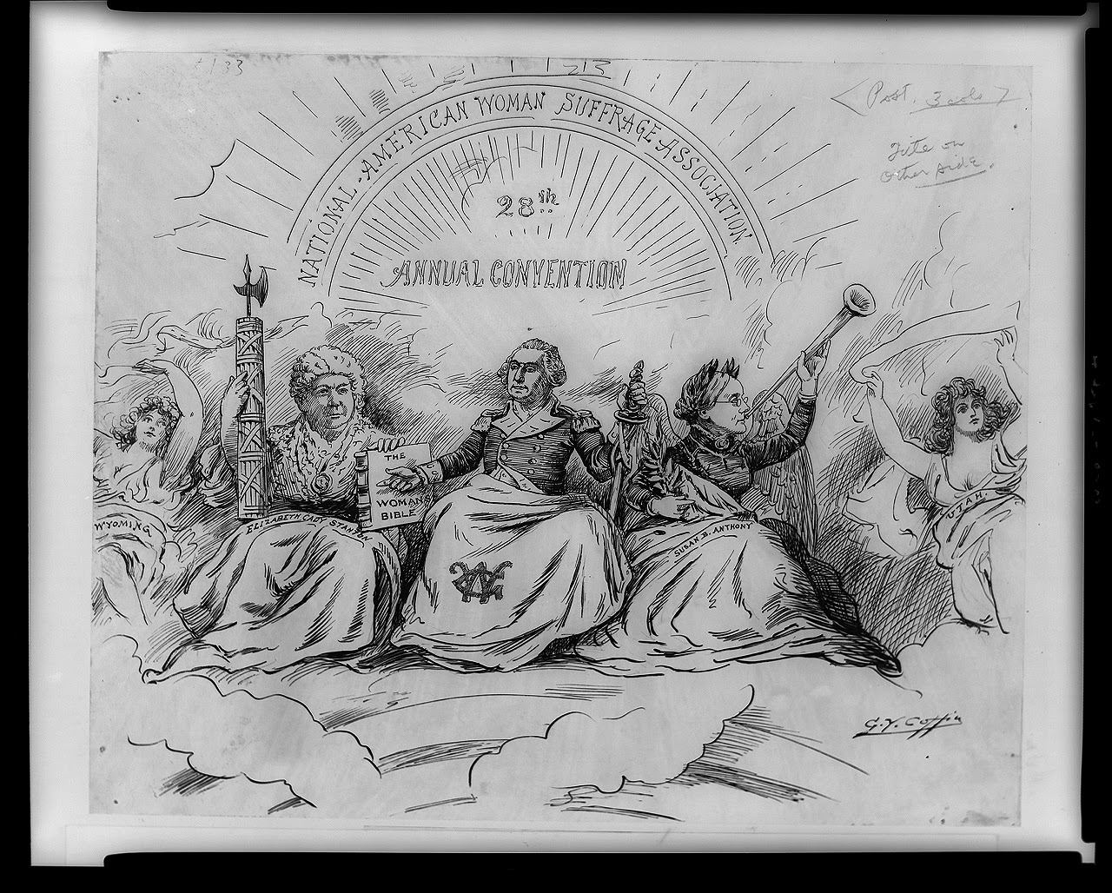
Notes:
George Coffin, “The Apotheosis of Liberty,” Washington Post, 1896

Slide 10
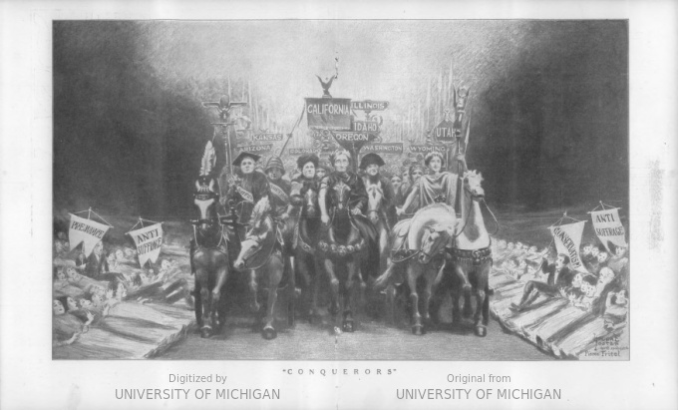
Notes:
Woman’s Journal, front cover, 1912
“Conquerors”

Slide 11
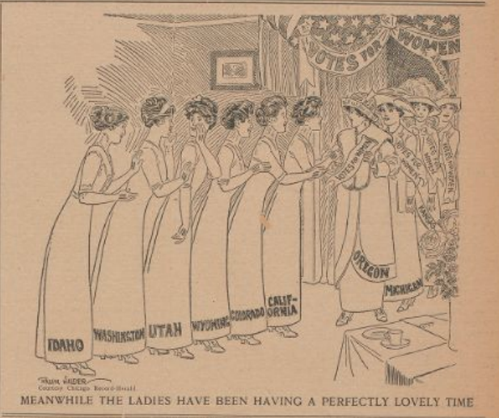
Notes:
Judge, front cover, 1913
Caption: “Meanwhile the ladies have been having a perfectly lovely time”

