Slide 1
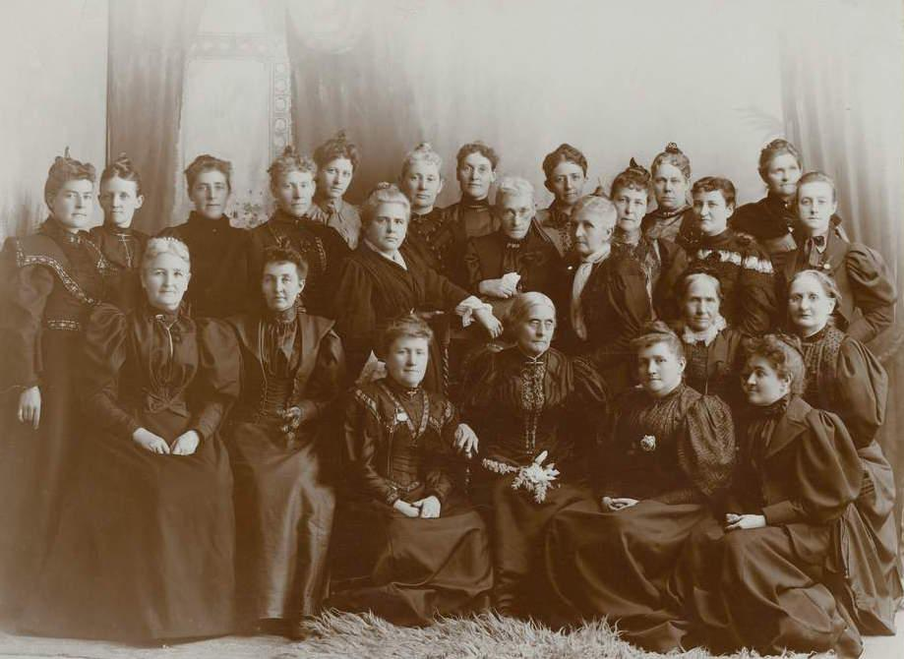
Receiving, Losing, and Winning Back the Vote
The Story of Women’s Suffrage in Utah

Slide 2
Key
Vocabulary

Slide 3
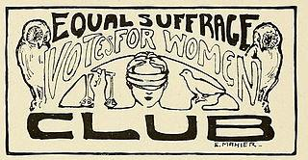
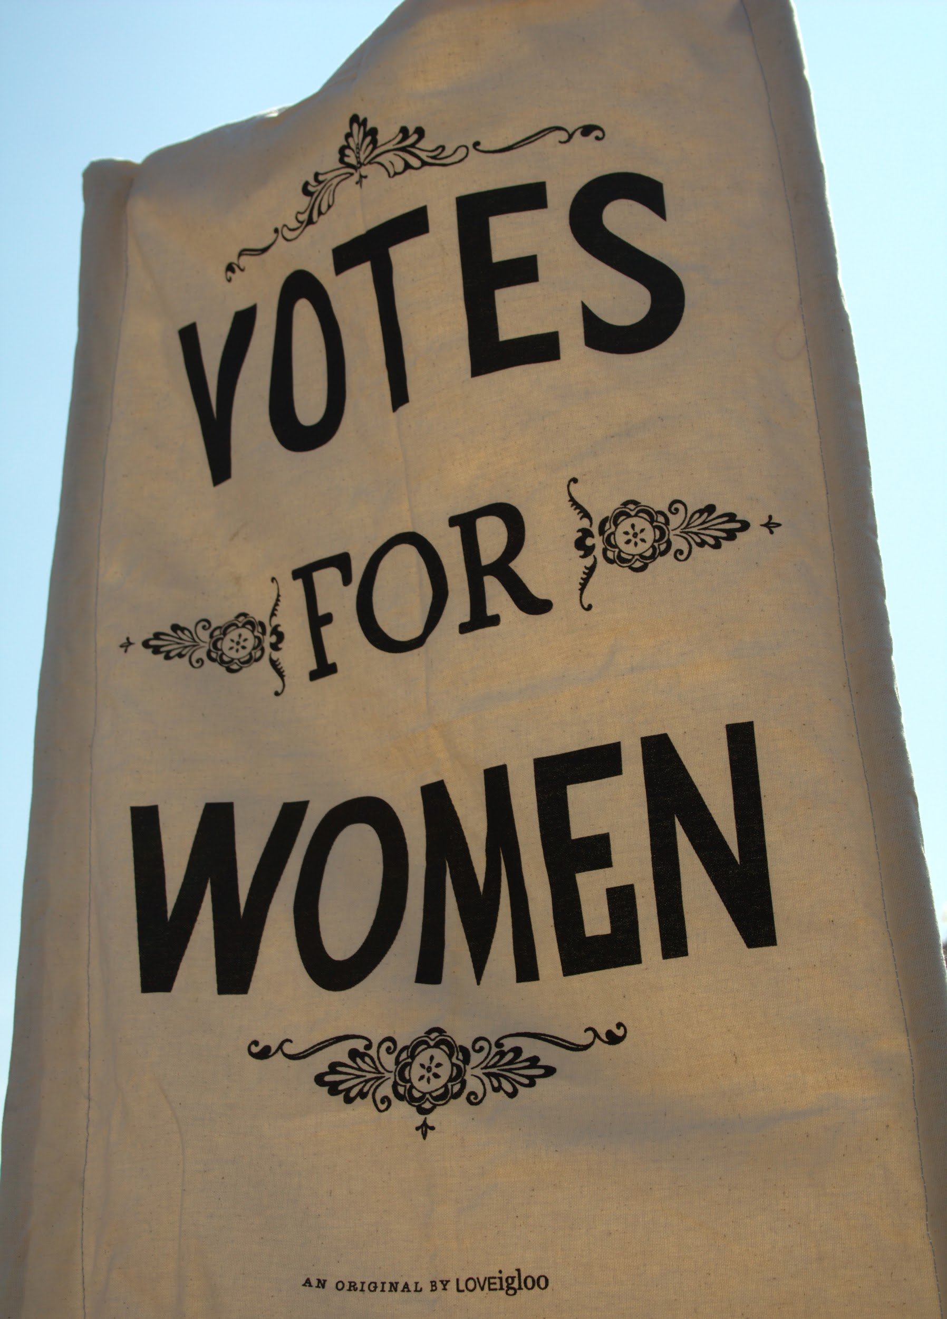
Suffrage
Definition: the right to vote in a political election
During the women’s suffrage movement, women fought for and won the right to vote in political elections.

Slide 4
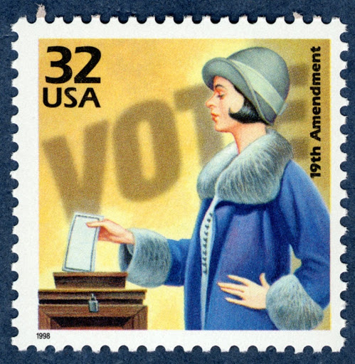
Franchise
(noun) the right to vote
(a synonym of suffrage, a more formal word choice)
The 19th Amendment granted the franchise to women. Also, The franchisement was granted to women by the 19th Amendment.
(verb) to give the right to vote
The 19th Amendment franchised women.

Slide 5
Pay attention to prefixes! They change word meanings.
Enfranchisement: to give someone the right to vote
“En” = to give something
Emmeline B. Wells was a Utah leader involved in enfranchisement of women.
Disfranchisement: to take away someone’s right to vote
“Dis” = the opposite of something
The Edmunds-Tucker Act caused the disfranchisement of Utah women.
Re-enfranchisement: to give back someone’s right to vote
“Re” = to do again
The re-enfranchisement of Utah women occurred when Utah attained statehood.

Slide 6
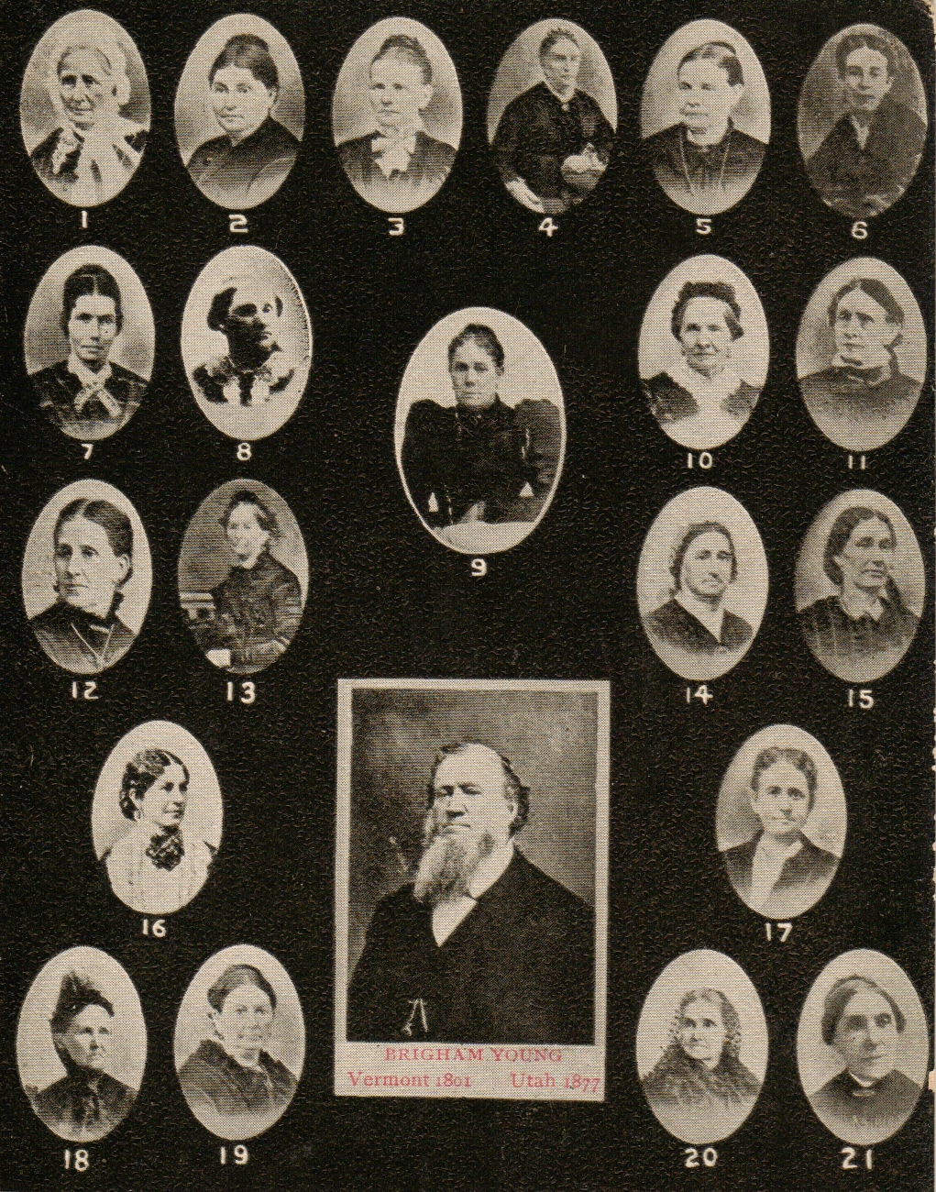
Polygamy
Definition: A marriage system in which a person is married to more than one living person at a time.
“poly” = many
The Church of Jesus Christ of Latter-day Saints practiced polygamy, in which some husbands had more than one living wife. Mormons called it “plural marriage” and considered it a religious principle. The church officially ended the practice in 1890.
LDS Church President Brigham Young had multiple wives. He was a polygamist, a person who practices polygamy.

Slide 7
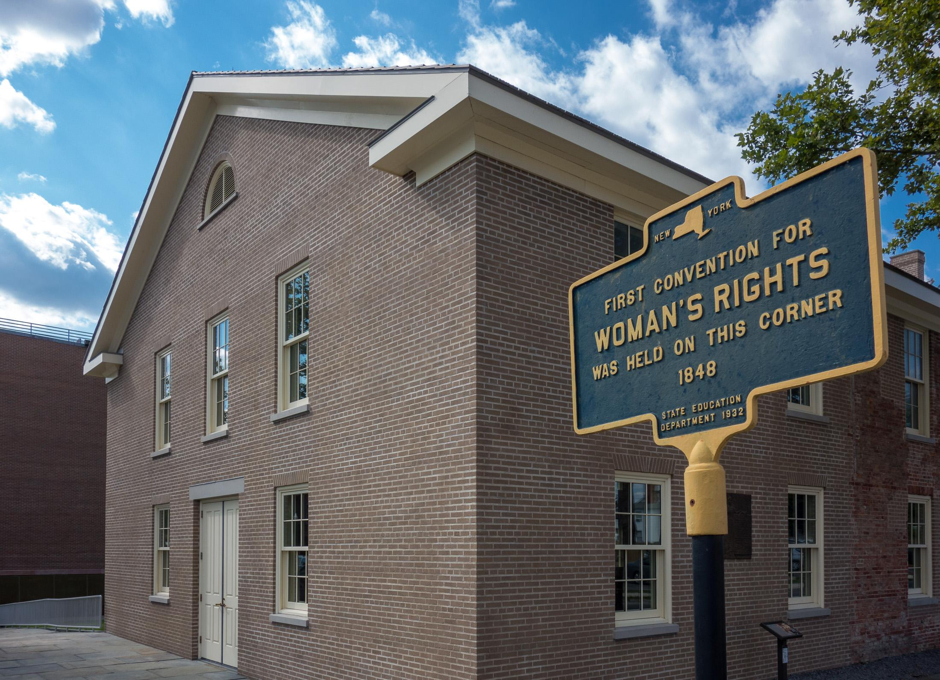
Beginnings of Women’s Rights Movement
“All women and men are created equal!”
Abolitionists turned their attention to women’s rights after the passage of the 14th Amendment
First Women’s Rights Convention
  Held in Seneca Falls, New York
  July 19-20, 1848
  Led by Elizabeth Cady Stanton and Lucretia Mott
  Created the Declaration of Sentiments

Slide 8
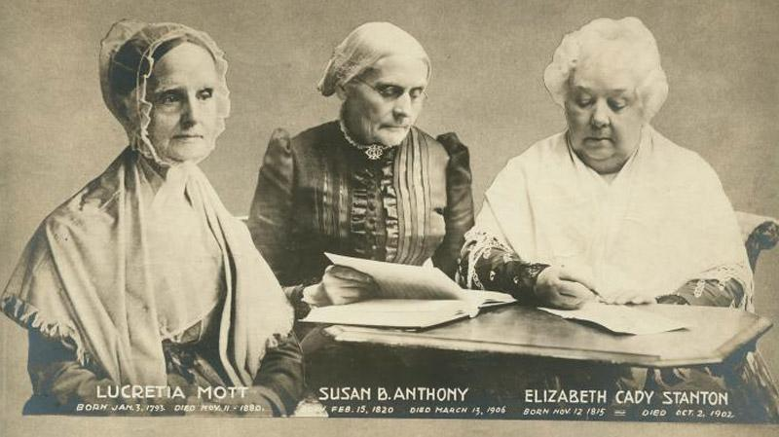
Notes:
Leaders of the national suffrage movement

Slide 9
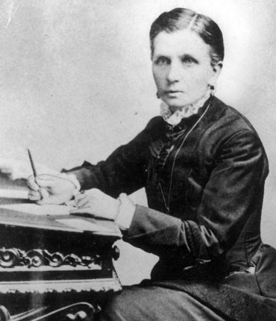
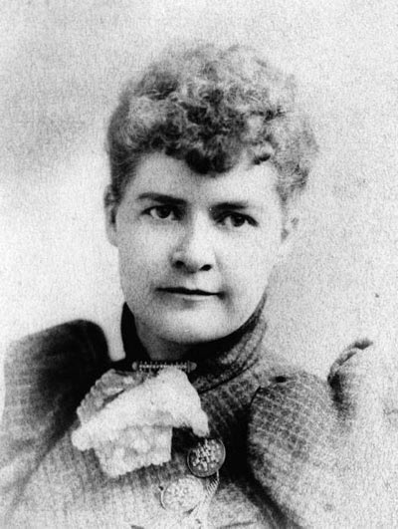
Utah was a Leader in the Women’s Suffrage Movement
Utah women were the first to vote in the modern nation
Utah suffragist Emmeline B. Wells met four U.S. presidents in her advocacy work for Utah women
Utah elected the first female state senator in the nation
(Dr. Martha Hughes Cannon)

Slide 10
Enfranchisement:
Getting the Vote
1870

Slide 11
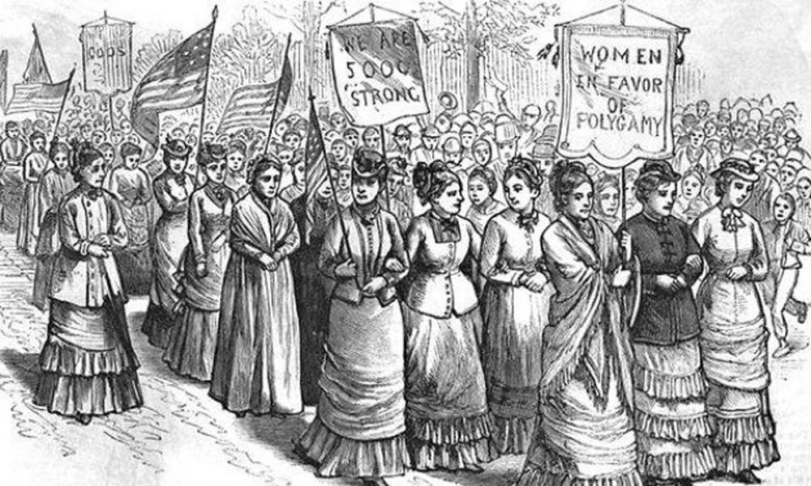
Polygamy’s Role
Anti-Polygamists: “Polygamy enslaves women, so if we give women the vote, it will empower them. They will vote against polygamy!”
Utah Legislature: “Sure, let’s given women the vote. They are already empowered.”

Slide 12
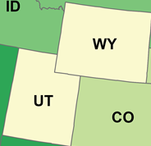
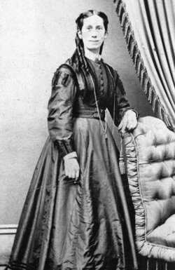
Wyoming was the 1st to grant women’s suffrage (Dec 1869)
Utah was the 2nd (Feb 12, 1870)
BUT
Utah held an election before Wyoming, so…
Utah women were the first to vote
(on February 14, 1870)
Charlotte Cobb Godbe Kirby was one of the first in Utah to speak in favor of women’s suffrage, as early as 1869
Notes:
Wyoming passed a law allowing women in that territory to vote only two months before Utah passed a similar law (1870). But elections were held in Utah sooner. So, Utah became the first place in the nation to see women voting.

Slide 13
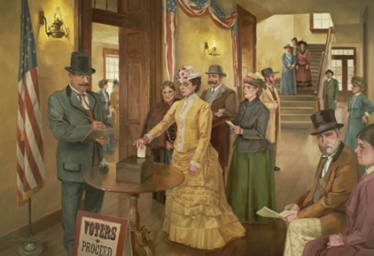
Notes:
Seraph Young, a school teacher, and other Utah women became the first women in the U.S. to vote! They voted in a municipal (local) election in Salt Lake City on February 14, 1870.

Slide 14
Disfranchisement:
Losing the Vote
1887

Slide 15
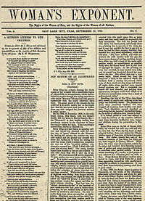
Utah Women Became Politically Involved
The LDS Church’s Relief Society organization started educating women about government and community life
For 40 years, Emmeline B. Wells edited and wrote for the Woman’s Exponent, a pro-suffrage newspaper
BUT...
Utah women did not use their new political power to end polygamy

Slide 16
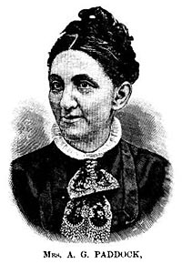
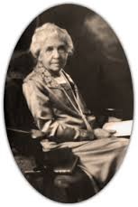
Non-Mormon suffragists were divided over the issue of Utah women’s suffrage
Many supported the principle of suffrage for all women but held that granting the vote to Utah women strengthened the political power of the LDS Church and perpetuated the practice of polygamy
Cornelia Paddock joined other anti-polygamy Utah women in petitioning Congress to abolish the women’s vote in Utah.
Jenny Froiseth, the editor of Utah’s Anti-Polygamy Standard, did not support the removal of Utah women’s suffrage but joined other anti-polygamy women in lobbying to exclude Mormon women from national suffrage organizations.

Slide 17
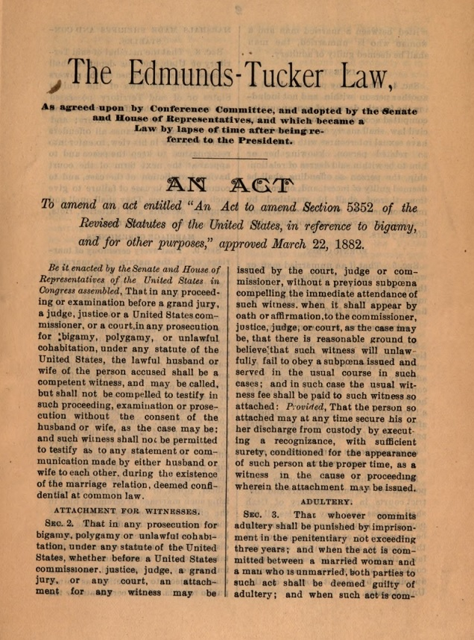
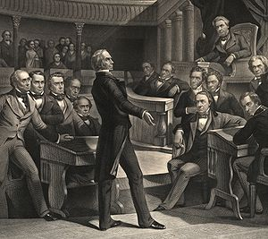
So Congress passed laws to make polygamy illegal
AND took away Utah women’s (and polygamist men’s) voting rights with the Edmunds-Tucker Act in 1887

Slide 18
Re-enfranchisement:
Gaining Back the Vote
1896

Slide 19
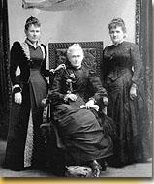
Utah Women Were Angry to Lose the Vote
They had voted for 17 years
Created the Utah Woman Suffrage Association in 1889
  An affiliate of the National Woman Suffrage Association run by Susan B. Anthony
  Founded chapters throughout Utah
Worked with national suffrage leaders
Wrote letters and articles; gave speeches
(L to R) Emily S. Richards, Phoebe Beattie, and Sarah Granger Kimball
Notes:
In photo from L to R: Emily S. Richards (co-organized the Utah Woman Suffrage Association, created local suffrage associations, and was a featured speaker at national and international suffrage conventions), Phoebe Beattie (delegate to the International Council of Women which was held at Washington, D. C. in 1891 and good friends with Susan B. Anthony), and Sarah Granger Kimball (first president of Utah Suffrage Association)

Slide 20
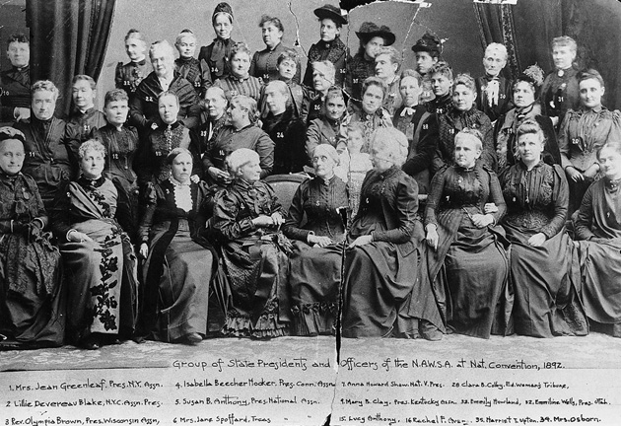
Utah’s Emmeline B. Wells
Group of State Presidents & Officers of the National American Woman Suffrage Association, 1892
Source: Bryn Mawr College Library Special Collections

Slide 21
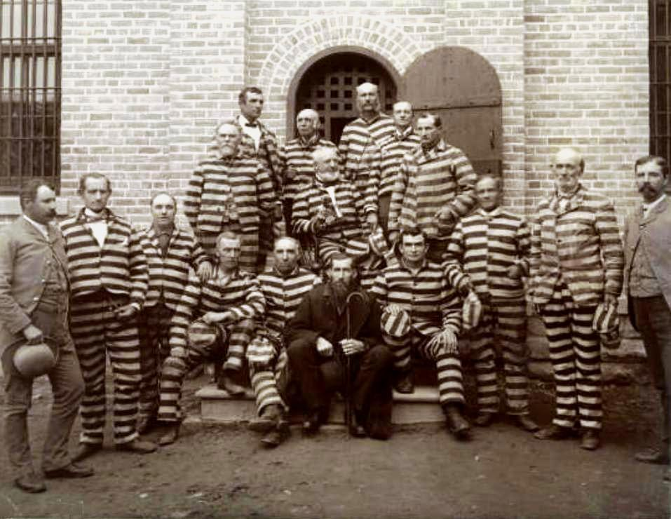
End of Polygamy
Manifesto by LDS Church leader, Wilford Woodruff, in 1890 called for no new plural marriages
Utah Territory sought statehood once again
Mormon polygamists in prison, at the Utah Penitentiary, 1889. Source: Harold B. Lee Library

Slide 22
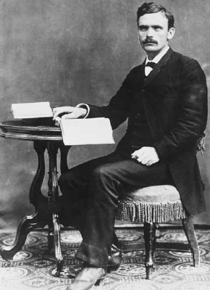
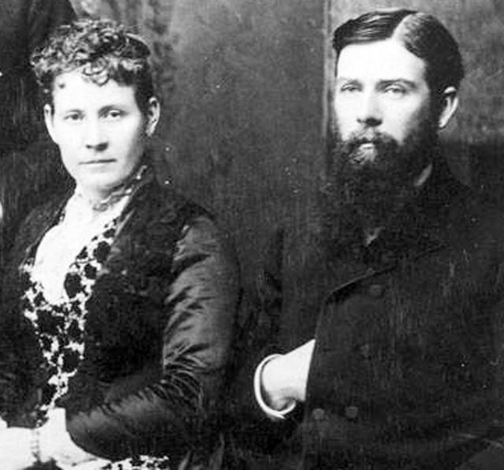
Utah State Constitutional Convention, 1895
Debate about whether to include women’s suffrage in proposed state constitution lasted 2 weeks
Opponents were afraid the constitution would not be approved
Most delegates (and Utahns) supported its inclusion
Emily S. and Franklin S. Richards
B. H. Roberts
Notes:
B. H. Roberts was the most vocal opponent to including women’s suffrage in the Utah State Constitution. He was a constitutional delegate from Bountiful. Franklin S. Richards was also a delegate and the most vocal advocate for including suffrage in the Utah State Constitution. Both he and his wife, Emily, were highly involved and influential suffragists.

Slide 23
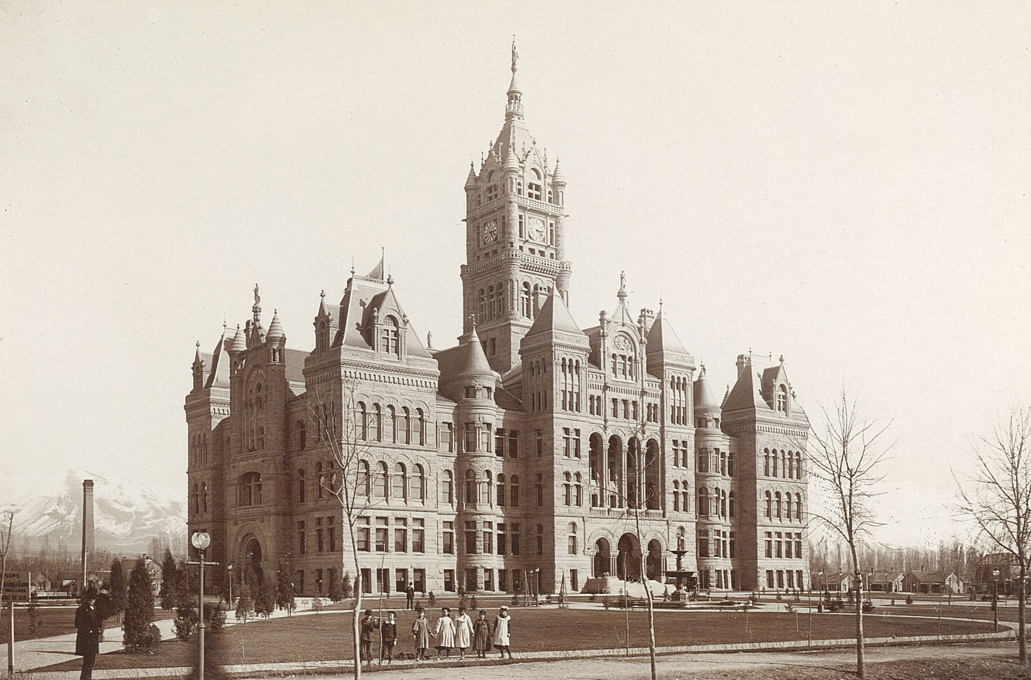
City and County Building:
Site of the Utah State Constitutional Convention

Slide 24
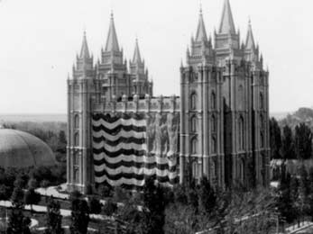
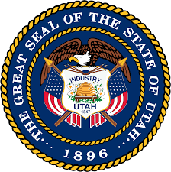
Statehood Granted WITH SUFFRAGE!
Utah voters, all of them male, then voted overwhelmingly to approve the proposed constitution
Utah women were given back the vote, or refranchised, in 1896, after Congress accepted Utah’s constitution and granted statehood

Slide 25
Utah Women
and the
National Suffrage Movement
1896 and Beyond

Slide 26
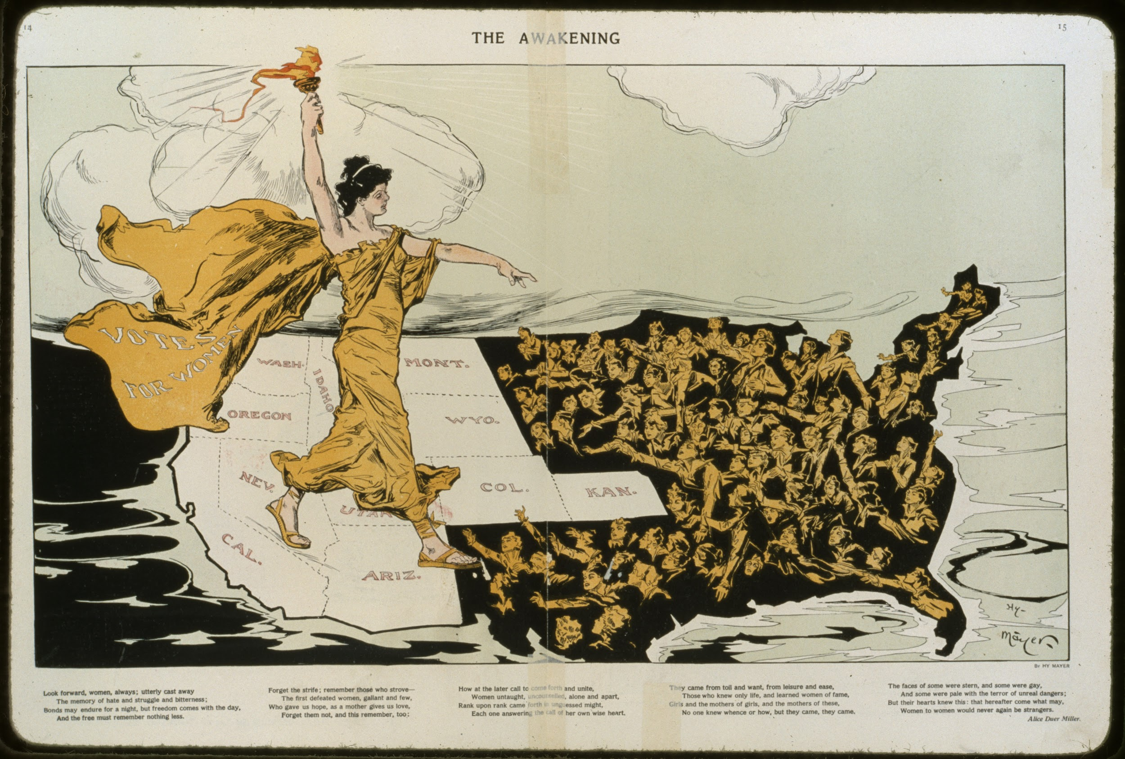
Notes:
Suffrage moved from West to East with Wyoming and Utah leading the way

Slide 27
Assisted with the National Suffrage Movement
Continued to work with national suffrage organizations
Helped to fund and served as leaders of these organizations
Attended and spoke at national and international women’s rights conventions
Utah and other Western Suffragists with Susan B. Anthony (center)

Slide 28
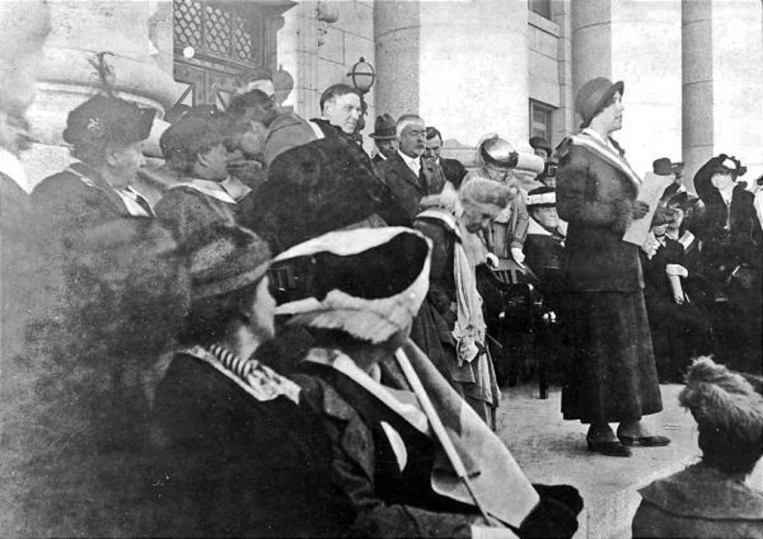
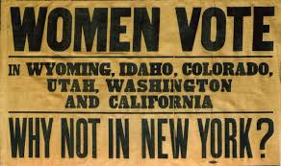
Sarah Bard Field addresses women on the steps of the Utah State Capitol during a national suffrage campaign on Oct. 4, 1915. Emmeline B. Wells stands behind Field.
Image courtesy of Utah State Historical Society

Slide 29
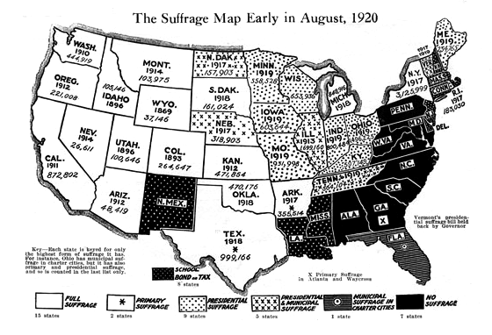

Slide 30
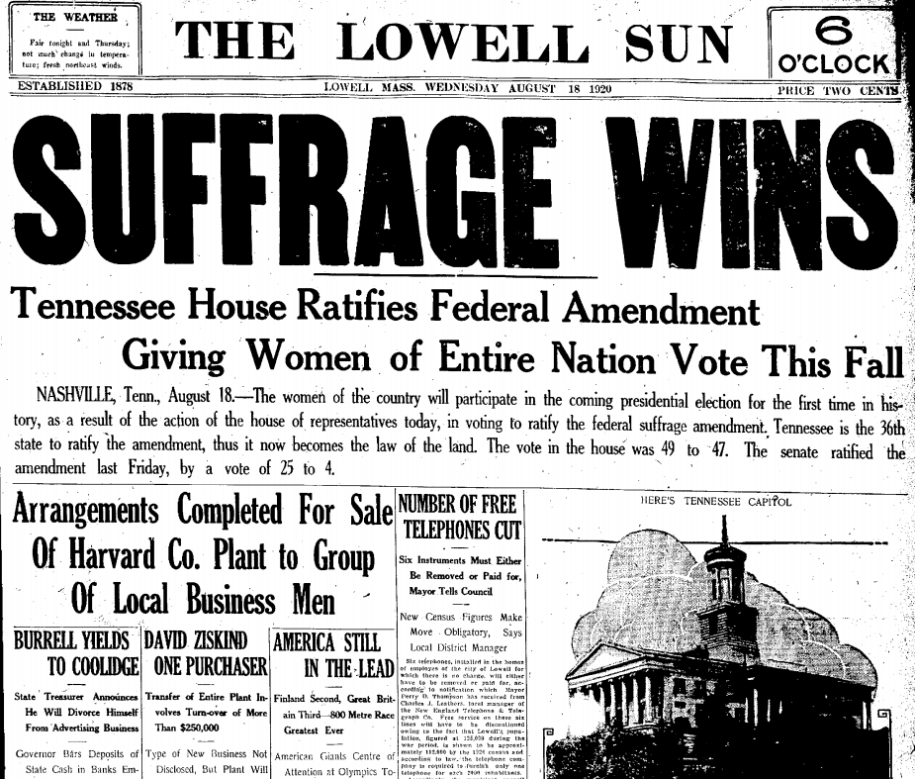
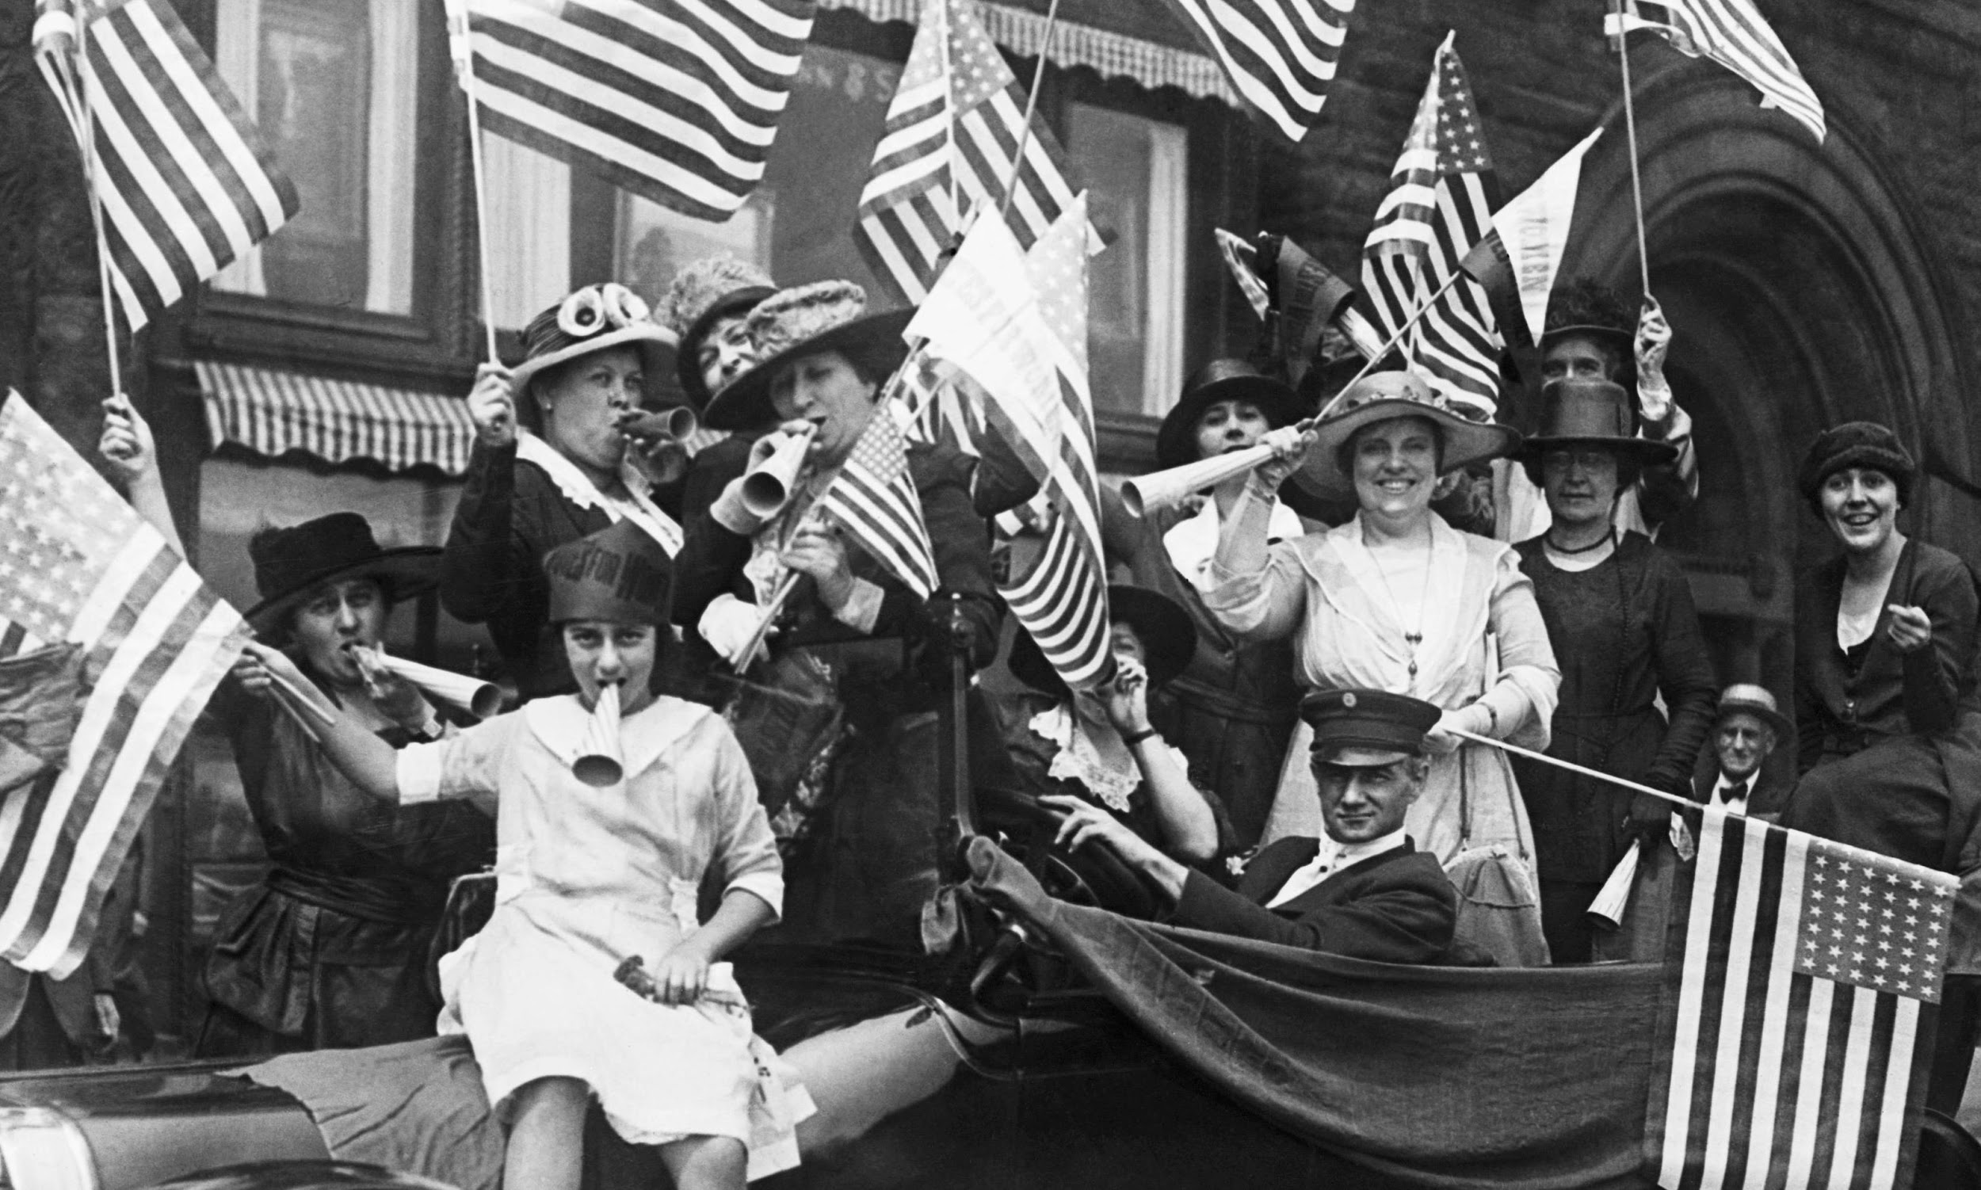
19th Amendment Ratified on August 18, 1920!
“The right of citizens of the United States to vote shall not be denied or abridged by the United States or by any state on account of sex.”

Slide 31
BUT...
American Indians were denied full citizenship and voting rights until Congress passed the Indian Citizenship Act in 1924.
American Indians in Utah could not vote in state elections until 1956.
Many Asian immigrants were legally prohibited from becoming citizens (with voting rights) until the passing of McCarran–Walter Act of 1952.
Legal barriers put in place by some states made it practically impossible for African Americans to vote until Congress passed the Voting Rights Act of 1965.

Slide 32
Sources of Opposing Quotes

Slide 33
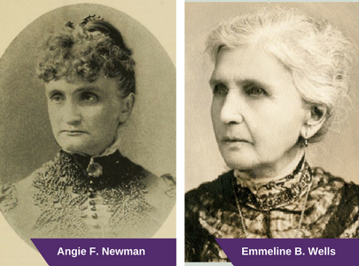

Slide 34
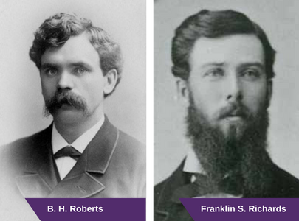

Slide 35
